Slide 1
Technology, Media, and Telecom

Slide 2



Brainteaser!
What are the answers to these MC questions?
Hint: Start with Question 3

Slide 3
Brainteaser!
Examine Question 3. Suppose no questions have an answer of A. Then the answer to question 3 would be A, a contradiction since we supposed none of the answers were A. Thus, there must be at least one A, and Question 3 is not A so either Question 1 or Question 2 is A. Since Question 1 always has the same answer as Question 2, if one of the two is A then both must be A. So both Question 1 and Question 2 are A, which means there are 2 answers that are A. Thus, the answer to Question 3 is C, so the final set of answers is AAC. Going back to check our work, we can verify that AAC makes all three questions true.

Slide 4
Technology

Slide 5
Tech Industry Landscape
Communications Equipment
Computer Systems
Internet/Digital Media
Semiconductors
Information Technology Services and Payments Processing
Software

Slide 6
Tech Industry: Thinking Exercise
Company | Profit (mm) | Market Cap (mm)
Dropbox
Spotify
Salesforce
Snap

Slide 7
Tech Industry: Thinking Exercise
Company | Profit (mm) | Market Cap (mm)
Dropbox | (494.0) | 8,871
Spotify | (87.5) | 25,305
Salesforce | 1,110 | 124,269
Snap | (1,255.9) | 15,007

Slide 8
Tech Industry
Common Valuation Mistakes
76% of the companies that listed in 2017 were unprofitable in the year before their initial public offerings
While profitability should be the goal of any company, using profitability to value a tech company is a common mistake
For unprofitable companies, it is difficult to value the company using multiples at the current state
Eg. If EBITDA is negative, you cannot use an EBITDA multiple, need to find other multiples such as revenue multiple

Slide 9
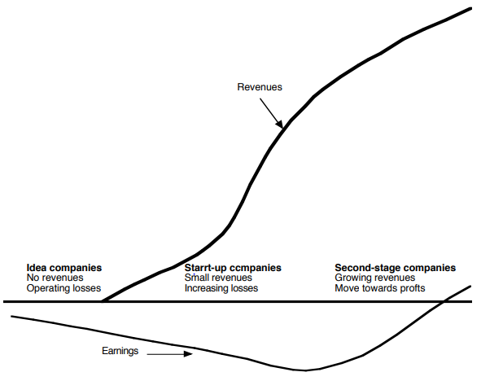
Tech Industry: Growth Cycle

Slide 10
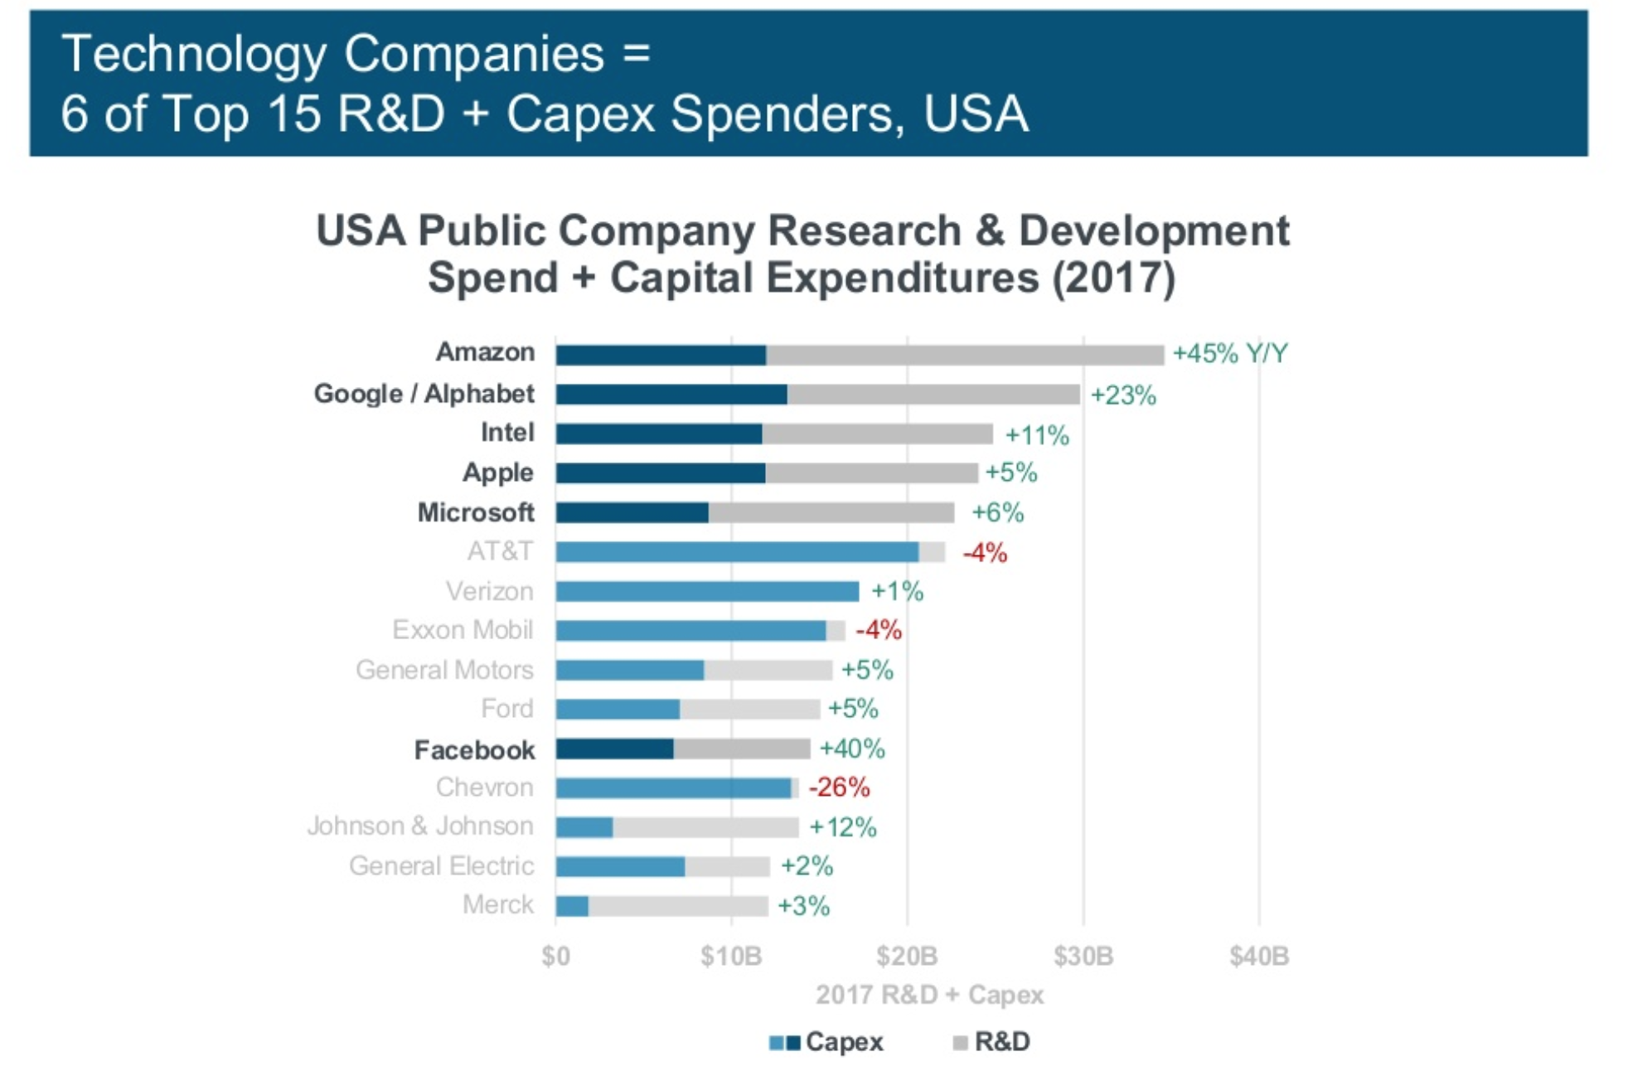
High R&D and Capex

Slide 11
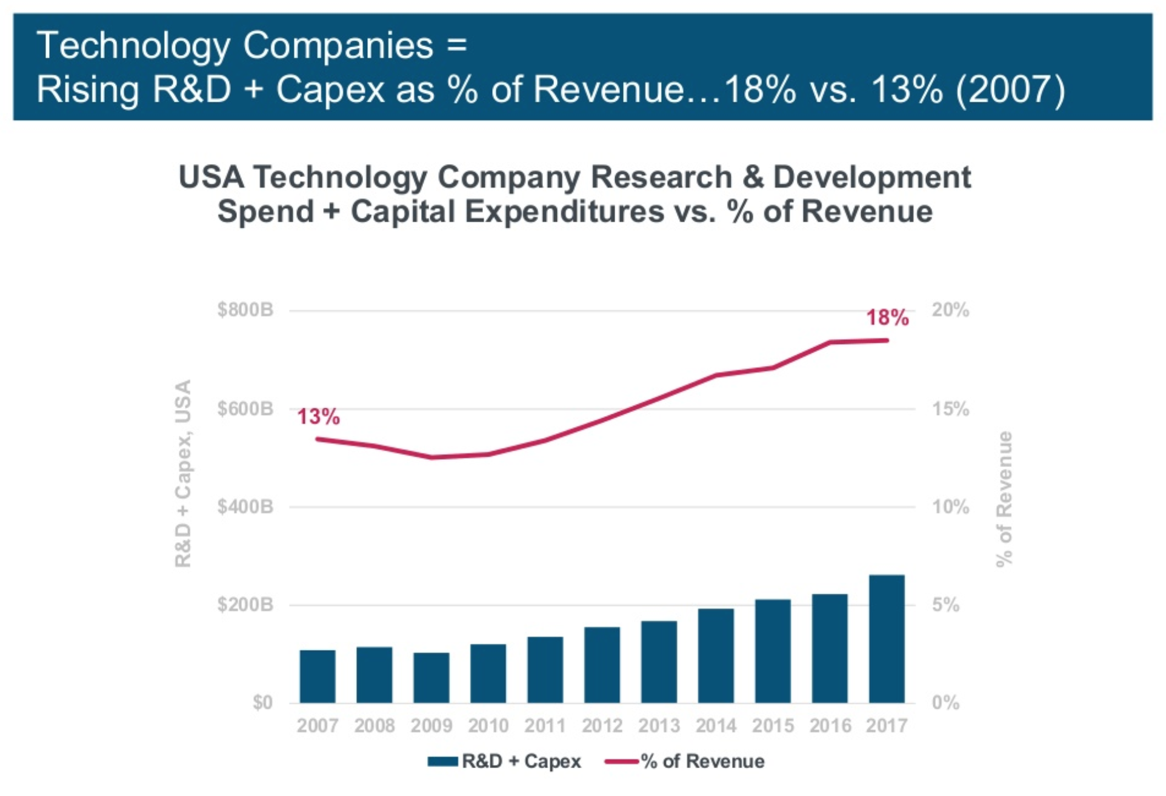
High R&D and Capex

Slide 12
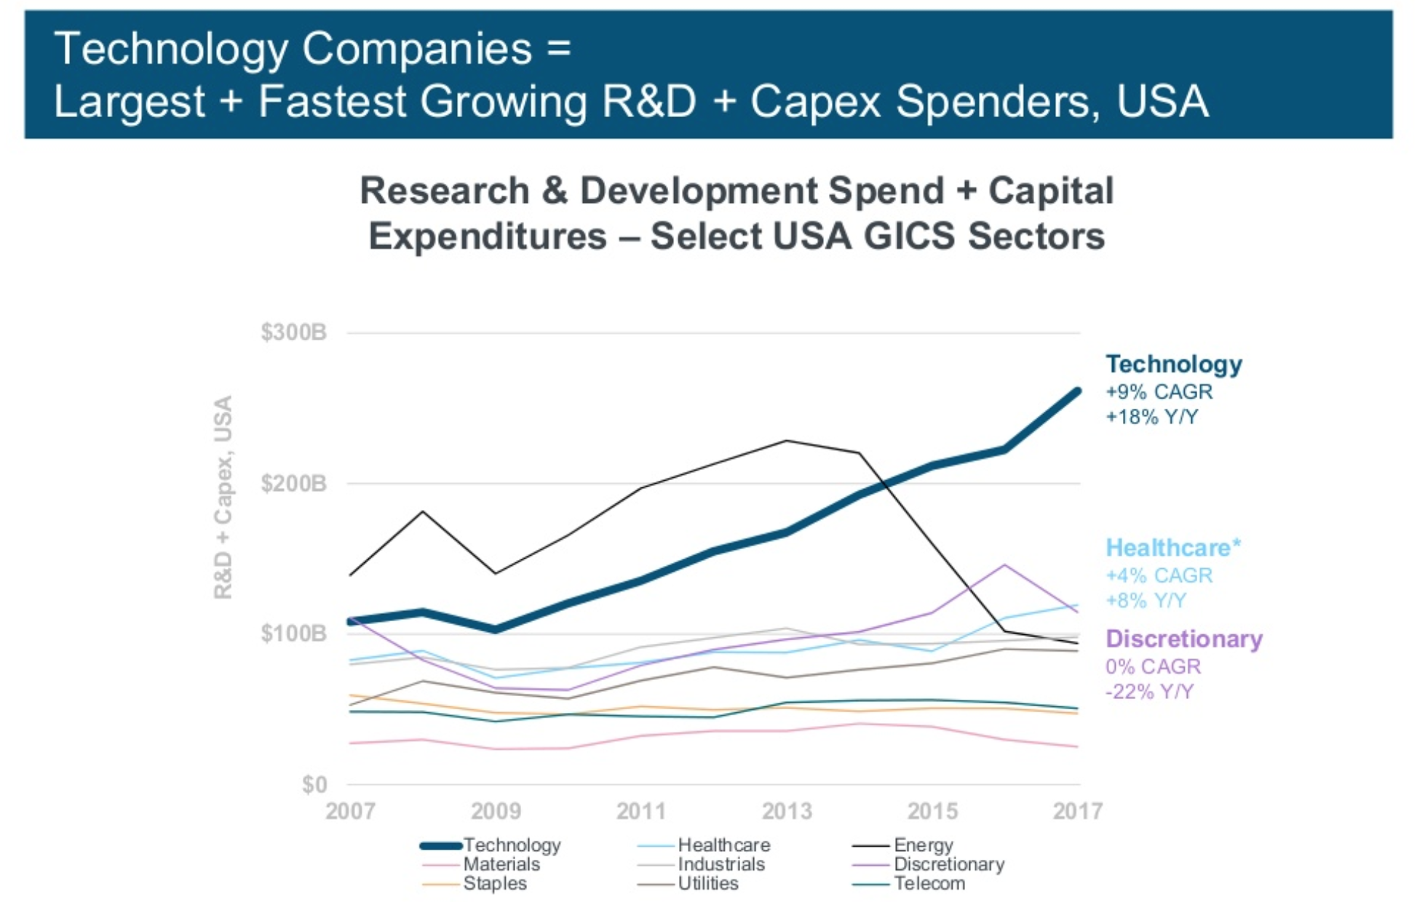
Sector Spending Breakdown

Slide 13
Tech Industry: Intrinsic Valuation
Method
Can still utilize traditional valuation methods of top-down and bottom-up analyses
For top-down analysis, need to make assumptions about the product niche, market size, market growth rate, and evolution of company’s market share
For bottom-up analysis, need to figure out pricing and quantity, and operating costs
Caveats
Some firms do not have sufficient financial information
In the early growth stage, firms will invest significant amount of money to capture market share and customers
Past data provides little guidance on future projections

Slide 14
Tech Industry: Relative Valuation
Method
Can look into multiples of relatively stable companies in the same industry
Need to adjust for the level of risk, cash flow and growth characteristics
Caveats
Using relative valuation may cloud your judgement and lead to irrational exuberance
Valuation result largely depends on the current market sentiments

Slide 15
Dot.com Bubble
Bull market in the late 1990s and increased liquidity due to tax cut caused many investors to channel capital onto internet company stocks
Many investors overlooked the fundamental businesses and cash-generating abilities of internet companies
Instead, investors and entrepreneurs became preoccupied with new ideas that were not yet proven to have market potential – they bought into the hype of internet businesses
NASDAQ index rose from under 1,000 to more than 5,000 between the years 1995 and 2000
The bubble burst from 2001 – 2002, and the equity market fell by 77% from its peak

Slide 16
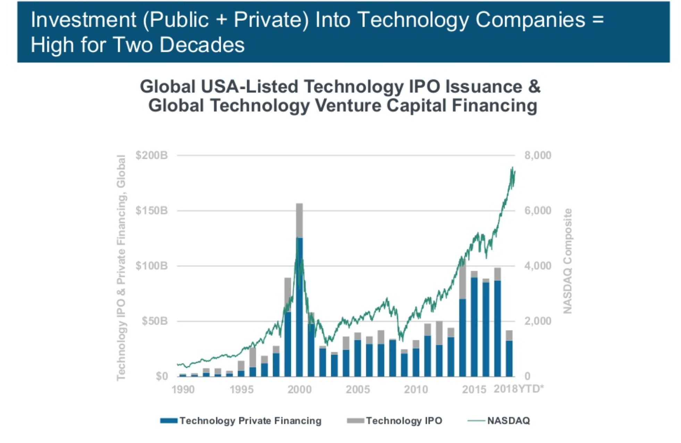
The Next Dot.com Bubble?

Slide 17
Significant Events
Tax Reforms in the US
Many technology companies are looking to “repatriate” their cash back to the United States, with a goal of enhancing shareholder value
This infusion of repatriated cash may spur a sizable increase in mergers and acquisitions across the technology sector in 2019
13 Tech companies made acquisitions totaling $278 billion by the middle of 2018—a 50 percent increase over the same period in 2017

Slide 18
Significant Events
Tax Reforms in the US
Many technology companies are looking to “repatriate” their cash back to the United States, with a goal of enhancing shareholder value
This infusion of repatriated cash may spur a sizable increase in mergers and acquisitions across the technology sector in 2019
13 Tech companies made acquisitions totaling $278 billion by the middle of 2018—a 50 percent increase over the same period in 2017

Slide 19
Significant Events
Net Neutrality and Save the Internet Act
Data Regulations
  EU: General Data Protection Regulation (GDPR) – requiring architectural and engineering changes and increasing compliance costs
  India: data localization law – requiring US cloud providers to ramp up data centers and storage in India
  US: CLOUD Act – giving law enforcement greater access to personal data

Slide 20
Media

Slide 21
Media Industry Landscape
Print
Films
Music
Radio
Animation & VFX
TV
Advertising
Gaming

Slide 22
Media Segments Breakdown

Slide 23
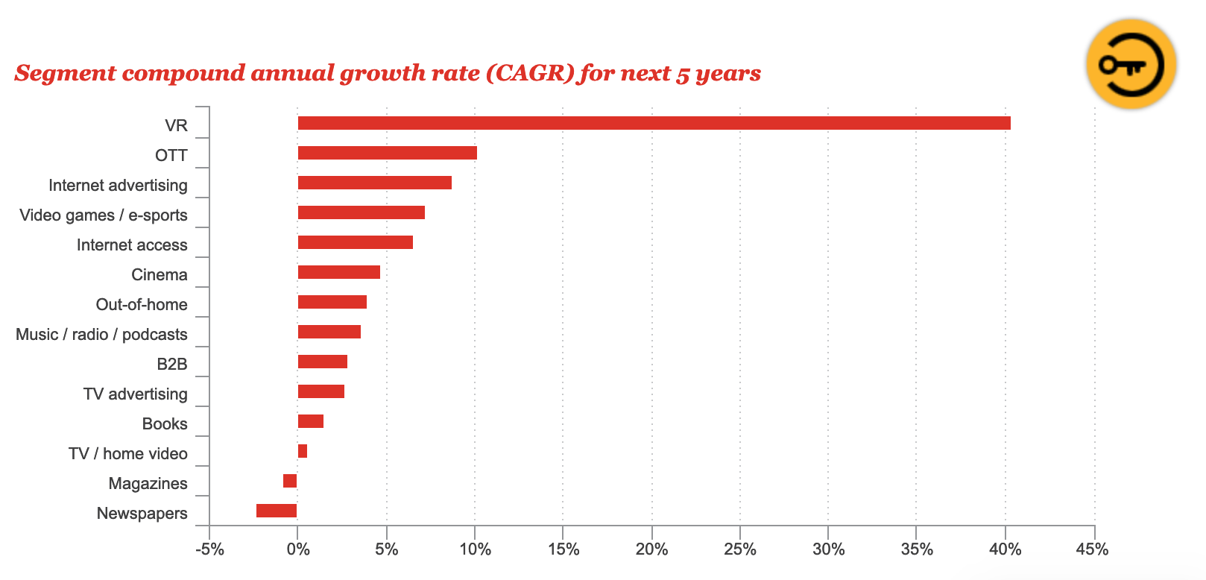
Media Segments Outlook

Slide 24
Media Segments: OTT
Over the Top (OTT) Segment
  Refers to content providers that distribute streaming media directly to viewers online, bypassing telecom and traditional TV broadcasting channels
  Think subscription-based video on demand wesites
  Eg. Amazon Video, Hulu, Netflix
  Streamed over public internet instead of set-up boxes

Slide 25
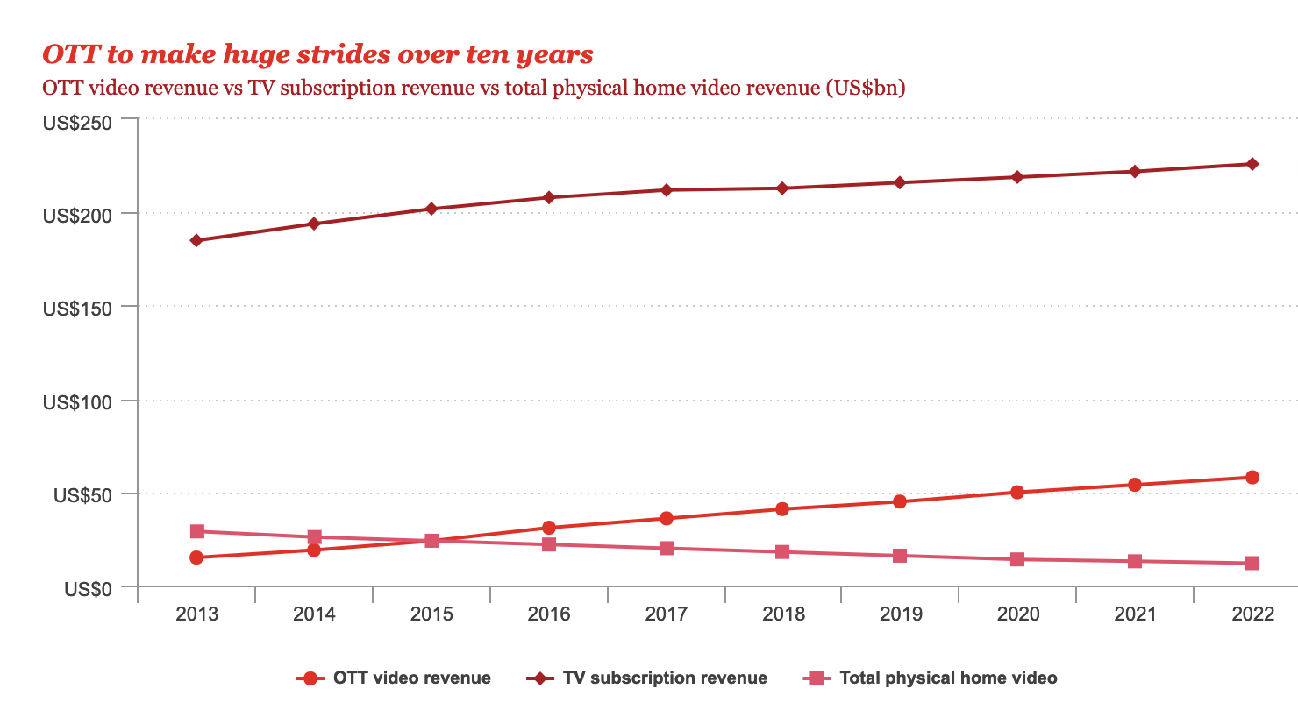
Media Segments: OTT

Slide 26
Media Segments: Advertising

Slide 27
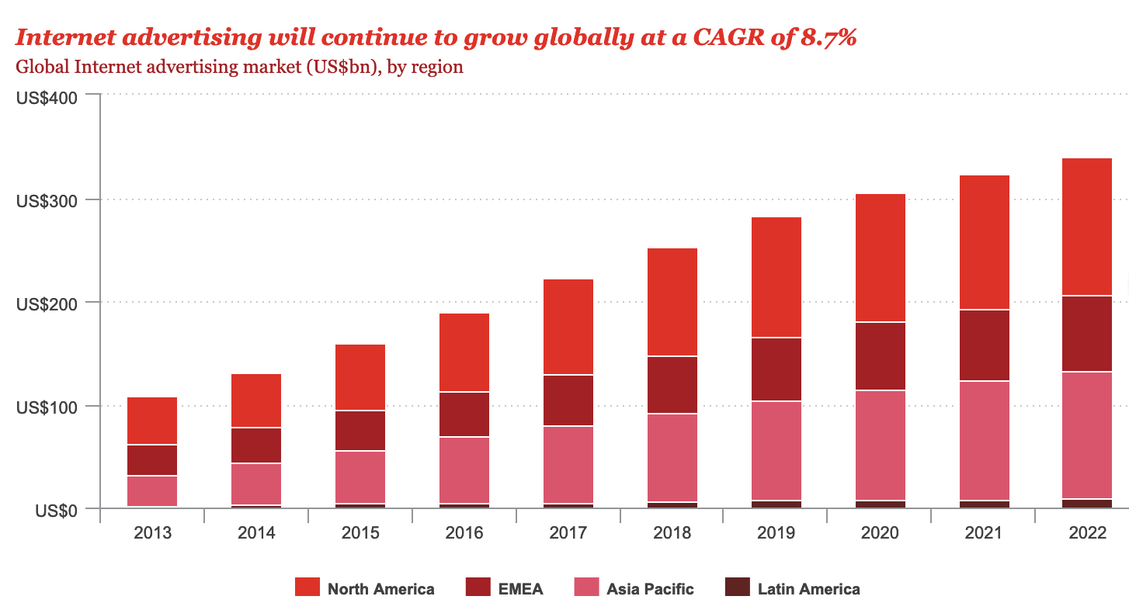
Media Segments: Advertising

Slide 28
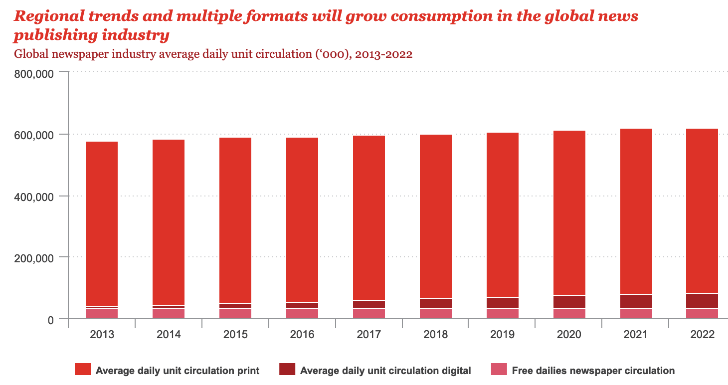
Media Segments: Print

Slide 29
Investing Opportunities
Identify fundamentally strong businesses in declining sectors (eg. print and radio) that are undervalued due to secular headwinds
Understanding the economic moats of these businesses, and accessing their audience base
Evaluating events and opportunities of consolidation and potential buyout and in the space
  Meredith Corp & Time Inc (M&A)
  Nine & Fairfax (M&A)
  USA Today (potential buyout)

Slide 30
Telecommunications

Slide 31

Telecom
Definition
Companies that provide fixed and mobile voice, text, and data transmission to consumers, small businesses, enterprises and government entities
Segments
Voice
Video
Text
Internet/Data

Slide 32
Characteristics
Features
Regional monopolies/duopolies
  Significant barriers to entry
Stable generation of FCF
  High leverage
Large fixed asset base
  High capital expenditures
Network effects – incremental benefit from gained by an existing user for each new user that joins the network
Returning capital to shareholders

Slide 33
Key Metrics
Subscribers
  Volume function of revenue equation
  Gross Additions vs. Net Additions
ARPU (Average Revenue Per User)
  Price function of revenue equation
Churn
  % of subscribers that stop using the service given a current timer period
  Measures of customer satisfaction and changes in pricing
Capital Intensity
  Capital expenditures over revenue

Slide 34
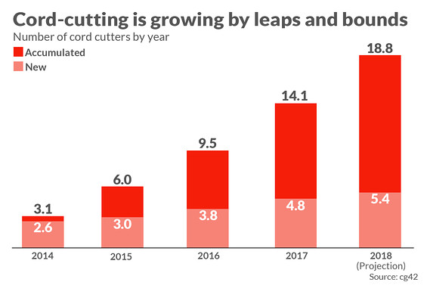
Industry Trends
Increased cord-cutting, hurting the video segment
  Consumers adopting Internet-based streaming services as replacements for cable
  Customers accessing TV content via the Internet
  Live sports has retained some customers

Slide 35
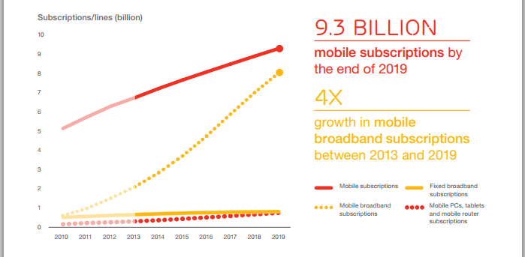
Industry Trends
Increased demand for data
  Consumers continue to display an insatiable appetite for mobile data
  37% of respondents in Deloitte’s 2018 survey have unlimited data plans (up from 25% from year before)
  Data needed to support streaming services that are replacing traditional cable

Slide 36
Industry Trends
Broadband data a better business
  Consumers continue to display an insatiable appetite for mobile data
  37% of respondents in Deloitte’s 2018 survey have unlimited data plans (up from 25% from year before)
  Data needed to support streaming services that are replacing traditional cable
  Monopoly in broadband data means strong pricing power but regulated by FCC
    Sell-side estimates that margins on Internet are ~4x higher than those on video

Slide 37
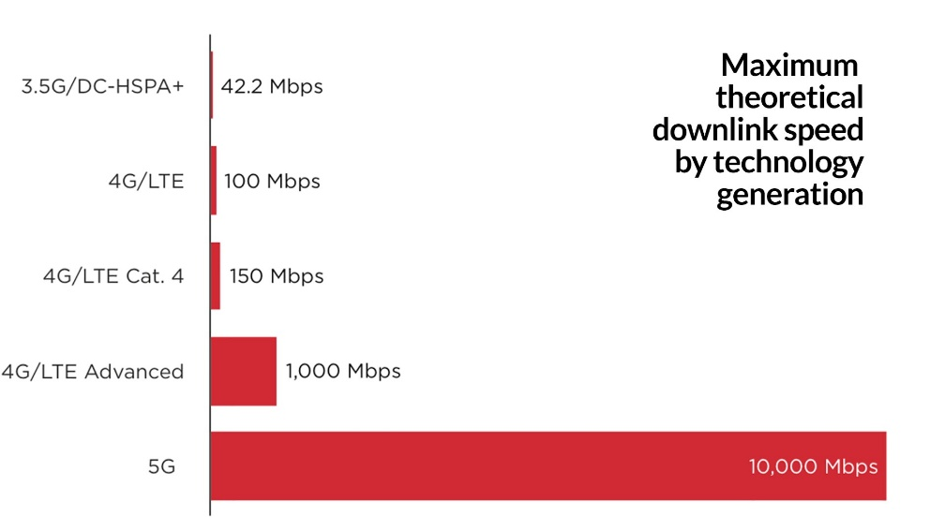
Industry Trends
Rise in 5G
  5th generation of wireless technology
  Expected to outperform the current 4G and 4G LTE standards by up to 100 times and reduce latency problems
  Will help support Internet of Things (industrial and residential), autonomous vehicles (need constant connection data), and other technologies

Slide 38
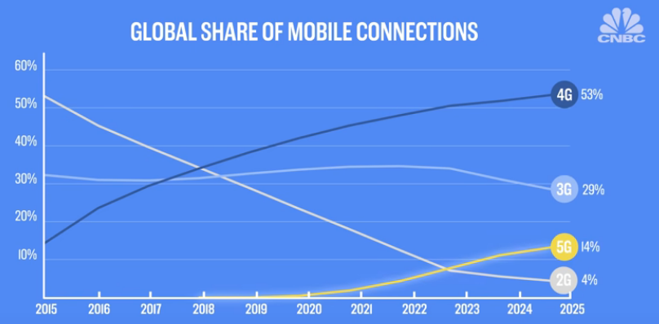
Industry Trends
Hurdles to 5G
  Cost → 5G requires brand new infrastructure such as antennas that only make fiscal sense in population dense areas
  Line of sight issues, such as from trees/walls (waves are smaller so more easily interfered with)

Slide 39


Industry Trends
Consolidation

Slide 40
Valuation

Slide 41
Valuation

Slide 42
Valuation
Intrinsic Valuation
Ideal for building intrinsic valuation model → Discounted cash flow model
  Can easily break down into subscribers and ARPU
  Stable cash flows
  High capital expenditures
  Mature businesses
  Highly levered
Relative Valuation
Common multiples
  EV/UFCF
  EV/EBITDA
  FCF Yield

Slide 43
Questions?

