Slide 1
Intro to Short Selling

Slide 2
Brain Teaser
Question: What digit is the most frequent between the numbers 1 and 1,000 (inclusive)? What digit is the least frequent between the numbers 1 and 1,000 (inclusive)?

Slide 3
Solution: Brain Teaser
Answer: The most common digit is 1 and the least
common digit is 0.
The digits 0 through 9 follow the same pattern. There
is exactly 1 occurrence digit for every 10 numbers.
For instance, the digit 2 appears once between 10 and
19 and once between 30 and 39. 2 also appears in 20,
21, etc… and 200, 201, 202, etc… The only
difference for 1 is that 1,000 includes a 1, so there is a
single extra occurrence (301 vs. 300).
The reason 0 has the least occurrences is because 0
doesn’t have any equivalents to 22, 33, 44, 222, 333,
etc…

Slide 4
Short Selling
Betting against an asset
Short assets that you believe are overvalued
Unlike traditional value investing, hedge funds tend to have much higher turnover with shorts and shorter time horizons
How do we short/What is a short?

Slide 5
What does it mean to “Short”
Borrow shares of a stock (or any asset)
Sell them at today’s value
Pay “borrow”, which is effectively the interest rate to the lender of the shares
Borrow is typically a couple % but can be much higher if you want to short a stock many other people are short
Eventually have to buy back shares and return them to the lender
In the example below, the borrower is short 1 share of stock X at $100
1 share of Stock X ($100)
Lender
Borrower
Borrow Fee

Slide 6
Risks of Shorting
Market goes up over time
9% CAGR over the last 50 years
Infinite Downside and Capped Upside
Short Squeeze
Short sellers need to buy stock to cover their position if margin called on a sharp increase, causing the price to increase more and forcing more to buy
Margin Call: Broker can force you to buy back stock or put-up capital if the stock prices rises dramatically
Recent Examples?

Slide 7
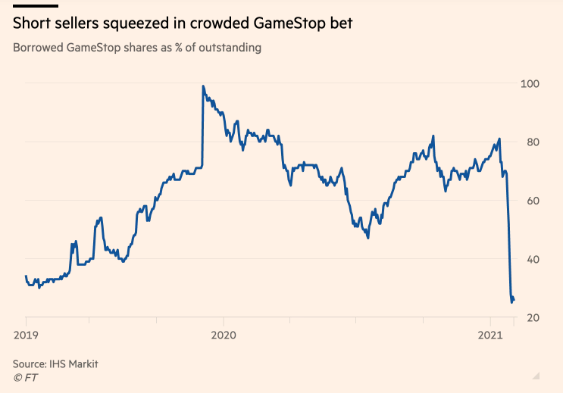
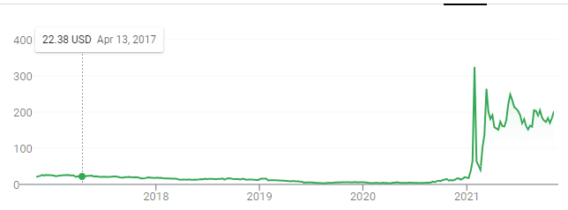
Melvin Capital - GME
Long/Short Hedge fund, hailing from P72
53% loss in January 2021 due to Gamestop saga
Number of extraneous factors, but shows the ultimate risk case when shorting
Factors at play
Short Squeeze (and more)
Infinite Downside

Slide 8
Why do we Short?
Increase leverage
When you short, you borrow a stock and sell, giving you capital you can invest for the time being with your “interest” being the borrow
Generating “free” alpha
Hedge
Beta
Factor/Pair Trades
Generating higher fees (generalization)
In both a comical and legitimate sense
P72/Multi-managers can charge 3 and 30, other hedge funds can’t
L/S can charge 2 and 20
L/O probably can only charge 1 and 20 if not worse

Slide 9
Fund Structures (Net vs Gross)
Gross: Total “Capital Invested
Net: Can be thought of as effective capital exposure to the market (as a %)
% of original capital invested on long side - % on short side
Can take it a step further and look at it on a beta basis instead of capital basis
By reducing exposure to market, but “levering up” you can magnify returns if you can generate alpha while reducing your exposure to beta
If the market returns 8%, 6% of true alpha is small even if impressive (0% net/0 beta exposure), this structure can counteract this
Hence why funds can charge higher fees

Slide 10
Pod Shops
P72, Citadel, etc
Run market neutral with excessive leverage (5-10x capital)
Have no exposure to the market theoretically but can generate strong returns if they are generating alpha
Run with multiple managers each with different factor exposures which is also balanced
Super tight risk controls: 5-10% drawdown in a PMs book means the whole team is getting fired as that level of drawdown is really magnified with leverage
Mitigated by lack of market exposure means you shouldn’t have as large of drawdowns
Access to a lot of research and institutional data; invest with a very short-term focus as a result

Slide 11
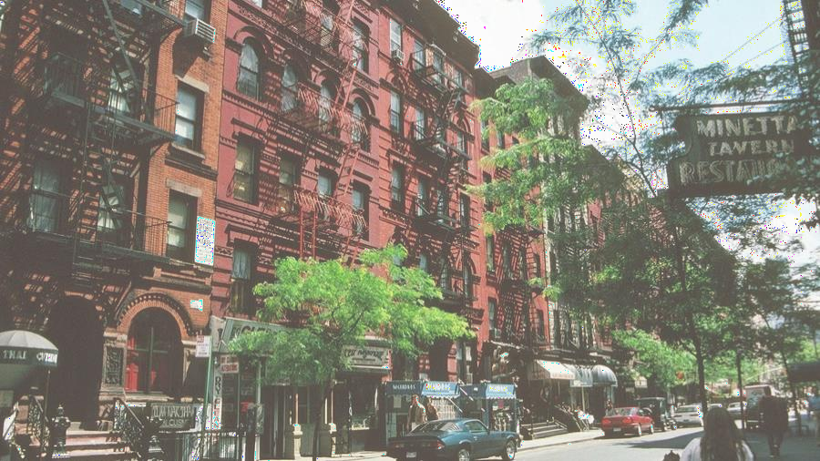
Common Pitch Types - Shorts
Structural Share Donor
Brick and Mortar retail
First-mover in high-growth industry without a moat
Frauds/Accounting Gimmicks
Companies with crazy high-expectations, popular fads
Plant-based meat
Overearning Cyclical
Industry in an upcycle (demand outstripping supply in the short-term), yet the market assumes this upcycle will last forever
Key Takeaway: Need a reason why you are confident the bulls/market and this has to have a much stronger catalyst than a typical long due to risks discussed (earnings miss is by far the most common in shorts)

Slide 12
Bad Shorts
High Short Interest
Can work within reason if you are experienced
Exposure yourself to “Gamestop” risk, however, if inexperienced
“Valuation Short”
Lack of catalyst
Who are the holders?
Have to pay borrow in the mean time, cannot hold forever
“The markets can remain irrational longer than you can stay solvent” – John Keynes
Shorts where the holders are not worried about earnings, etc
Tesla
Gamestop
Can be confident they will miss on consensus revenue/earnings, and the stock will still fly up

Slide 13
Case Studies

Slide 14
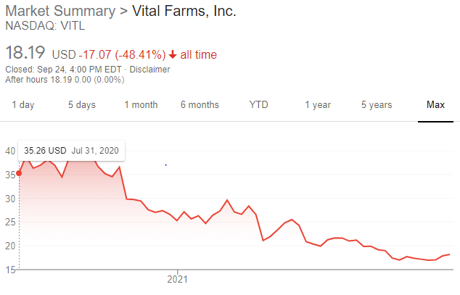
Crazy Expectations: Vital Farms (NASDAQ: VITL)
Business Overview: Branded pasture-raised egg company. Eggs are produced in a more animal friendly manner and are sold for $6 per dozen vs $1-2 per dozen for normal eggs
Situation Overview: Company IPO’d in July of 2020 and was doing extremely well on the back of COVID-induced stockpiling and ESG tailwinds leading to very bullish sell-side coverage
Thesis: Ultimately, on the back of their success in the last year due to stockpiling, the market assumed this company could maintain 70% market share over the next decade and the market could grow at a 20% CAGR for the foreseeable future. The market was valuing it as a growthy tech business, valuing it on sales despite 30% gross margins. Long-term, it was clear that the pasture-raised egg market could not CAGR at 20% for the next decade. Pre-COVID the market was seeing declining YoY velocities (sales per distribution points). Distribution points were going to be harder and harder to increase as Vital had already penetrated all of the nature store locations (Whole Foods, Sprouts). Meanwhile the remaining whitespace was at Target, Walmart where the customer base is significantly less affluent. Further, private-label competition was rapidly increasing in Whole Foods, Kroger etc. Valuing the company, it was clear that they would likely see a return to pre-COVID velocities. Giving the company credit for consensus estimates of ~15% CAGR in distribution points, but a -9% CAGR in velocities (largely driven by a return to pre-COVID, market share loss to private label and lower quality locations) as well as a more realistic multiple in-line with Cal-Maine Foods at 15x EBITDA led to significant downside

Slide 15
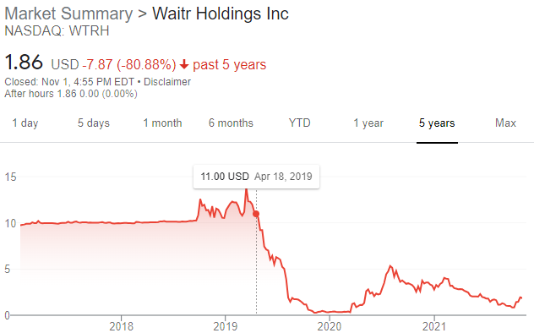
Structural Share Donor: Waitr Holdings (NASDAQ: WTRH)
Business Overview: Food delivery company primarily focusing on tier 2,3, and 4 markets that they believe the bigger players are not worried about
Situation Overview: Waitr had just deSPAC’d and was trading up due to delivery exposure and strong historical growth at the time of the deSPAC. Company grew from basically no revenue in 2015 to $70m in 2018.
Thesis: DoorDash, GrubHub, Postmates, and Uber were all entering Waitr’s core markets. Waitr’s core market was Louisiana and looking at a data source like Google Trends (or downloads etc), it was clear that it was losing search interest to the newcomers. The market’s focus on historical’s and lack of business analysis here meant they completely missed this. The larger players were able to enter and discount aggressively and rapidly rip up market share and since Waitr is much smaller they struggled to compete (amortize expenses over a much larger base of customers). Additionally, Waitr could not really enter other markets where the large players existed meaning future growth opportunities were minimal (Yet market was underwriting 60% top-line growth). Waitr also used an employee based driver model vs the contracting model of competitors making it harder to match supply and demand (have a set base of drivers at all times), and also made an acquisition unrealistic (no large player wanted to take on an employee based company when all of their drivers are contracted). Today the company primarily trades at option/acquisition value after losing massive share. This was a classic case of the market assuming past growth was sustainable despite the company operating in a winner take most industry with significant disadvantages.
Per Second Measure

Slide 16
Get in Touch
Feel free to reach out to us over Facebook or email if you have any questions
www.quantfsnyu.com
quantfsnyu@gmail.com
President – Ram Ramanathan (rer407@stern.nyu.edu)
Vice-President – Alex Poon (alex.poon@stern.nyu.edu)
Co – Head of All Portfolios – Connor Sheehy (connor.sheehy@stern.nyu.edu)
Co – Head of All Portfolios – Kevin Duan (skd359@stern.nyu.edu)

