Slide 1
Intro to Derivatives: Swaps

Slide 2
Brainteaser!
How many perfect squares are there in the list {1^1, 2^2, 3^3, 4^4... 100^100}?

Slide 3
Answer
Answer: If n is even, then n^n is a perfect square since any number to an even power is a perfect square. This gives us fifty perfect squares so far. However, if n is odd, then n^n will be a perfect square only when n itself is a perfect square. So this gives us five additional perfect squares: 1^1, 9^9, 25^25, 49^49, and 81^81. So in total, there are 55 perfect squares in the list.

Slide 4
What Is a Derivative?
Derivative
An derivative is a financial instrument, whose value is from the value of another underlying asset
When the price of the underlying changes, the value of the derivative also changes
Types of Derivatives
Forwards/Futures
Options
Swaps
Warrants/Convertibles

Slide 5
Key Definitions
Swap Contract
An agreement to exchange one stream of cash flows for another over a set period of time
Features of Swaps
Agreement between 2 parties
Not exchange-traded instruments (no secondary market)
Each party exposed to the default risk of default by the other
Value of a swap is 0 when initiated but can change

Slide 6
Key Terms to Know
Fixed Interest Rate
An interest rate on a liability, such as a loan or mortgage, that remains the same either for the entire term of the loan or for part of the term
Floating Interest Rate
An interest rate that moves up and down with the rest of the market or along with an index (ex. LIBOR, Fed Funds Rate)
LIBOR
Benchmark rate that represents the interest rate banks offer funds to each other in international market

Slide 7
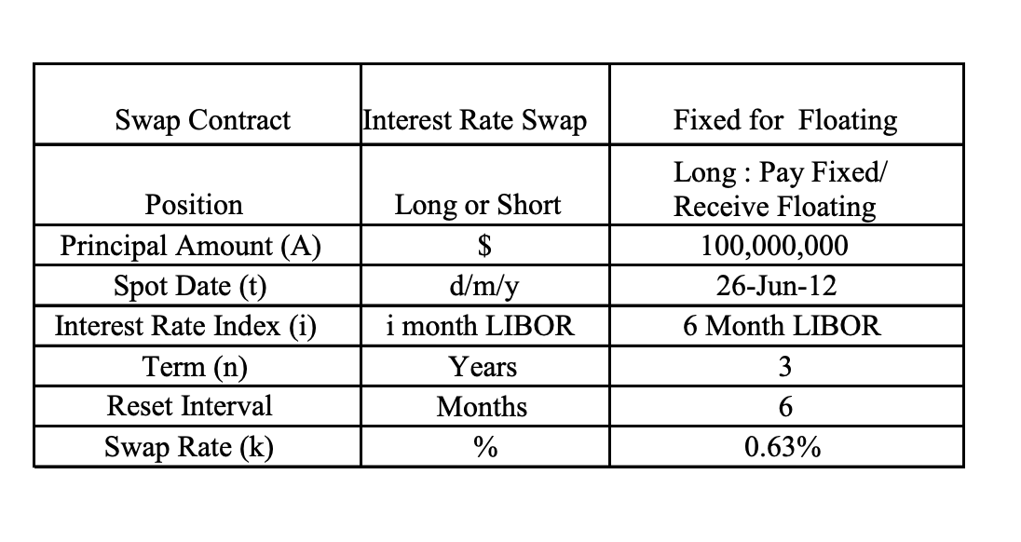
Swaps

Slide 8
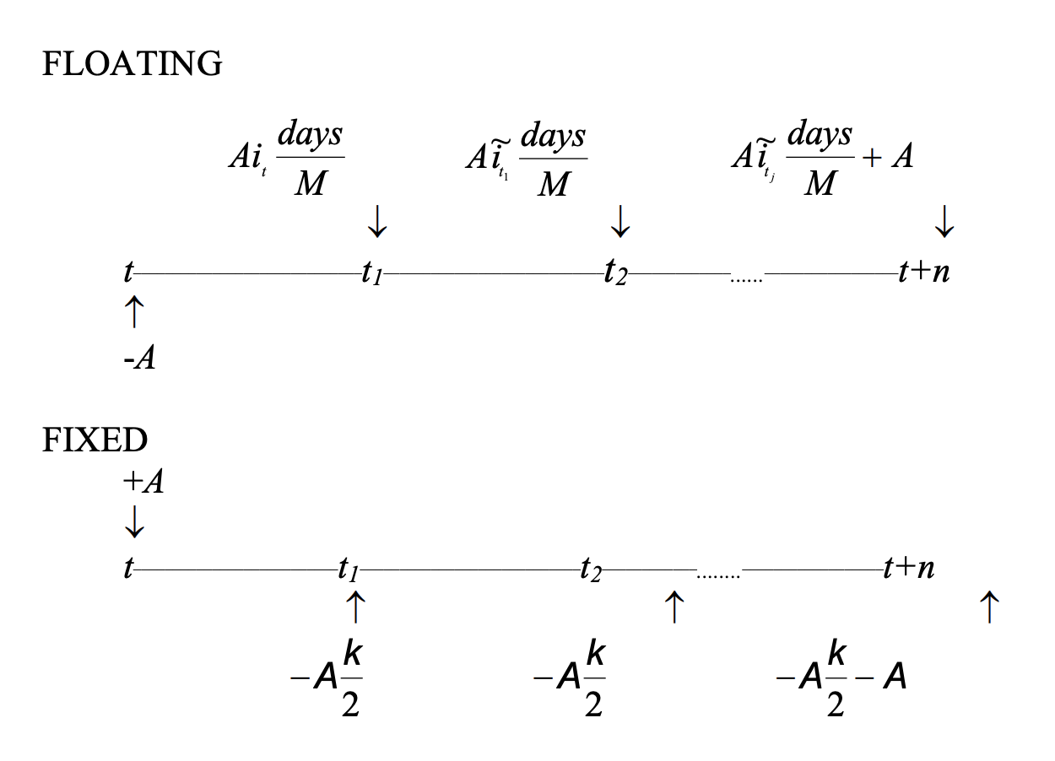
Swaps

Slide 9
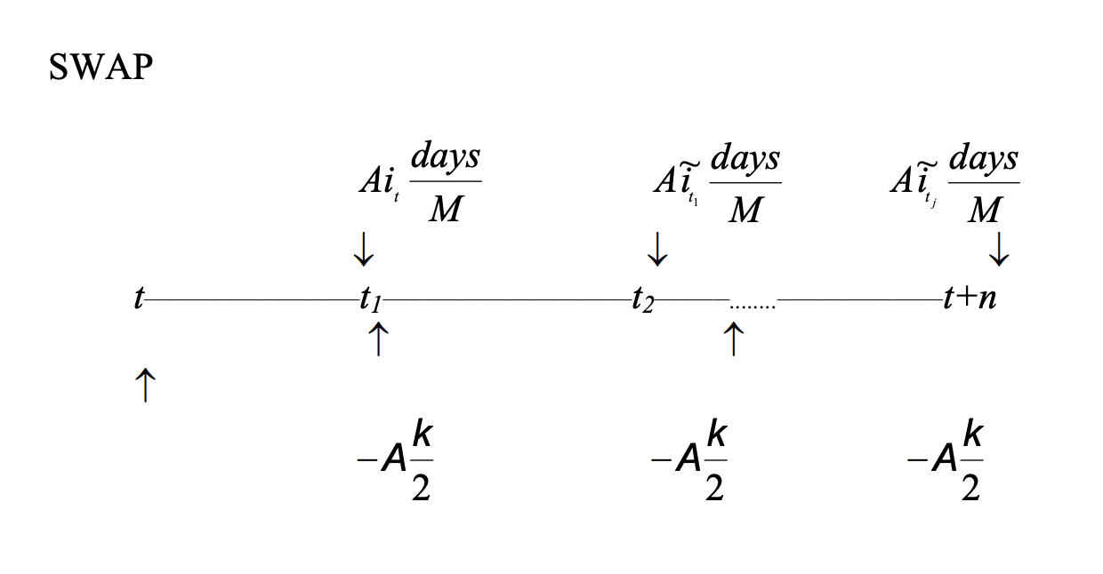
Swaps

Slide 10
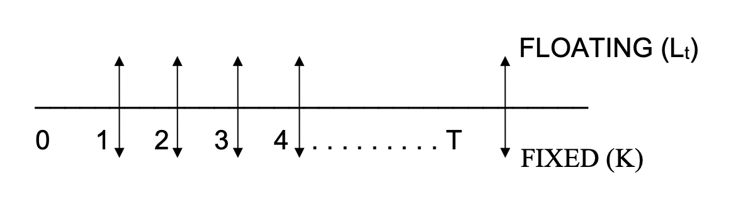
3 Types of Swaps
Plain Vanilla Fixed/Floating Swap
Exchange of a fixed interest rate rate cash flow for floating interest rate cash flows on the same notional principal
Floating Rate: Typically LIBOR
Fixed Rate: Called the price of the swap

Slide 11
3 Types of Swaps
Basis Swap
Both legs of the swap are floating
Ex. Exchanging the Treasury bill rate for the LIBOR rate
Why would a company want to enter into this type of agreement?

Slide 12
3 Types of Swaps
Basis Swap
Both legs of the swap are floating
Ex. Exchanging the Treasury bill rate for the LIBOR rate
Because a company could lend money to individuals at a variable rate that is tied to LIBOR, but borrow money based on the Treasury bill rate. Entering the basis swap eliminates the interest-rate risk for the company.

Slide 13
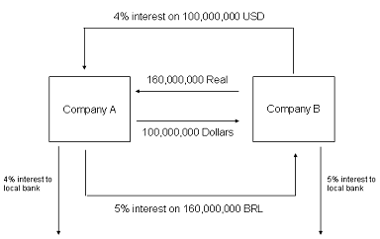
3 Types of Swaps
Currency Swap
Exchange of interest payments in one currency for interest payments in another
Usually involves exchange of principal
Interest rate on either leg may be fixed or floating

Slide 14
Benefits of Swaps
1. Comparative Advantage in Different Markets
Assume :
A issues fixed-rate debt and B issues floating-rate debt

Slide 15
Benefits of Swaps
A pays LIBOR and receives 3.5% fixed
B pays 3.5% fixed and receives LIBOR

Slide 16
Benefits of Swaps
A : 3% + LIBOR – 3.5% = LIBOR – 0.5%
B: LIBOR + 1% +3.5% - LIBOR = 4.5%

Slide 17
Benefits of Swaps
What does this example not take into account?
A : 3% + LIBOR – 3.5% = LIBOR – 0.5%
B: LIBOR + 1% +3.5% - LIBOR = 4.5%

Slide 18
Benefits of Swaps
The risk profiles of both companies!

Slide 19
Benefits of Swaps
2. Hedging
Interest Rate Risk
Foreign Exchange Risk
Notes:
EXPOSED TO RISK OF INTEREST RATES RISING; CAN HEDGE ITS RISK BY ENTERING A FIXED FOR FLOATING INTEREST RATE SWAP.
EXPOSED TO RISK OF € DEPRECIATING AGAINST US $. CAN HEDGE ITS RISK BY ENTERING A € /$ SWAP.

Slide 20
Valuing a Swap

Slide 21
Forward Rate Agreements (FRAs)
FRA
An agreement to exchange fixed rate payments at a rate k for LIBOR, on an underlying loan principal A, for the period of time T to T+m

Slide 22
Forward Rate Agreements
Long FRA
Pay fixed and receive floating
Short FRA
Pay floating and receive fixed
Who benefits when LIBOR increases?

Slide 23
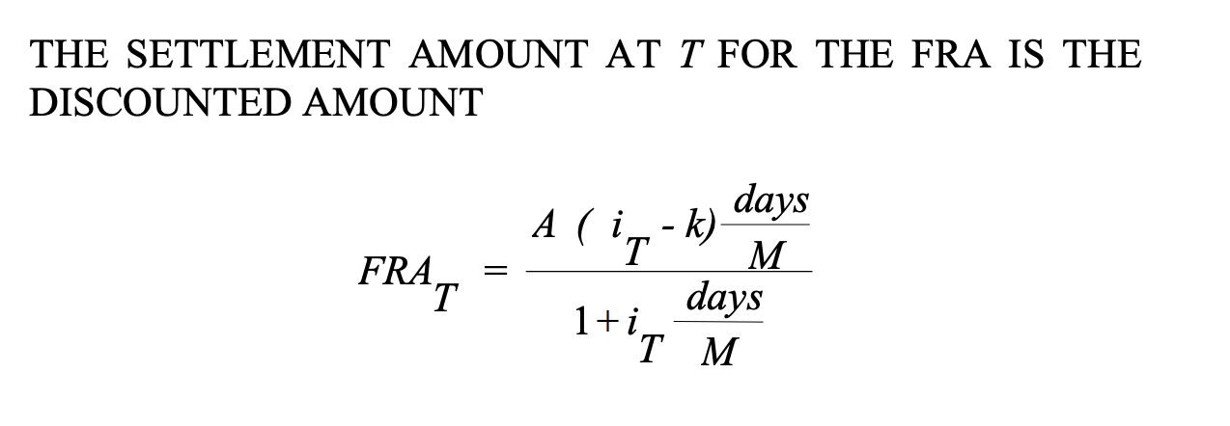
Settlement Amount/Valuation
When you value FRAs or consider the settlement amount, you have to consider the time value of money

Slide 24
Questions?

