Slide 1
Investing in Spin-Offs and M&A Roll-Ups

Slide 2
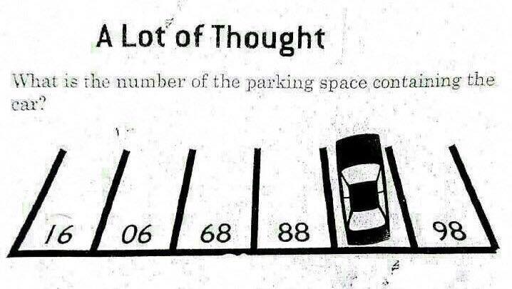
Brainteaser!
What is the number of the parking space containing the car?

Slide 3
Brainteaser!
What is the number of the parking space containing the car?
87

Slide 4
What Is a Spin-off?
Spin-off
A spin-off occurs when a subsidiary (SpinCo) of a larger company (ParentCo) separates from the ParentCo through the distribution of its shares to the ParentCo’s shareholders
This often occurs by issuing shares of the SpinCo to ParentCo shareholders at a predetermined ratio
Advantages of a spin-off
Tax efficient
Avoids hassle of the divestiture process
Allows current shareholders to maintain an interest in the SpinCo

Slide 5
What Makes Spin-Offs Interesting?
Forced Selling
Investors in ParentCo often have multiple reasons to sell a spun-off subsidiary, regardless of business quality:
The SpinCo might be too small, or in a different index than the ParentCo
The SpinCo might be exposed to a different set of industries than what ParentCo investors were interested in investing in
Pure Play Multiple Rerate & Better Market Understanding of the Business
Being part of a larger company often clouds the underlying quality of a subsidiary business
Companies are often rewarded for focusing on their niche over being a conglomerate
Current investors often completely misunderstand the nature of the business being spun-off, leading to discrepancies in value

Slide 6
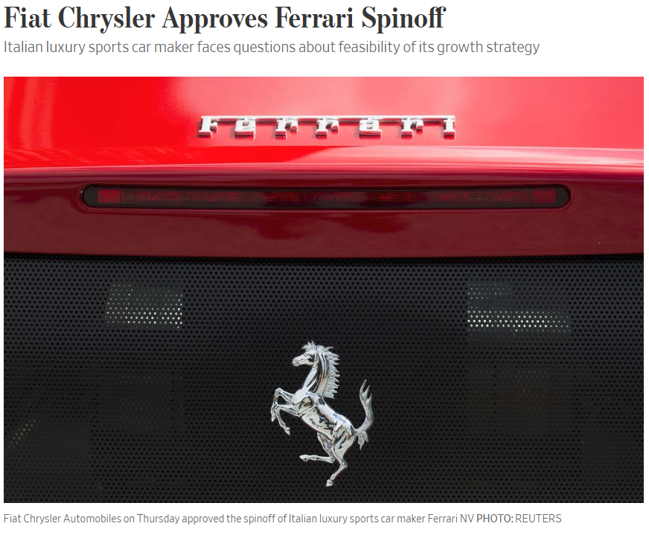
Example: The Ferrari Spin-off

Slide 7
Example: The Ferrari Spin-off
The Mechanics
In October 2015, Fiat Chrysler made 10% of Ferrari shares publicly traded through a partial IPO
In January 2016, shares were spun off at a ratio of 10:1 (for every 10 shares of FCA, you would receive one RACE share)
Ferrari lined up a €2.5 billion bond to fund a €2.7 billion dividend
Reasoning for the Spin-Off
Allowed Fiat Chrysler to raise cash through a post-spin dividend from Ferrari, to be used to pay down debt or fund new investments
Allowed investors to value Fiat Chrysler and Ferrari separately, benefitting shareholders

Slide 8
Example: The Ferrari Spin-off
Pre-Spin
Post-Spin
Shareholders
100% ownership @ 1000 shares
Shareholders
ParentCo
100% ownership @ 1000 shares
100% ownership @ 100 shares
100% ownership @ 100 shares
ParentCo
SpinCo
2.7bn Dividend
SpinCo

Slide 9
Example: The Ferrari Spin-off
What Made The Spin-Off Interesting?
Ferrari represented a classic spin-off opportunity
Fiat Chrysler’s market cap was vastly larger than Ferrari’s
Ferrari sold a vastly different, luxury product which deserved a higher multiple
Ferrari’s underlying business fundamentals were attractive, with artificially restricted volume of 10k units becoming unrestricted and numerous super-high end releases, as well as negative working capital and significant brand loyalty

Slide 10
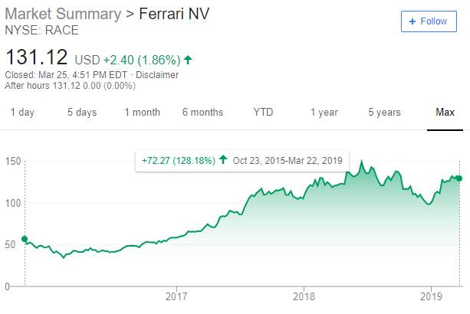
Example: The Ferrari Spin-off
Result

Slide 11
More On Spin-offs
ParentCo can Often be More Interesting than Spinco
Key is to look for the higher quality business that is being undervalued or dumped by investors
Spin-offs Have Become Relatively Priced In
Spin-offs used to regularly outperform the S&P 500
Nowadays, their common use and fund awareness of the opportunity makes them less attractive investments
Regardless, interesting spin-offs, such as KAR and ASIX remain in the market
You Can Be a Spin-Off Genius By Reading Greenblatt
Spin-offs became a well-known sit thanks to famous investor Joel Greenblatt, founder of Gotham Capital and Value Investors Club
You can read much more about spin-offs and other special sits in his book: You Can Be a Stock Market Genius

Slide 12
Next: Roll-Ups and M&A/Capital Allocation Opportunities!
What is a roll-up?
A roll-up is a company strategy that involves buying up and merging smaller competitors in order to gain scale
The idea is that scale should make up for the premium paid for the underlying businesses
Why are roll-ups interesting?
Roll-ups are incredibly hit-or-miss – you can either double/triple your money or lose it all in bankruptcy
Roll-ups employ a tremendous amount of leverage to fund their acquisitions
Roll-ups can be fantastic capital allocators, and, if in the right business, compound capital over time

Slide 13
Next: Roll-Ups and M&A/Capital Allocation Opportunities!
More roll-up characteristics
Roll-ups are often found in fragmented industries undergoing consolidation (see: internet backbone, newspapers, trucking)
Roll-ups have many of the same characteristics of private equity investors – high leverage meant to be cut down by a newly advantaged cost structure driving free cash flow going forward
Roll-ups are a delicious fruit snack served in American grocery stores since 1983

Slide 14
How To Think About Roll-Ups
Earnings Growth
Organic growth + reinvestment growth
Cash Yield
Represents capital returned to shareholders
(1-reinvestment rate) * FCF or alternate earnings yield
Multiple Expansion/Contraction
Consider that you buy a company year 0 for 10x EBITDA then sell for 5x on year 5
Your IRR will decrease by (10/5)^(1/5)-1 = (12.9%)
IRR = Earnings Growth + Cash Yield + Multiple Expansion/Contraction

Slide 15
How To Think About Roll-Ups
Earnings Growth
Organic growth + reinvestment growth
Cash Yield
Represents capital returned to shareholders
(1-reinvestment rate) * FCF or alternate earnings yield
Multiple Expansion/Contraction
Consider that you buy a company year 0 for 10x EBITDA then sell for 5x on year 5
Your IRR will decrease by (10/5)^(1/5)-1 = (12.9%)
IRR = Earnings Growth + Cash Yield + Multiple Expansion/Contraction

Slide 16
How To Think About Roll-Ups
Reinvestment growth = Incremental ROIC * Reinvestment Rate
In other words, how much will the company grow earnings by reinvesting its capital
If a company has incremental returns of 10% and reinvests 50% of its capital, it can expect to grow 5% per year
This reinvestment can come through CapEx or M&A
This is a roll-up’s entire strategy

Slide 17
How To Think About Roll-Ups
What does this tell us?
What is the objective of a good roll-up?
What happens when a roll-up successfully reinvests 100% of its earnings at 10-20% ROCs forever?
What does a roll-up need to continue its strategy?

Slide 18
How To Think About Roll-Ups
You Can Solve Backwards for Reinvestment Growth
Let’s say you are a PE fund and you are targeting a 25% IRR
You know a company will organically grow alongside GDP at 2% for at least the medium term future
You also know the company will maintain the same multiple
The company trades at 10x P/E
What does reinvestment growth need to be to achieve your IRR target?

Slide 19
How To Think About Roll-Ups
You Can Solve Backwards for Reinvestment Growth
It’s simple math
Cash yield = reciprocal of 10x P/E = 10% yield
Multiple expansion/contraction = 0% tailwind/headwind per year
Organic growth = 2%
IRR without reinvestment = 12%
Let’s say the company reinvests all its capital… you need ROICs of at least 18% to reach your target

Slide 20
A few examples of roll-ups
Sinclair Broadcast Group (SBGI)
Acquired numerous TV news stations to create a local news behemoth
Highly cash-generative
Uses scale to negotiate RSN agreements with networks
Entercom Communication Corp (ETM)
Purchased numerous radio stations over the years
Most recently purchased CBS Radio from CBS to create the largest radio provider in the United States
Following the bankruptcy of its peers, controls the market for radio advertising
Due to take advantage of >$100mm in synergies through cost reductions
Daseke Inc (DSKE)
Largest flatbed truck operator and owner in the United States
Consolidating the highly-fragmented flatbed truck industry, effectively taking out disadvantaged mom-and-pop shops
Taking advantage of new rules and regulations on trucker hours to outcompete local flatbed shops

Slide 21
More on M&A and Roll-Ups
There are more opportunities surrounding M&A
Also covered in the Greenblatt book, many opportunities arise from M&A
Weird transaction structures, purchase mixes, and merger securities often create forced sellers (preferred shares, converts, warrants, rights, LEAPS, and more)
Imagine you sell one of your subsidiaries and get $100mm in cash/stock and then $1mm in preferred shares
Investors will often dump the $1mm thrown in as ‘sweetener’
Example: pre-acquisition special purpose acquisition corporations (SPACs)
Merger arb works until it doesn’t…

Slide 22
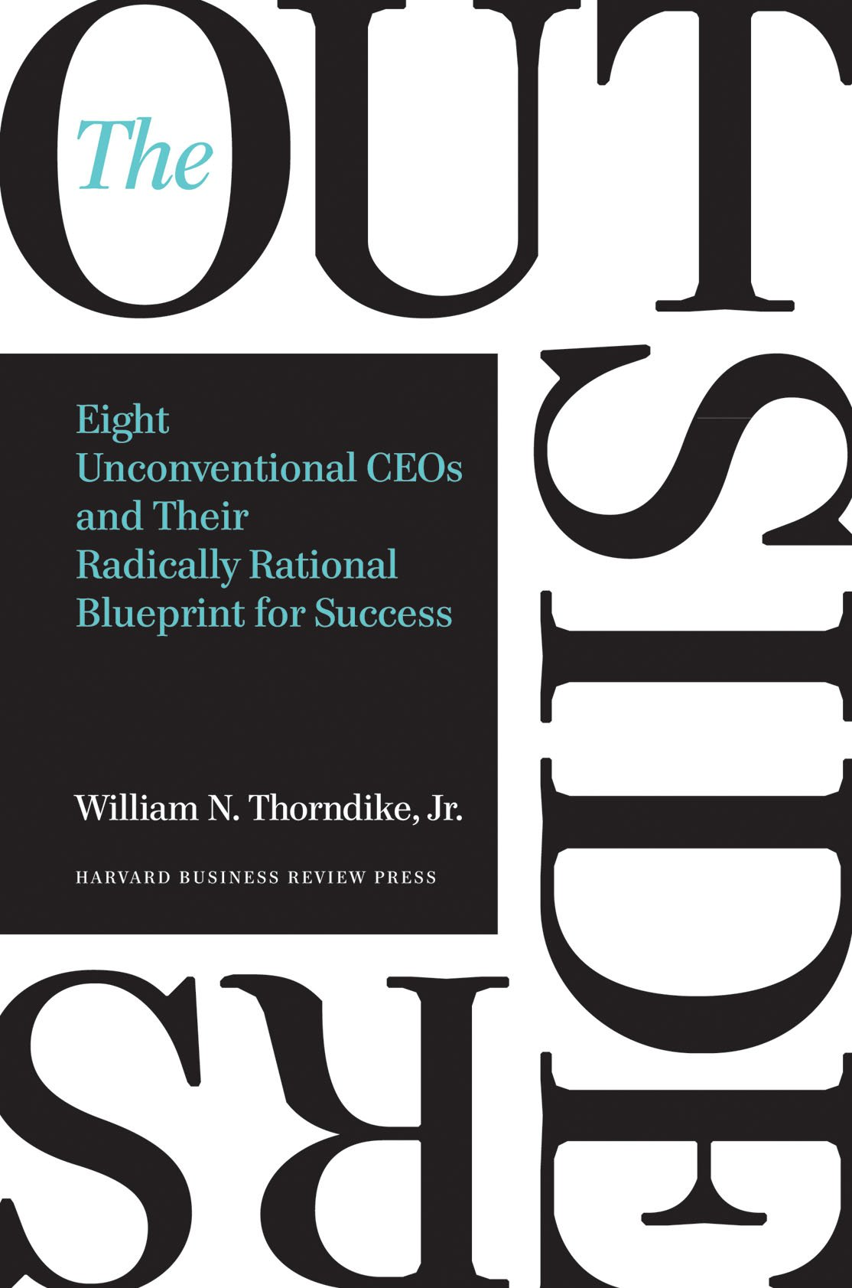
To Learn More About Roll-Ups and Capital Allocation: my favorite book

Slide 23
Questions?

