Slide 1
QFS Sector Overview: Transportation Industry

Slide 2
Brainteaser :
What is the largest five digit number whose digits multiply to 120?

Slide 3
Answer:
85311

Slide 4
Table of Contents
Relationship between Macro and transportation industry
Macro Factors that shape the transportation industry
Transportation Industry Overview and different segments
What drives value in the transportation industry
Updates on current industry trends
Trade idea: Top down analysis and how we picked our company

Slide 5
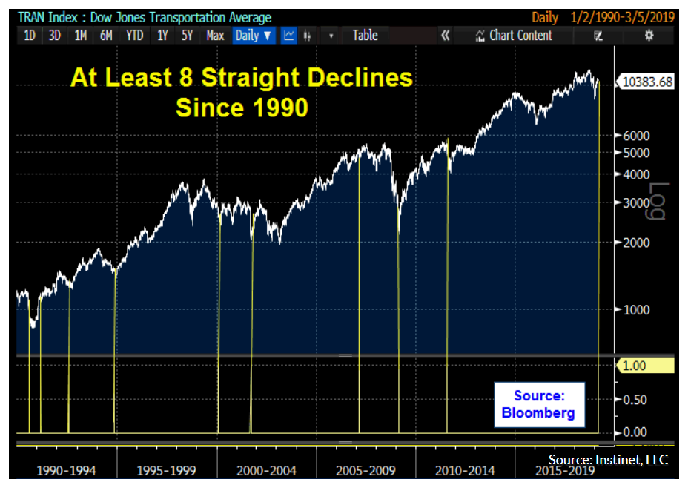
The Importance of Macro in the Transportation Industry
The Dow Jones Transportation Average includes the 20 largest transportation companies, and is a proxy for the overall health of the economy.
  Includes railroad operators, airlines, trucking, and car companies
  Recently, the index began to drop, causing some market concern that economic growth was weak
  WHY??

Slide 6
Why Transportation and the Economy are Linked
Inputs
Delivery to Manufacturing Companies
Production of Goods
Goods transported to final destination or continue through supply chain
Consider a general supply chain
    Inputs→ Delivered to Manufacturing companies→ Produced goods→ Transported to retailers and warehouses
If there’s greater consumption within an economy, there’s demand on production and based on the supply chain, a greater demand for transportation to deliver goods.
  The increase in demand for transportation services, increases the rates transportation companies can charge, improving their profitability.

Slide 7
Important Macro Factors to Consider
Infrastructure spending
Domestic demand
Oil Prices
Retail/Manufacturing Industry
Future growth of the economy (all of the above relate to this)
Wage inflation and wage growth
Trade policies and trade flows

Slide 8

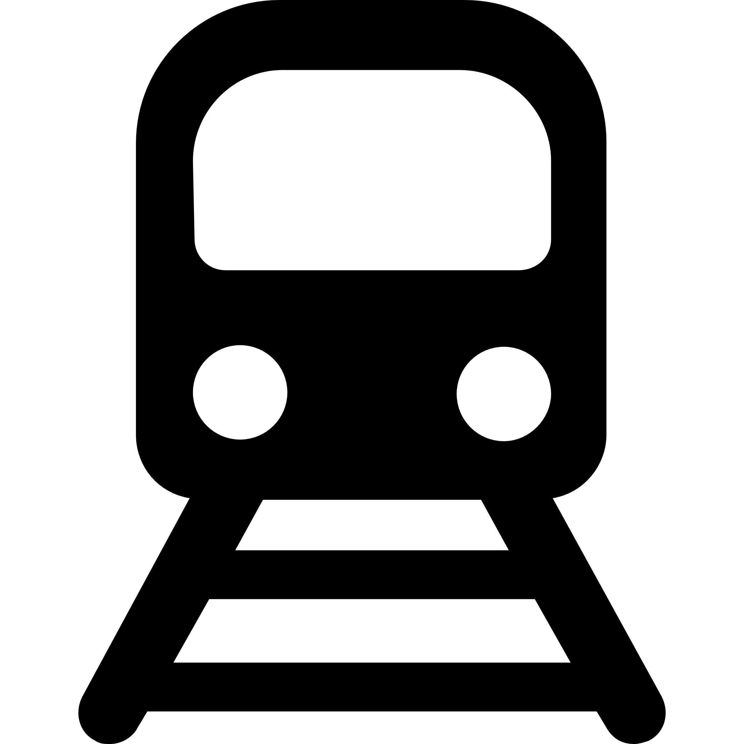


Breakdown of Transportation Industry
Airlines
  United Continental, Spirit, Southwest Delta, UPS, FedEx
Railway Companies
  CSX, BNSF, Norfolk Southern
Trucking/Logistics Companies
  ArcBest, Patriot Transportation Holding, Landstar, JB Hunt, Swift, XPO
Container shipping Companies
  A.P. Moller–Maersk Group, MSC, COSCO
Each sector is driven by economic growth, but have different drivers
of value.

Slide 9
Industry Breakdown: Airline companies (cargo planes)
Important Drivers :
  Trade policy and world growth
  Capital spending and interest rates (expensive to buy/lease planes)
    Aircraft production and delivery time
  Production of high value, low density goods (computer chips, precious metals)
    If products are heavy, ocean freight is much cheaper
Fun fact: This year, an early Lunar New Year impacted air freight
  Freight ton kilometers (one metric ton of revenue load carried 1 km) fell 2% globally and industry experts explain that an early Lunar New Year shut down manufacturing in China for 2 weeks, considerably slowing commerce in the Asia Pacific Area

Slide 10
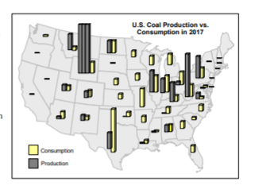
Industry Breakdown: Railway Companies
Drivers of Value :
  Important end markets : agriculture, coal, steel, chemicals
    Some important end markets that exclusively use rail lines
    Coal : Coal accounted for 32% of 2017 originated tonnage for US Class 1 Railroads, and 15% of total revenue
      Coal is typically produced in specific areas, but delivered to all parts of the country, and rail is typically the best long distance transportation method.
  In general, railway companies move products in markets with production concentrated in a few locations but delivery to all parts of the US
Other Unique Drivers :
Capital investment (railway companies can only grow by increasing their track)
Input prices: Rail cars are much more fuel efficient than trucks

Slide 11
Overview: Railway Companies continued
Think about how typical companies grow-→ they sell products, acquire companies, and increase market share
  Rail companies can only grow if they increase their tracks, meaning growth comes at a high cost and must guarantee an extremely high return.
During periods of low demand, rail companies still don’t find it profitable to remove track. Mileage has stayed pretty consistent for the entire industry. This could negatively impact operating efficiencies if there’s underutilized track.

Slide 12
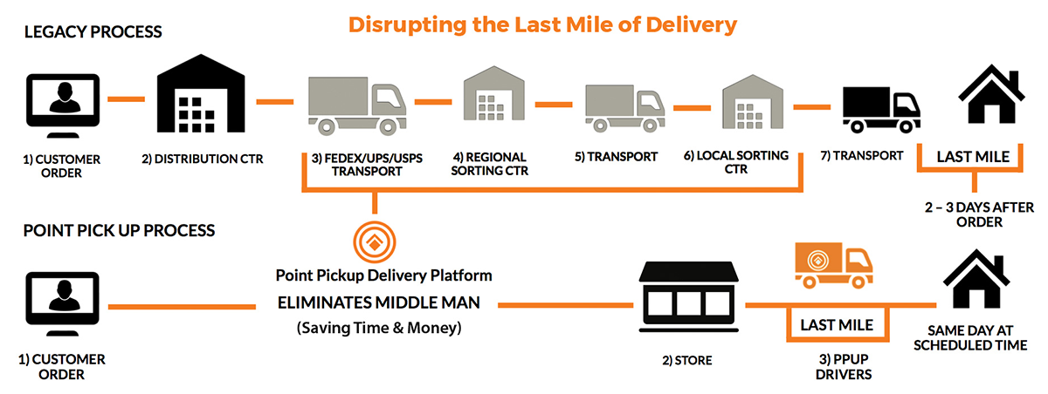
Industry Breakdown: Trucking/Logistics
Infrastructure spending- Government controls road infrastructure which directly impacts trucking (compared to rails that build their own track)
Trucking companies typically handle the “last mile” of deliveries
Drivers of Value :
  Retail sales/manufacturing
  Input prices- high diesel prices impact contract prices, impacting profitability of retail and manufacturing companies
  Driver wages
  E-Commerce Shipments
“Everywhere there is wage inflation — there’s shortage of labor in every single country that we’re operating in, in different degrees.”
- CEO of XPO Logistics

Slide 13
Industry Breakdown: Shipping (Marine Transportation)
Trade policy and government initiatives
  Belt and Road Initiative of China increased delivery of raw materials, cement, heavy machinery, and equipment
World growth
Commodity prices – more than 50% of marine shipments are dry bulk commodities (iron ore, coal, grain)
  Crude oil shipments- OPEC policy
    “Reduced shipments from exporters of the Organization of Petroleum Exporting Countries were offset by increased trade flows originating from the Atlantic basin and moving eastward towards Asia.”
        - From 2018 UN Review of Maritime Transport

Slide 14
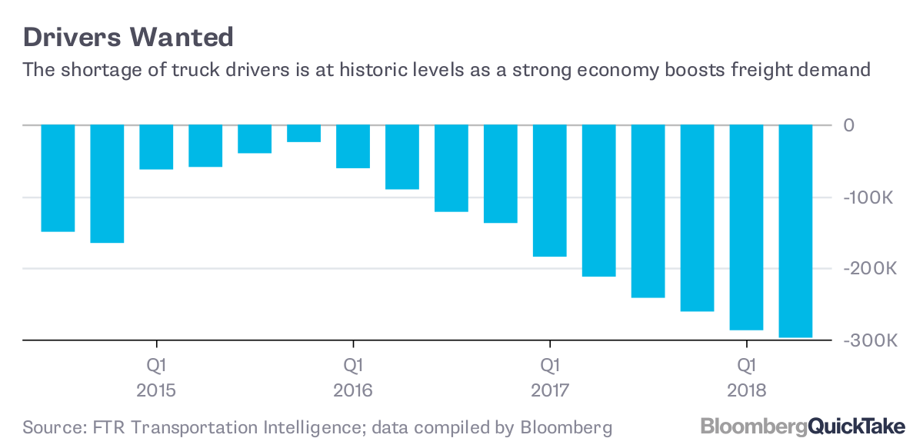
Focus on Trucking: Important Industry Drivers
Since 2005, the trucking industry has been plagued with a shortage of drivers
  Poor wages and limited benefits
  ELD (electronic logging device) and other government regulations limit hours driven and thus income of a truck driver
  Bad lifestyle
During periods of high demand, the driver shortage exacerbates
  2018 is a perfect example.
2018: After the announcement of tariffs, the trucking industry saw a massive surge in demand as manufacturing and retail companies tried to ship goods before getting hit with tariffs.
  Trucks have limited capacity to move goods + limited drivers→ causing significant wage inflation

Slide 15
2018 was the Perfect Storm for the Trucking Industry
High diesel prices
Increased capacity demand
Driver shortage
Strong global growth and demand for deliveries
Rise of E-commerce and frequent deliveries

Slide 16


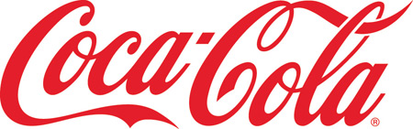
Retailers Feeling the Impact
"We did see a tick up in transportation expenses which were the primary drivers of the headwind this quarter.
  Head of IR WalMart (1Q18)
“Freight costs were up 20% YoY”
  CFO of Coca Cola (1Q18)
Everybody is seeing an increase… U.S. freight costs will rise by the “high-single digits to high-teens due to higher demand and requests by retailers for more frequent deliveries,”
  CFO Unilever (1Q18)
Other companies with similar commentary: P&G, Nestle, Hasbro

Slide 17
Shift Between Industries : Trucking and Rail
Trucking and Rail can be used interchangeably through intermodal shipments
  Intermodal- transportation of containers or trailers using a mix of truck and rail freight
As a result of the 2018 trucking shortage: railway companies saw a boost in earnings and bookings.
  Union Pacific Railroad booked contracts in Southern California for the entire year by mid 2018 as retailers were desperate to lock in contracts for the holiday season

Slide 18
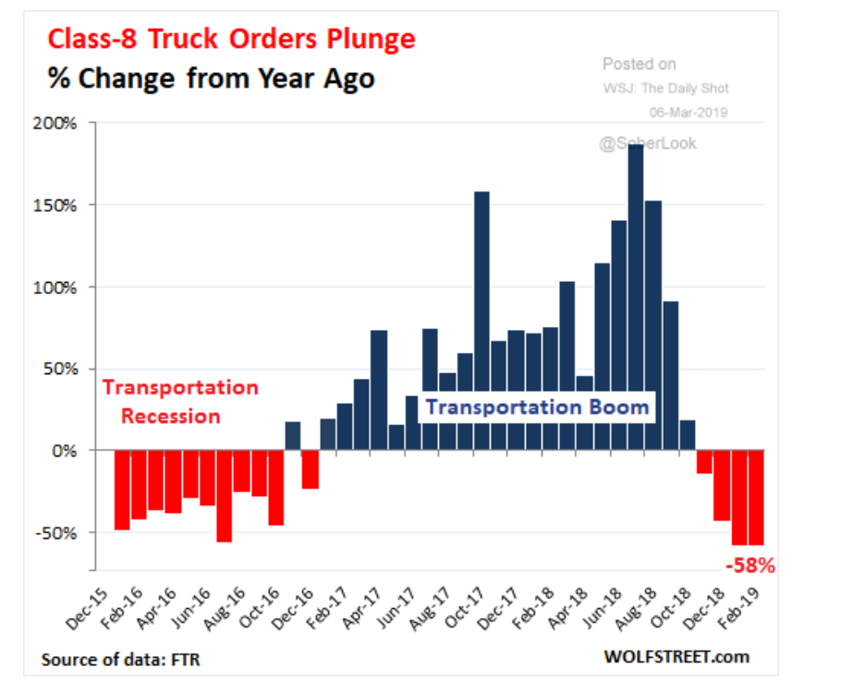
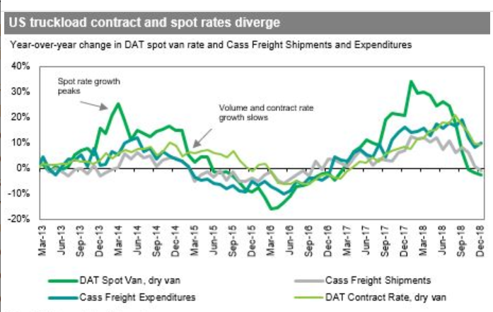
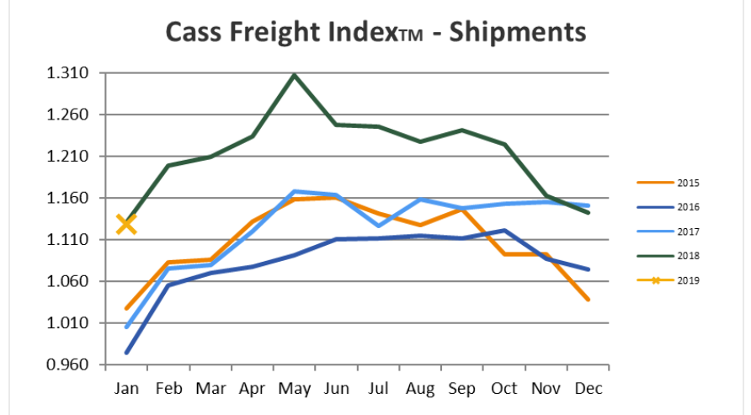
Relief in Trucking Market:
Class 8 truck registrations increased 40% by the end of 2018. During 2019, orders have been falling considerably
Spot and contract freight prices have fell from their peak (divergence in spot and contract prices tells a different story)
Shipments are starting out at much lower levels
These indicators demonstrate that there is relief in the trucking market
Other macro factors to consider for 2019 : slower global growth, trade tensions, weak commodity prices, lower gas and diesel prices→ should be a worse year for the transportation industry

Slide 19
Cycles in Trucking Industry: 2014 Repeat?
2014 trucking boom driven by :
  Worker shortage
  High diesel prices
  Regulation capping hours a trucker could drive
  Decline in trucking capacity and trucks post recession
    Shift to rail: Intermodal rail traffic grew at 5% and rail traffic grew faster than historically at 5% as well.
    Extreme price increases: pre-tax ROC for Class 1 railroads increased from 10% in 2004 to 19% in 2014.
By 2015:
  Trucking companies purchase more trucks and diesel prices fall
  Retail and manufacturers shift from domestic intermodal back to trucking
  Loss of rail pricing power because of shift in demand

Slide 20
How to trade this idea ?
Concerns of limited growth has been priced into trucking companies.
Has the impact of the shift back from rail back to trucking been priced in?

Slide 21
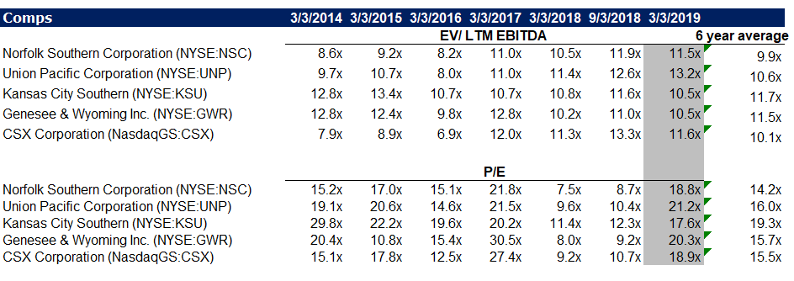
Step 1 : How are Railway Companies trading?
Some railway companies are trading at higher than average multiples. (Norfolk Southern and Union Pacific)

Slide 22
Step 2: Isolate What’s Important
We want to look for railway companies that benefitted the most from the trucking shortage. These would be companies that
  Saw a dramatic increase in the intermodal segment (the segment companies used to ship goods when trucks were lacking capacity)
  Companies with large intermodal segments
  Companies that still look expensive on a multiple basis

Slide 23
Step 3: Idea: Short Union Pacific :
Norfolk Southern has the largest intermodal segment (see below)
  Typically other railways have between 15-20% of revenue from intermodal
Union Pacific’s intermodal segment benefitted the most from the trucking shortage (see below)

Slide 24
Step 4: Valuation Union Pacific – Past Growth
The premium segment grew annually at a much faster pace than the other segments and the entire company because of “an increased demand for intermodal” because of shorter trucking capacity, higher fuel surcharge revenue and pricing power.
Moreover, assuming the amount put in a car (or in case of intermodal a container) stayed constant, we can use average revenue/car as a proxy for pricing. (not disclosed by segment)
  We see a dramatic increase again in the premium segment, probably due to higher pricing power

Slide 25
Step 5: Make Projections and Simple Valuation
Making some basic assumptions for growth, EBITDA Margin and the EV/EBITDA multiple, we can reach a conclusion.
Based on our research on the strengthening of the trucking industry and the shift back to trucking, the intermodal segment in 2019 should not see the growth it did in 2018. (these assumptions are reflected in the growth rate)

Slide 26
Next Steps
More fundamental valuation – look into all segments
Monitoring railway news and trucking capacity increases
Look at smaller railway companies- typically transport different things so impacted by different end markets
Look into railway supply chains
  Railcar leasers and suppliers look cheap- could be because limited railway demand and poorer railway outlook

