Slide 1
Intro to Derivatives: Options

Slide 2
Brainteaser!
There are 8 people sitting in a room at an investment bank. 4 of them are traders and 4 of them are bankers. They are split off into 4 teams of 2 for team-building exercises. What is the probability that each group of 2 has 1 trader and 1 banker?

Slide 3
Answer: Probability Approach
Select any person to be the first member of the group. 8/8 ways to do this. For their partner there are 4/7 valid people to select. Repeat for 2nd group, with 6/6 ways to select the first person and 3/5 ways to select the 2nd person. Same logic applies for 3rd group, for a total of 4/7 * 3/5 * 2/3 = 24/105 = 8/35. Note that we don’t have to worry about the 4th group because there will naturally be 1 banker and 1 trader left if the other groups are valid.

Slide 4
Answer: Combinations Approach
The total number of combinations is 8 choose 2 * 6 choose 2 * 4 choose 2 divided by 4! because the selection of groups does not require order. This comes out to 105 combinations. The number of valid groups can be thought of as 4*4 for group 1, 3*3 for group 2, 2*2 for group 3. Again divided by 4! because the order does not matter. This comes out to 24 valid combinations, for a total probability of 24/105 = 8/35

Slide 5
What Is a Derivative?
Derivative
A derivative is a financial instrument whose value is based on the value of another underlying asset
When the price of the underlying changes, the value of the derivative also changes
Types of Derivatives
Forwards/Futures
Options
Swaps
Warrants/Convertibles

Slide 6
Key Definitions
Call Option
An agreement that gives the buyer the right, but not the obligation, to buy an underlying asset at a specified price within a specific time period
Put Option
An agreement that gives the buyer the right, but not the obligation, to sell an underlying asset at a specified price within a specific time period

Slide 7
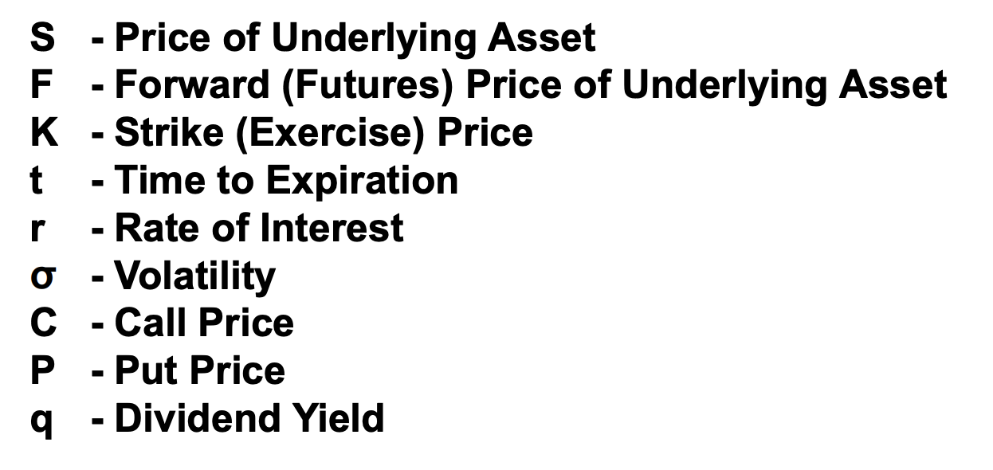
Other Key Terms To Know
What is the difference between the price of the underlying asset and the strike price?

Slide 8
2 Types of Options
American Options – buyer can exercise the option early, at any point up until expiration
European Options – buyer cannot exercise option early and has to wait until expiration

Slide 9
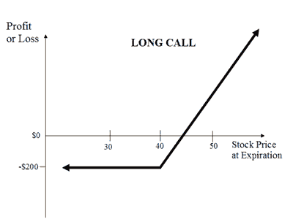
Payoff Diagram For Buying A Call

Slide 10
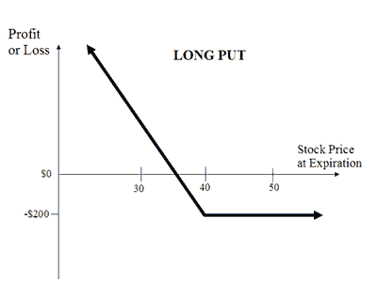
Payoff Diagram For Buying A Put

Slide 11
Concept of Moneyness
Options are heavily dependent on the concept of moneyness – relative position of the price of the underlying asset with respect to the strike price of the option
  In the Money
    If expiration were today, the option would have value
  At the Money
    Strike price = Spot price
  Out of the Money
    If expiration were today, the option would be worthless

Slide 12
Why People Trade Options
Leverage
Hedging – Protected downside risk
Speculation
Have a unique view that you can’t play with just the underlying asset
  Delta: betting on the price of the underlying
  Vega: betting on the volatility of the underlying
  Theta: collecting the time premium
  Etc.

Slide 13
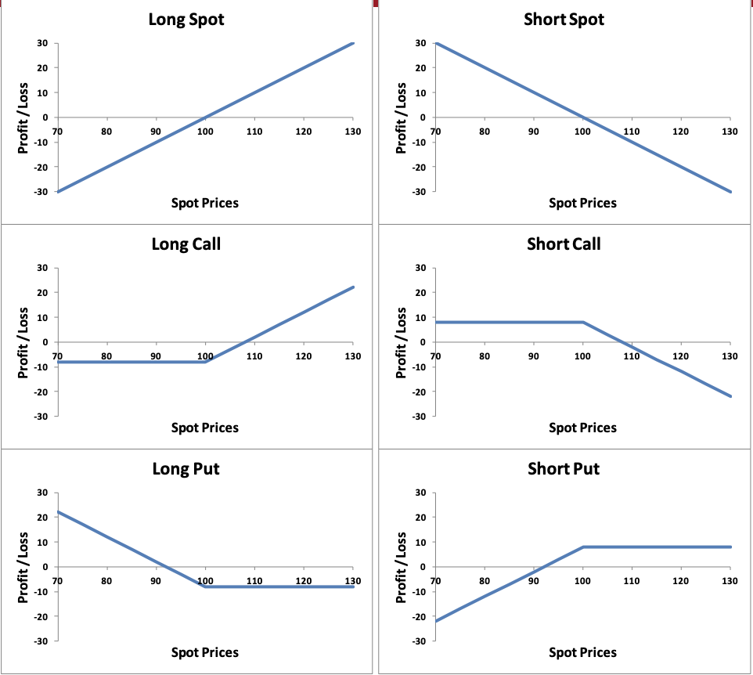
Summary Of Payoff Diagrams

Slide 14
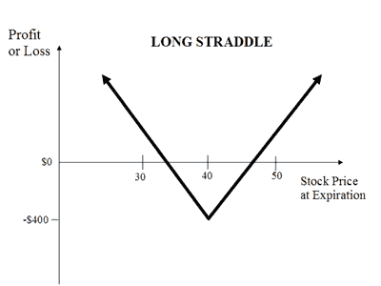
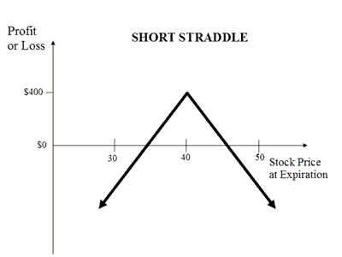
Different Strategies: Volatility Strategies

Slide 15
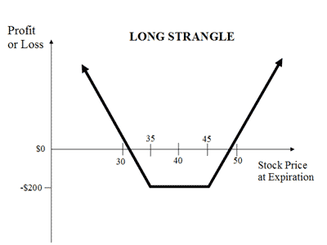
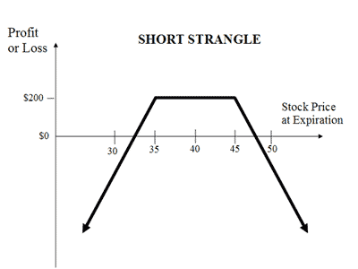
Different Strategies: Volatility Strategies

Slide 16
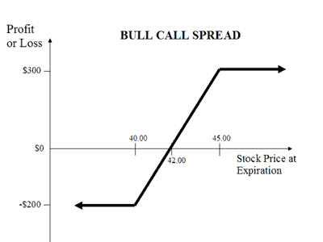
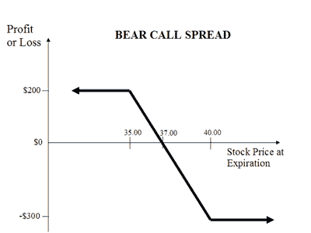
Different Strategies:

Slide 17
Pricing Exercise
How much do you think a call option should be priced if…
Strike price is 40
Price of underlying is 50
Expiration date is in a year

Slide 18
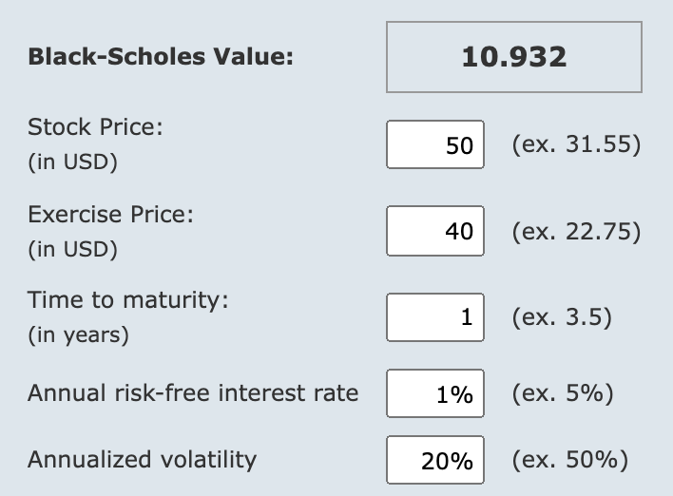
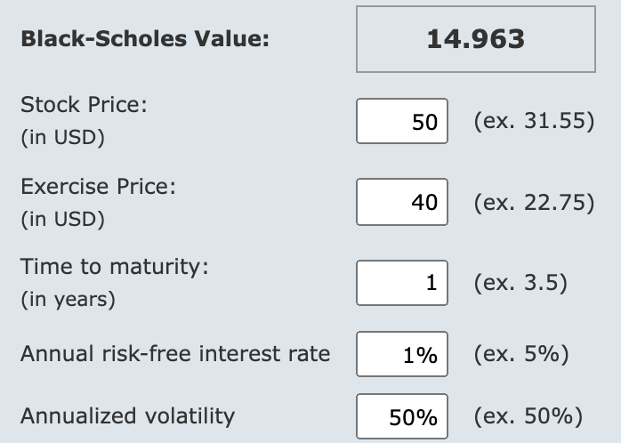
Pricing Exercise

Slide 19
Pricing Exercise
How much do you think a put option should be priced if…
Strike price is 40
Price of underlying is 40
Expiration date is in a year

Slide 20
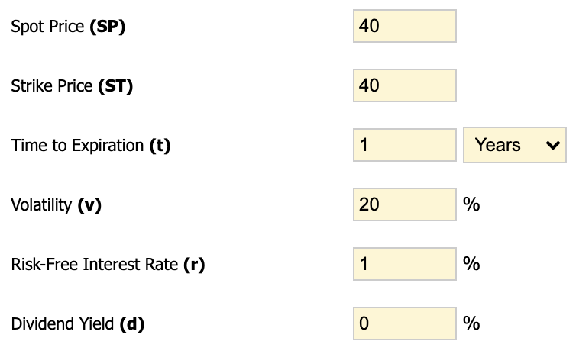
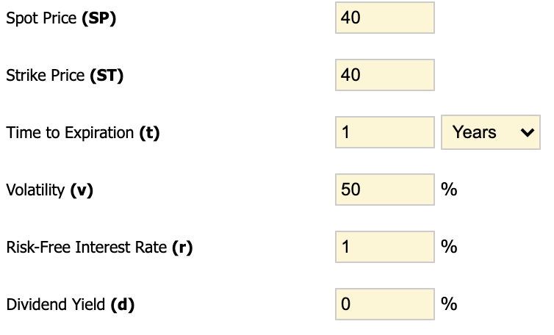


Pricing Exercise

Slide 21
Pricing Relationships
Max[0, S-K] <= C
C(K_{L}) > C(K_{H})
C(t₂) > C(t₁)
Max[0, K-S] <= P <= K
P(K_{L}) < P(K_{H})
P(t₂) > P(t₁)
S, K = spot price, strike price
K_{L}, K_{H} = lower strike, higher strike
T₁, T₂ = shorter maturity, longer maturity
Intrinsic vs. Extrinsic Value?

Slide 22
Impact of Each Variable
What happens to the cost of a call option when the following variables change?
  Price of underlying increases…
  Strike price increases…
  Volatility increases…
  Time increases…
  Interest rates increase…
  Dividends increase…

Slide 23
Impact of Each Variable
What happens to the cost of a put option when the following variables change?
  Price of underlying increases…
  Strike price increases…
  Volatility increases…
  Time increases…
  Interest rates increase…
  Dividends increase…

Slide 24
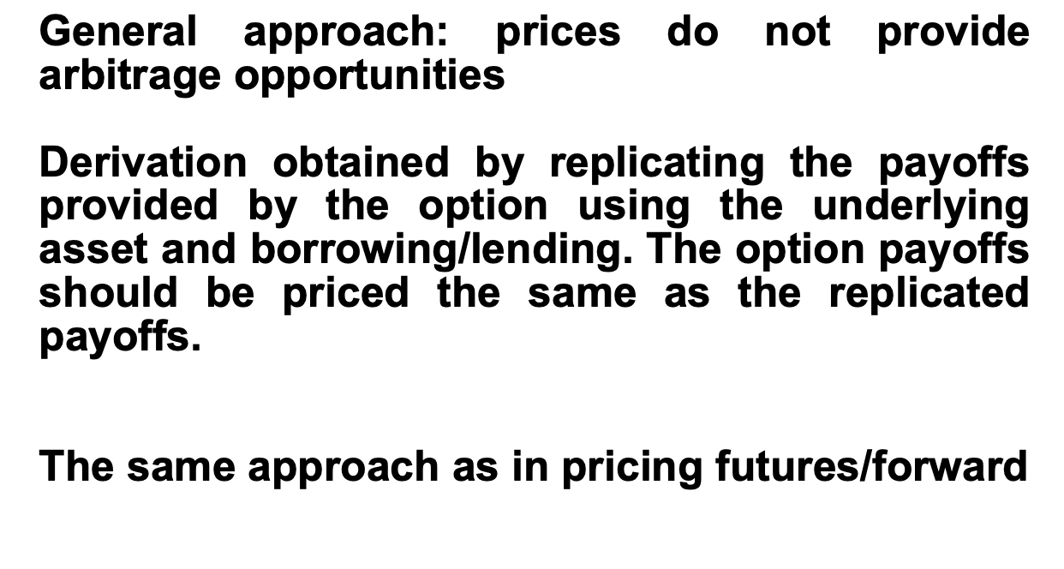
Put-Call Parity

Slide 25
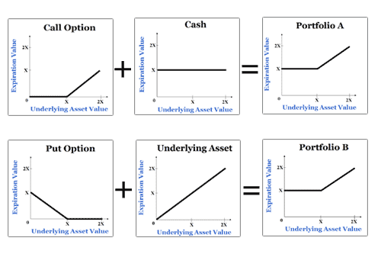
Put-Call Parity
Defines the relationship between the price of a European put and European call of the same class (same strike/underlying asset/expiration date)

Slide 26
Put-Call Parity
P + S = C + PV(K)
C = P + S – PV(K)

Slide 27
Questions?

