Slide 1
Intro to Derivatives: Futures

Slide 2
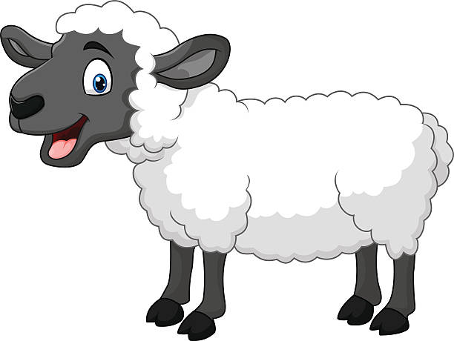
Brainteaser!
There are 100 tigers and 1 sheep. Tigers like eating sheep, but they don’t like being eaten themselves. However, if a tiger eats a sheep, then it turns into a tiger. When there are 100 tigers and 1 sheep, what happens? (Assume every tiger acts rationally)

Slide 3
What Is a Derivative?
Derivative
An derivative is a financial instrument, whose value is from the value of another underlying asset
When the price of the underlying changes, the value of the derivative also changes
Types of Derivatives
Forwards/Futures
Options
Swaps
Warrants/Convertibles

Slide 4
Key Definitions
Forward
An agreement between two parties to trade on a given future date a given commodity, or underlying asset, at a prespecified price
Future
The same as a forward contract, except that it is a standardized contract trading on a futures exchange
Difference between Forward and Future
Forward is traded OTC, while future is traded on exchange

Slide 5
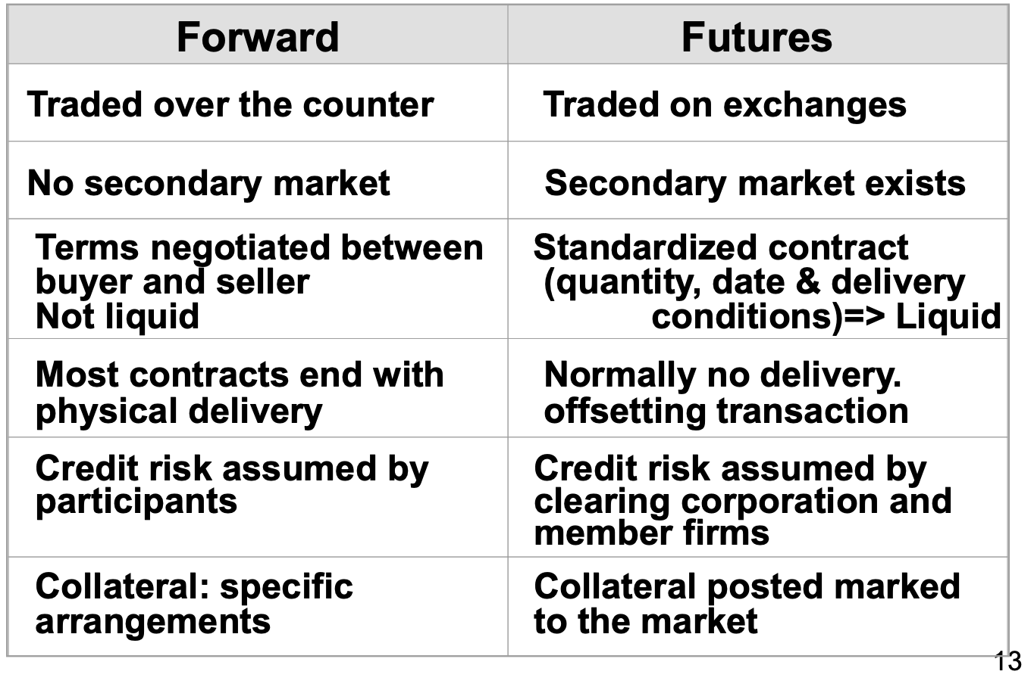
Differences Between Futures and Forwards

Slide 6
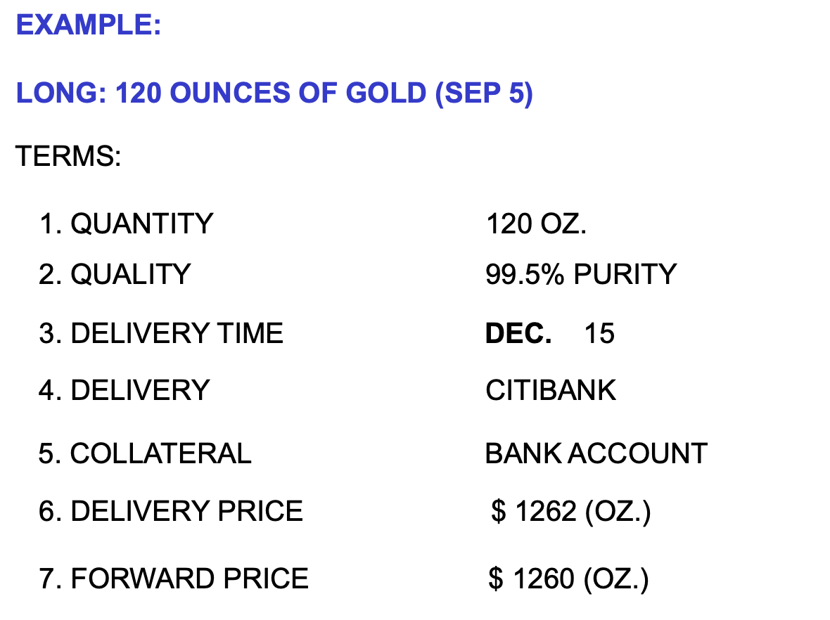
Example of a Future Contract

Slide 7
Types of Futures/Forwards
Financial Assets
Stocks, bonds, market indices, interest rates, currencies, etc…
Commodities
Natural gas, gold, copper, silver, oil, sugar, and pretty much everything you can think of

Slide 8
Types of Traders
Speculators
Hedgers
Arbitrageurs
Market makers

Slide 9
The Concept Behind Futures
Option 1
Buy future (or forward) contract expiring at time x
The only cost is the price of the future contract
Option 2
Buy spot of underlying asset right now, and hold it until time x
Incurs the cost of spot, plus the holding costs (interest, storage, insurance), and receives benefits (dividend, coupon)
By the no-arbitrage principle, the two options should result in the same cost

Slide 10
How Does a Future Contract Work
At settlement, what is the relationship between spot price and forward price?

Slide 11
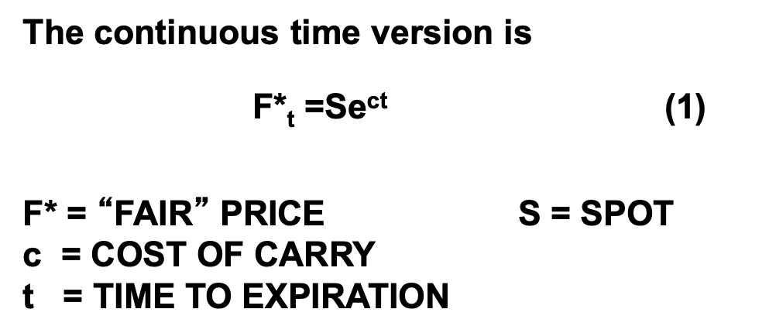
The Concept Behind Futures
Futures (or forward) = spot price + cost of carry
Cost of carry includes interest, dividends, and coupons

Slide 12
Cost of Carry
Includes: financing costs, storage costs, insurance costs, and transportation costs
Cost of carry is different depending on the underlying asset of the future/forward
Financial Assets
Interest Rate to Finance Asset – Dividends
Commodities
Interest Rate to Finance Asset + Storage Costs – Convenience Yield

Slide 13
Thought Exercise
Using the future formula, the fair price of future (i.e. the cost of holding the asset until maturity) is $100.
However, the market price of future on future exchange is $110 right now.
Is there an arbitrage? If so, how do you arbitrage it.
What if the price of future is $90 right now?

Slide 14
Contango
When a market is in contango, the forward price of a futures contract is higher than the spot price
Physically delivered futures contracts may be in a contango because of fundamental factors like storage, financing (cost to carry) and insurance costs

Slide 15
Backwardation
Conversely, when a market is in backwardation, the forward price of the futures contract is lower than the spot price.
The futures forward curve may become backwardated where there is a benefit to owning the physical material, such as keeping a production process running.

Slide 16
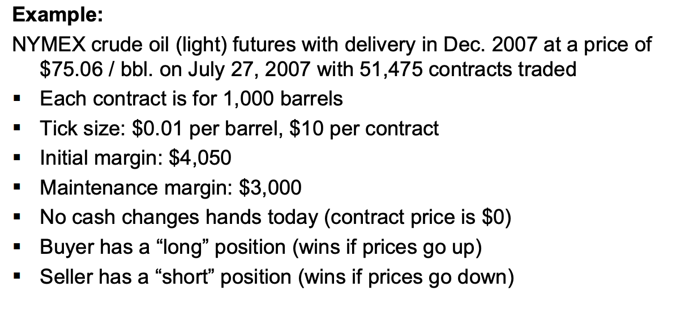
Real-life Application

Slide 17
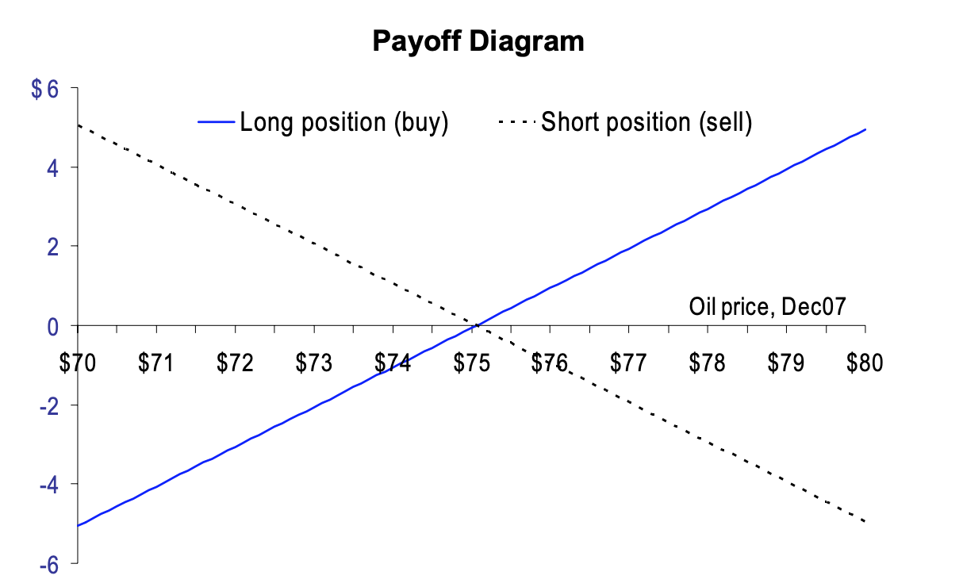
Real-life Application

Slide 18
Real-life Application

Slide 19
Real-life Application

Slide 20
Hedging With Futures
Futures contracts are one of the most common derivatives used to hedge risk
Main reason that companies or corporations use future contracts is to offset their risk exposures and limit themselves from any fluctuations in price
Goal of investor using future contracts to hedge is to perfectly offset their risk
What are some potential problems?

Slide 21
Hedging With Futures
What are some industries that use futures to hedge their exposure?

Slide 22
Hedging With Futures Example
A company knows that it will be making a purchase in the future for a particular item:
Company X knows that in 6 months, it will have to buy 20,000 ounces of silver to fulfill an order. Assume the spot price is $12/ounce and the 6 month futures price is $11/ounce. What can the company do to hedge?

Slide 23
Questions?
https://commodityhq.com/trading-strategies/the-best-commodity-trades-of-all-time/

