Slide 1
Industry Overview: Financial Institutions

Slide 2
Brainteaser!
Alice and Bob are playing a game with two boxes of raisins. They have two bowls and they pour 99 raisins in each bowl. Alice gets to move first. She eats all the raisins in one bowl, and then distributes the remaining raisins between the two bowls however she wants, making sure each bowl has at least one raisin.
So, for example, she eats all the raisins in one of the bowls (99 raisins) and distributes the other raisins between the two bowls as desired (33 raisins in one bowl, 66 raisins in the other bowl). Bob then repeats the process, eating all the raisins in one bowl and then splitting the raisins in the other bowl as he desires. The game ends when both bowls have exactly 1 raisin, so the person whose turn it is cannot split either bowl, and so they lose.
Which player has the winning strategy, and what is it? Turn to the person next to you and play a few games of the raisin game. While we don't have actual raisins, you can play it on a piece of paper:

Slide 3
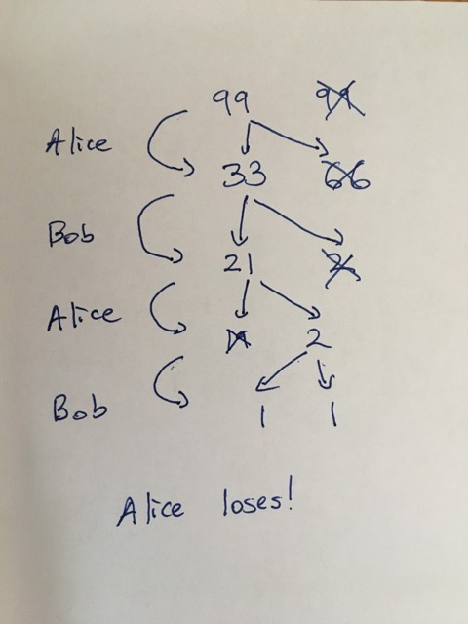
Brainteaser!

Slide 4
Solution
Bob wins.
The game only ends when both piles have 1 raisin, which means both piles have to have an odd number of raisins. When the game begins on Alice's turn both piles have an odd number of raisins so no matter how Alice splits the pile, one pile has an even number of raisins and one pile has an odd number of raisins. Bob then repeats the process by eating the pile with an odd number of raisins and splitting the pile with an even number of raisins into two piles that both have an odd number of raisins, so that the process repeats and Alice is always stuck with two odd piles. Since Bob will always have an even pile to split, he will never lose and thus Alice will be the one who loses.

Slide 5
What are we covering?
Financial Institutions
Commercial/Investment Banks
Asset Management
Insurance Companies
Example: KKR Pitch

Slide 6
Commercial/Investment Banks
Commercial Bank
Takes deposits and makes loans
Makes money off the spread between deposits and loans minus operating costs
Offers a variety of services to depositors such as payments, personal wealth management, and brokerage services
Investment Bank
‘Underwrites’ a variety of transactions by purchasing securities and then selling them to investors
Often also serves an advisory role to companies looking to pursue different strategic options

Slide 7
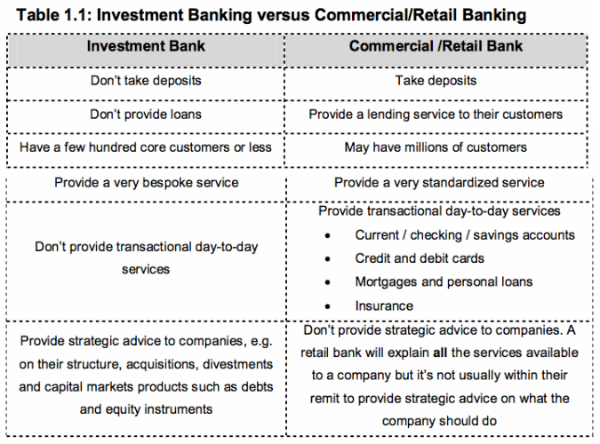
Differences Between Investment and Commercial Banks

Slide 8
Key Things To Understand Before Looking at a Bank
Equity Value
Banks are valued in terms of equity and not firm value
This is because the way a bank earns money is inherently tied to its capital structure – unlike other operating businesses
This means we look at banks in terms of P/E, P/BV, Div Yld, ROE and ROA – NOT EBITDA
Mark-to-Market Assets
A bank’s balance sheet is much more honest than other types of businesses because many assets are carried at fair value
Allows for accurate use of ROE and ROA metrics, as well as modeling of the balance sheet

Slide 9
Key Metrics/Terms
Net Interest Margin
Net interest margin is a ratio that measures how well a bank is deploying the capital it gets from its deposits and borrowings
(ineptest income – interest expense) / average earning assets
Average Earning Assets
A bank’s loans, securities, leases, trading assets, etc. that earn the bank income, averaged between two periods
Leverage Ratios (Tier 1 Leverage Ratio)
Regulatory ratios that indicate a bank’s level of liquidity, based on a comparison between tier 1 capital and total assets
Tier 1 assets are assets that could be easily liquidated if needed
Basel III regulations require that banks have at least a 10.5% Tier 1 Capital Ratio defined as Tier 1 Capital (Shareholder’s Equity) / Risk-Weighted Assets
Efficiency Ratios
Measures a bank’s overhead as a percentage of its net revenues

Slide 10
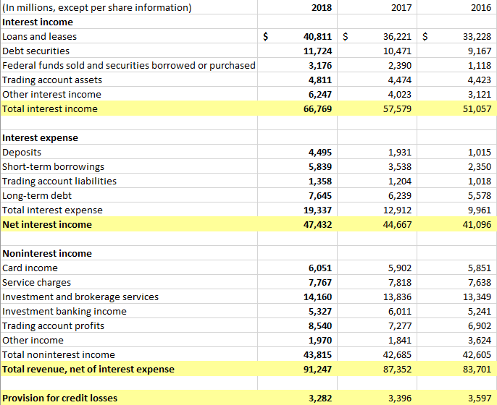
A Bank’s Income Statement

Slide 11
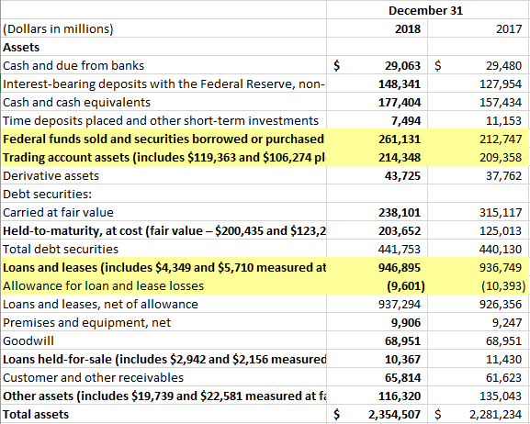
A Bank’s Assets

Slide 12
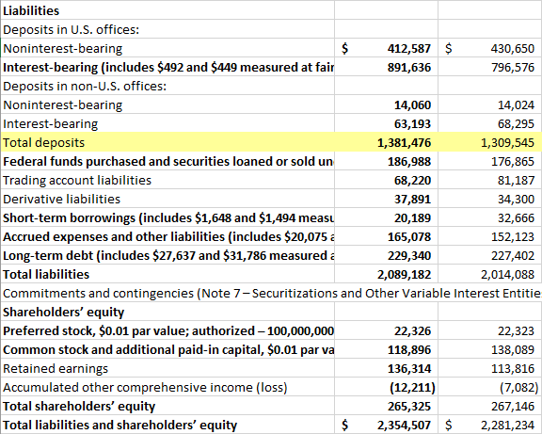
A Bank’s Liabilities

Slide 13
What Makes Banks Difficult to Look At
Un-Analyzable Balance Sheet
Only the bank really has the information required to project their balance sheet
What kind of loans a bank makes is purely up to the bank itself
Cyclical Risk/Interest Rate Exposure
Bank are extremely exposed to economic cycles for two reasons
First, economic trends affect default rates and overall company cash flows
Second, rates tend to come down during a crisis, leading to lower NIM spreads
What to Look For
Clear discounts to book value
High ROEs; ROAs at low P/Es
Small banks with potential to be taken out in geographically advantaged areas
For a longer term compounder pitch, good capital allocation, brand and company management (e.g. Goldman Sachs)

Slide 14
Recent Industry Trends
Industry Consolidation
A bank’s biggest asset is its scale - scale allows for loan diversification and widespread use of financial systems (high op. leverage)
Small, less sophisticated banks with geographic advantages are being rolled up
Dovish Fed & Expectations of Recessionary Environment
Banks are no longer benefitting from rate increases – increases the spread between loans and deposits (deposits lag and are less sensitive to rates)
Expectations of a recessions means bank stocks have generally traded DOWN, but not excessively – expected to weather this recession better than the last due to more stringent regulatory environment
That said, Crapo bill has greatly benefitted banks between $50bn-$250bn in assets
Slowing Deal Flow Hurting IB Profits – Shift Toward AM
IB revenues are very cyclical in nature and high yield loan markets tend to aggressively freeze when there’s fear in the economy
E.g. not a single high yield bond was issued in all of December
Solution has been to shift towards fee-related-earnings (“FRE”) in order to lock in more stable revenues
Many niches have appeared across different levels of wealth

Slide 15
What are we covering?
Financial Institutions
Commercial/Investment Banks
Asset Management
Insurance Companies
Example: KKR Pitch

Slide 16
Asset Management
What is Asset Management?
Asset managers take a client’s money and manage it for a fee
Different asset managers have different fee structures
$114
$120 (20% return)
Client
Asset Manager
Investments
$100
$100
Earns $6 in Fees
2%*100+20*20%

Slide 17
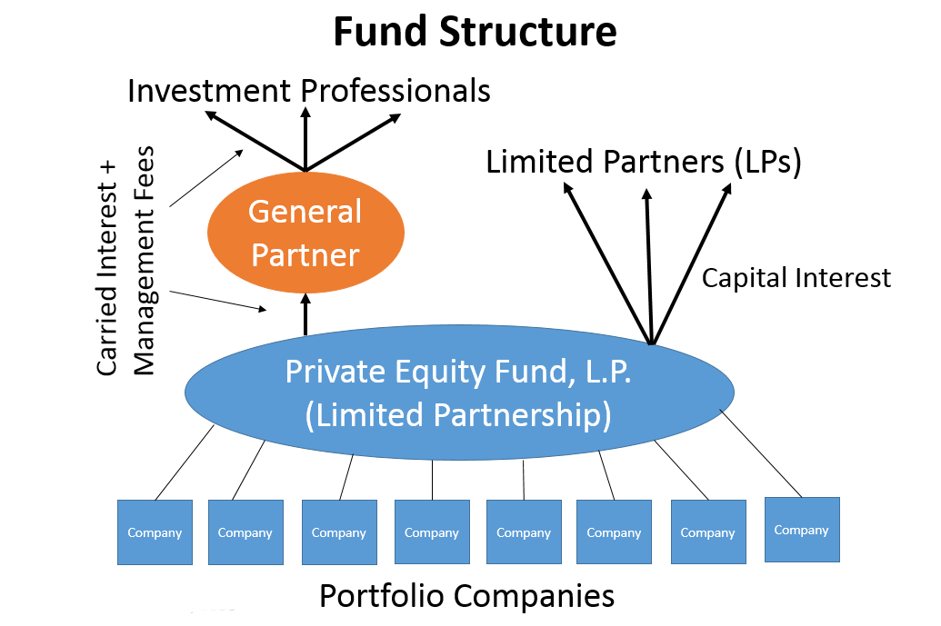
Types of Asset Managers
Hedge Fund/Private Equity Fund GP
HF/PE General Partner (“GP”) sets up an Limited Partnership (“LLP”) and usually provides 1-2% of funds
Limited Partners (investors or “LPs”) put money in the fund
GP manages the fund and receives management and incentive fees – usually 2/20

Slide 18
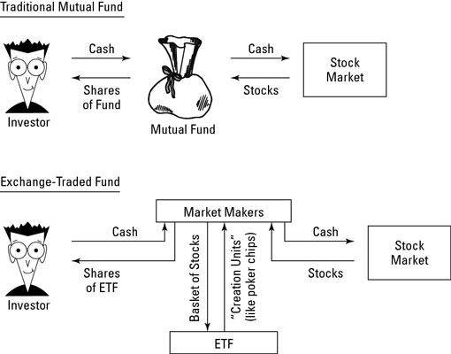
Types of Asset Managers
ETF/Mutual Funds
ETFs and Mutual Funds are publicly investable structures
ETFs usually passive, MFs passive & active

Slide 19
Trends in Asset Management
Shift Towards ETF/Passive Structures
Active managers have historically underperformed their benchmarks – most recently only 49% overperformed
Passive managers have far lower costs – ETFs have even lower costs than MFs
Pressure on Fees
Unless you can truly differentiate and have a great brand name, 2/20 fees are facing pressure
Combined with fund outflows to passive structures, it has become difficult to manage a HF in the past few years

Slide 20
What are we covering?
Financial Institutions
Commercial/Investment Banks
Asset Management
Insurance Companies
Example: KKR Pitch

Slide 21
What Do Insurance Companies Do?
Types of Insurance Companies
P&C
Life & Annuities
Reinsurance
P&C Brokers

Slide 22
How Do Insurance Companies Make Money
Generally, insurance companies make money by taking risk away from individuals for regular premiums and benefitting from diversification. Profits arise from underwriting and investment of the float.

Slide 23
How Do Insurance Companies Make Money
Underwriting
At year 0, company collects $100 and pays out $30 to acquire customers and cover other overhead expenses
Over the course of the insurance policy, claims are paid out – assume $60
Premiums collected ($100) – claims paid ($60) – SG&A expenses ($30) = underwriting profit ($10)

Slide 24
How Do Insurance Companies Make Money
Investment
Not all insurance companies make a profit through underwriting – many focus on investment income
There is a lag between premiums being received and claims being paid – this constitutes the investment ‘float’
Insurance companies often invest in high grade government and corporate bonds as well as some higher yield securities
Insurance companies also have special access to some loans as they are often holders until maturity – allowing them to finance companies that do not want to be rated
Instead, can receive a confidential rating through the National Association of Insurance Commissioners (“NAIC”)

Slide 25
Some Insurance Terms
Loss Ratio
(Total losses through claims + expenses) / total premiums earned
Expense Ratio
(Customer acquisition costs + underwriting costs) / total premiums
Combined Ratio
(Incurred losses & expenses) / earned premiums
Loss + expense ratio

Slide 26
What Do Insurance Companies Do?
P&C Insurance
Property: 1st party damage to insured property like car, home or business damage through fires, earthquakes, etc
Casualty: 3rd party damage or bodily injury caused to 3rd party
About 55% commercial and 45% personal
Personal auto and commercial casualty are 55% of entire P&C premiums volume
More money earned through underwriting due to shorter duration of policies and claims being paid out
P&C insurance is cyclical
Valuation/Financial Metrics to Use
Valuation: P/BV, P/TBV, P/E, DDM
Financial: loss ratios, expense ratios, combined ratios, ROE, investment yield, financial/operating/investment leverage

Slide 27
What Do Insurance Companies Do?

Slide 28
What Do Insurance Companies Do?
Life & Annuities Insurance
Life & health insurance is explanatory – claims paid out when insured individual dies or falls ill and needs to pay for medication
Interesting because life insurance companies underwrite policies that they won’t find out if they are profitable for decades
Also includes fixed annuities and other vehicles like 401(k)s from employers
More money earned through investment income due to longer duration of policies and claims being paid out
Valuation/Financial Metrics to Use
Valuation: P/BV, P/TBV, P/E, DDM, P/Embedded Value, P/BV vs ROE regression
Financial: ROE, investment yield, financial & investment leverage

Slide 29
What Do Insurance Companies Do?
Reinsurance Companies
Reinsurance companies sell insurance to insurance companies who want to remove some of their risk
Makes sense because primary insurance companies often cover one particular type of policy – benefits of diversification become more limited
Types of reinsurance are Pro-Rata and Excess of Loss
Pro-rata reinsurance means that reinsurance companies pay for a % of losses relative to the primary insurer
Excess of loss reinsurance means that the primary insurer covers up to a certain amount, and then the reinsurer begins to cover losses
Valuation/Financial Metrics to Use
Valuation: P/BV, P/TBV, P/E (limited), DDM
Financial: loss ratios, expense ratios, combined ratios, ROE, investment yield, financial & investment leverage

Slide 30
What Do Insurance Companies Do?
P&C Broker
Best business model in the insurance business
Basically just assist the uninsured with the purchase of insurance, earn a commission
Low capital requirements (don’t underwrite policies), so cash flows are robust
Great because you earn a commission both of primary and reinsurance policies you sell – can sell the same risk twice
Valuation/Financial Metrics to Use
Valuation: EV/EBITDA, EV/Revenue, P/E, DCF
Financial: EBITDA margin, EBIT margin, leverage

Slide 31
Trends & What to Look For
Trends
P&C cycle turning towards a soft market
Insurers buying out asset management companies in order to better manage their assets
Technology & risk management systems improving the insurance business
More ways to check on the insured – potentially even better policies
What to Look For
I have no idea
Underappreciated companies with good ratios and a strong underwriting portfolio – misunderstood
Companies with good management and ability to invest float (WB!)

Slide 32
What are we covering?
Financial Institutions
Commercial/Investment Banks
Asset Management
Insurance Companies
Example: KKR Pitch

Slide 33
KKR Pitch
Investment Thesis
Fears over market cycle has caused KKR to become excessively cheap
Investors are not giving KKR credit for performance income, or attaching appropriate multiples to book value and FRE
KKR still seen as a capital intensive business despite growth in FRE from AM business
Strong tailwinds to KKR business – run-rate performance income could reach $2,000mm as AUM continues to grow rapidly

Slide 34
KKR Pitch

Slide 35
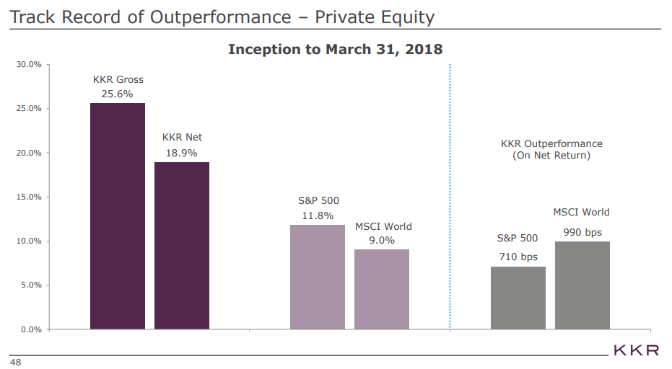
KKR Pitch

Slide 36
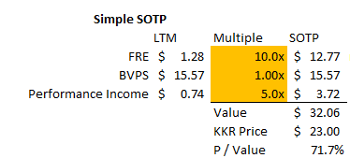
KKR Pitch

Slide 37
Questions?
http://yetanothervalueblog.com/2019/03/kkr-is-too-cheap.html

