Slide 1
Fixed Income
Kevin Chen

Slide 2
Brain Teaser
Question: Person A and Person B are playing a game. A takes two slips of paper and writes a different integer on each. He then conceals one slip in each hand.
B chooses one of A’s hands and sees the integer. B must now guess whether that number is larger or smaller than the other number. Devise an optimal strategy to win more than 50% of the time.

Slide 3
Solution: Brain Teaser
Answer: First, B can devise some probability distribution on integers (e.g., he can select random integers).
Every round, B selects an integer as a threshold and chooses a random hand.
If the integer (denoted as $t$) is larger than the threshold, then he guesses A’s number is the larger one (and vice versa).
$P\left(\#>threshold\right)=P(threshold>\#)$ by symmetry.
However, $P\left(t_{larger}>threshold>t_{smaller}\right)≥0$.
Therefore, B can win more than 50% of the time.

Slide 4
Agenda
Mathematics of Bonds
Duration & Convexity
Investing Guidelines
Sample Pitches

Slide 5
Time Value of Money
Money is ALWAYS worth more today than tomorrow. Why?
Money can be invested in some risk-free asset (e.g., U.S. Government Bonds).
We must discount money received in the future to present value with some opportunity cost.
$$Present Value= \sum_{1}^{T}{\frac{Cash Flow}{{\left(1+r\right)}^{t}}}$$

Slide 6
Zero-Coupon Bonds
Zero-Coupon Bonds, or “Zeroes,” are bonds that do not pay a coupon and pay a single cash flow equal to face value at maturity.
We can use Zeroes and the no-arbitrage principal to determine the price of a coupon bond.
$$Present Value=\frac{Cash Flow}{{\left(1+\frac{r}{2}\right)}^{2t}}$$

Slide 7
Law of One Price
Two assets which offer the same cash flows must sell for the same price.
Otherwise, there would be an arbitrage opportunity!
Limits to Arbitrage:
Transaction Costs
Capital Constraints
Barriers to Trading Across Markets

Slide 8
Fundamental Theorem of Bond Math
Let’s say that a debt instrument pays fixed cash flows $K_{1}, K_{2}, …, K_{n}$ at times $t_{1}, t_{2},…, t_{n}$. This is the same as:
$K_{1}t_{1}$-year zeroes + $K_{2}t_{2}$-year zeroes + … + $K_{n}t_{n}$-year zeroes.
$$V=K_{1}×d_{t_{1}}+K_{2}×d_{t_{2}}+…+K_{n}×d_{t_{n}}$$
Or
$$V=\sum_{j=1}^{n}{K_{j}×d_{t_{j}}}$$

Slide 9
Interest Rates
You discount future cash flows at the appropriate opportunity cost – some interest rate.
Buying a zero is lending money – you pay money now and receive money later.
Selling a zero is borrowing money – you receive money now and pay later.

Slide 10
Zero Rate Yield Curve
We plot a curve of zero rates implied by the STRIPS market:

Slide 11
Coupon Bonds
A coupon bond is a package of cash flows – we can value them as such.
In the U.S., coupon bonds pay coupons every 6 months and par value at maturity.
$$Bond Price=\frac{Principal}{{\left(1+YTM\right)}^{2T}}+\sum_{1}^{T}{\frac{Coupon}{{\left(1+YTM\right)}^{2t}}}$$
Note: a bond paying a coupon of $r$ pays coupon of $\frac{r}{2}$ every half year.

Slide 12
Coupon Bonds (cont.)
In the U.S., government bonds can be “stripped” into various cash flows to be traded as zeroes.
These zeroes are aptly called STRIPS.
This helps to enforce the Law of No-Arbitrage in the U.S. Treasuries market.

Slide 13
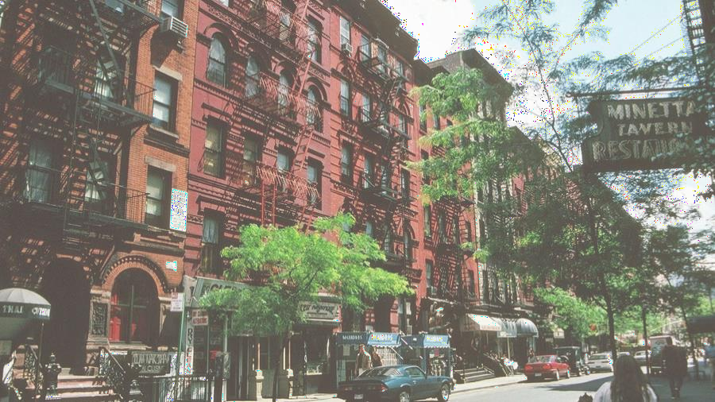
Duration
Three Definitions:
Percent change in the price of a bond given a 1% interest rate change.
Average maturity of cash flows, weighted by present value.
Holding period over which a bondholder will be compensated for his/her investment.
When rates rise, bond prices go down (and vice versa):
Future cash flows are discounted more.
Lower coupon bonds are worth less relative to higher coupon bonds.

Slide 14
Duration (cont.)
Zero Duration (we take the derivative):
$$Price_{zero}=\frac{1}{{\left(1+\frac{r}{2}\right)}^{2t}}$$
$$Dollar Duration_{zero}=−1∙\left(\frac{−t}{{\left(1+\frac{r}{2}\right)}^{2t+1}}\right)$$
Note: Dollar Duration is additive – you can find the overall duration of a portfolio.

Slide 15
Convexity
Measure of the curvature of the value of a bond as a function of interest rates.
Correction for the fact that the price-rate function is non-linear.
Via Taylor Series:
$$∆bond_{price}≈f^{′}\left(x_{0}\right)∙\left(x−x_{0}\right)+\frac{1}{2}∙f”(x_{0})∙{\left(x−x_{0}\right)}^{2}$$
Dollar Convexity (Zero):
$$d_{t}^{”}\left(r_{t}\right)=\frac{t^{2}+\frac{t}{2}}{{\left(1+\frac{r_{t}}{2}\right)}^{2t+2}}$$

Slide 16
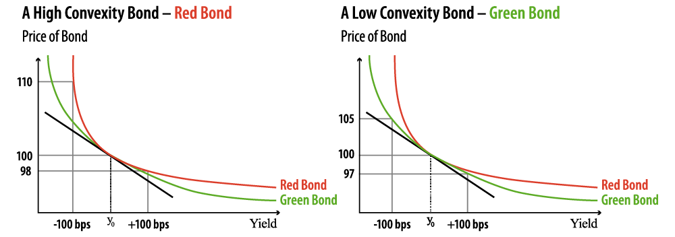
Convexity (cont.)

Slide 17
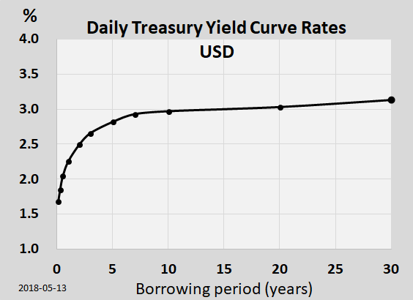
Market Phenomena
Demand for convexity bids-up the long-end of the Treasuries curve.
Higher coupon bonds tend to have lower duration and convexity (less spread-out cash flows).
Negative convexity exists in instruments such as mortgages.

Slide 18
Fixed Income Pitches
Considerations:
Tenor (Duration) & Convexity
Coupon
Credit Worthiness
Currency Risk
Liquidity
Counterparty
Market Positioning

Slide 19
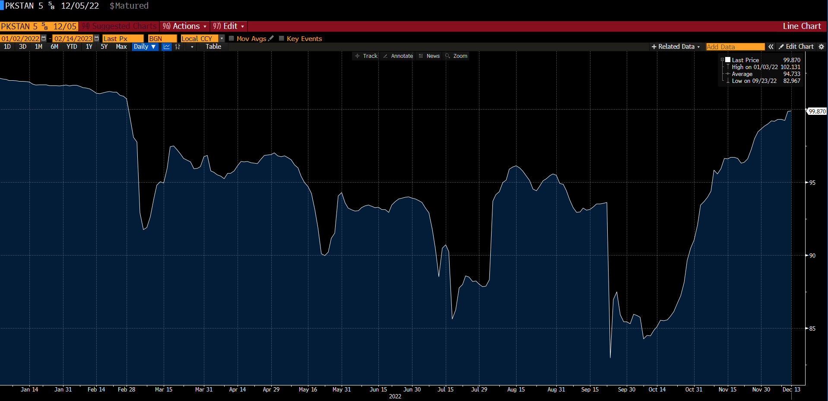
Long December 2022 Pakistan Sukuks
Key Points:
Pakistan’s resumption of its IMF Extended Fund Facility (EFF) program should buoy the country’s short-term finances
Former Prime Minister Imran Khan does not have the political capital to call early elections
Pakistan has also shown a willingness to pay
Recommendation:
I recommend longing the 12/05/2022 Pakistan International Sukuk

Slide 20
Long the 2024 NTN-B (Inflation-Linked) Brazilian Government Bond
Key Points:
Brazil faces runaway and de-anchoring inflation expectations as the BCB plans to end its hiking cycle.
The 2022 General Election has prompted incumbent President Jair Bolsonaro to accelerate populist spending policies.
Local investors have and will continue to rebalance their portfolios away from risky assets (equities, fixed-coupon bonds) and into floating notes as they seek to hedge against continued inflation and economic risks
Recommendation:
As such, I recommend a long position in the Real-denominated 08/15/2024 NTN-B (Inflation-Linked) Brazilian Government Bond

Slide 21
Get in Touch
Feel free to reach out to us over Facebook or email if you have any questions
www.quantfsnyu.com
quantfsnyu@gmail.com
President – Connor Liu (connor.liu@stern.nyu.edu)
Vice-President – Arjan Kang (ask9108@stern.nyu.edu)
Head of All Portfolios – Michael Lu (michael.j.lu@stern.nyu.edu)

