Slide 1
Options 301 – Volatility

Slide 2
Brain Teaser
8 Quants from different banks are getting together for drinks. They’re all interested in knowing the average compensation for the group. Since they aren’t investment bankers, each person prefers not to disclose how much they make to the group. Come up with a strategy for the group to find the average salary without knowing any individual’s salary.

Slide 3
Solution: Brain Teaser
Solution: 1st Quant adds random number to his salary and whispers it to 2nd. 2nd Quant adds his salary to that number and whispers it to 3rd. Goes around in circle until back to 1st Quant, who deducts the random number and divides by 8.

Slide 4
Review – What is an option?
Options are contracts between two traders who agree to certain conditions under which they are allowed/required to buy/sell stock over a prearranged timeframe. These contracts are exchange traded
Calls are agreements where the buyer has the right but not the obligation to buy a security at a specific strike price, as such the seller is required to sell the security to the buyer at that price if the buyer exercises their rights under the option agreement
Puts are agreements where the buyer has the right but not the obligation to sell a security at a specific strike price, as such the seller is required to buy the security from the buyer at that price if the buyer exercises their rights under the option agreement
Notes:
Options r usually packaged to 100.
Make not of American vs euros also interesting other things ppl do with this like Asian options which payout the average price over the time period
Questions:
does it make sense to exercise an option early? When does it make sense to do so.
Lets say expiry day has come, so the past question is now irrelevant, when does it make sense to use your option. When does it not make sense?

Slide 5
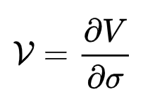
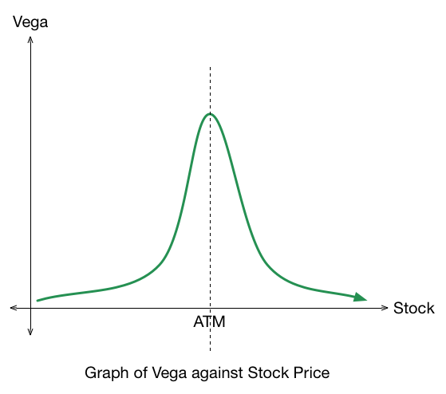
Review – Vega
Vega is the Change in the Price of an Option Relative to a 1% change in volatility.

Slide 6
What is volatility?
Statistically volatility is simply the standard deviation of an assets returns. Returns are just a way of tracking an asset’s performance over a given period.
We intuitively expect these returns to be normally distributed (events get less and less likely as they become more and more extreme).
In reality, our distributions are fat tailed (platykurtic/negative kurtosis) indicating more volatility/extreme events than a simple normal distribution.
Notes:
Options r always packaged to 100.
Make not of American vs euros also interesting other things ppl do with this like Asian options which payout the average price over the time period
Questions:
does it make sense to exercise an option early? When does it make sense to do so.
Lets say expiry day has come, so the past question is now irrelevant, when does it make sense to use your option. When does it not make sense?

Slide 7
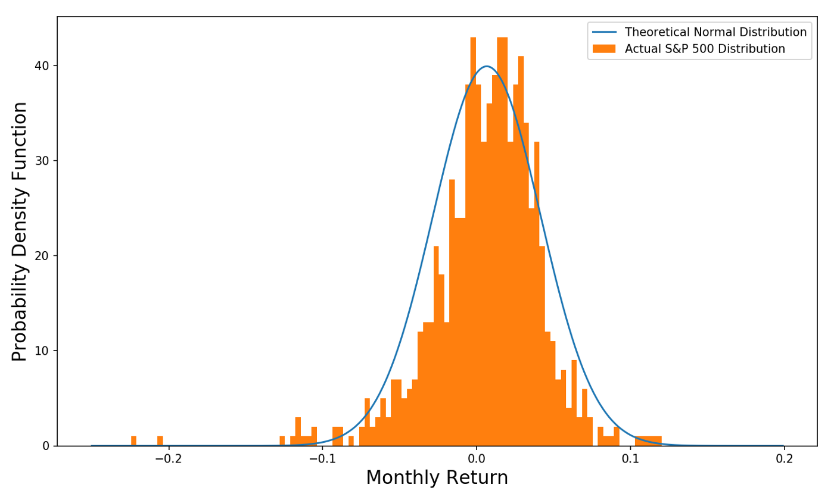
Normal Distribution of Returns
Notes:
Options r always packaged to 100.
Make not of American vs euros also interesting other things ppl do with this like Asian options which payout the average price over the time period
Questions:
does it make sense to exercise an option early? When does it make sense to do so.
Lets say expiry day has come, so the past question is now irrelevant, when does it make sense to use your option. When does it not make sense?

Slide 8
Deep Dive – Realized Volatility
Realized Volatility is a value calculated on top of spot prices which gives us a value for past volatility. It is not forward looking which means it is solely based on past data.
Calculating realized volatility can be done in many ways but it is always based on a set statistical test/formula to determine a value from intraday prices, daily returns, overnight jumps, etc.
We can calculate realized volatility without options prices, it is only based on the spot value as our formulae are not dependent on forward looking options strikes.
Notes:
Options r always packaged to 100.
Make not of American vs euros also interesting other things ppl do with this like Asian options which payout the average price over the time period
Questions:
does it make sense to exercise an option early? When does it make sense to do so.
Lets say expiry day has come, so the past question is now irrelevant, when does it make sense to use your option. When does it not make sense?

Slide 9
Deep Dive – Implied Volatility
Implied Volatility is a value dependent on current options black Scholes prices for those options. As we know there are 5 inputs to BSM (spot, strike, expiry, rates, and vol), if we know 4 of these and the market price, we can derive an inverse function to imply the 5th
In practice this derivation is only really done for volatility hence why we call it ”implied volatility” as we are implying it from BSM.
This volatility is forward looking as it is attached to a strike and expiry date. It is quoted in percent terms where the percent corresponds to a 1 std dev move in price. For example, if spot is $100 and IV is 10% a 1 std dev move in prices implied by the market is from 90 - 110, which, of course, has a 68% probability.
Notes:
Options r always packaged to 100.
Make not of American vs euros also interesting other things ppl do with this like Asian options which payout the average price over the time period
Questions:
does it make sense to exercise an option early? When does it make sense to do so.
Lets say expiry day has come, so the past question is now irrelevant, when does it make sense to use your option. When does it not make sense?

Slide 10
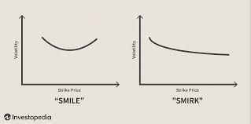
Black Scholes Failure
Returns are not normally distributed which means that our black scholes assumptions have been violated.
This manifests in something called skew as we want to hedge out our increased risk of negative tail events. I.e., BSM underprices puts.
Notes:
Options r always packaged to 100.
Make not of American vs euros also interesting other things ppl do with this like Asian options which payout the average price over the time period
Questions:
does it make sense to exercise an option early? When does it make sense to do so.
Lets say expiry day has come, so the past question is now irrelevant, when does it make sense to use your option. When does it not make sense?

Slide 11
Skew in current events
Oil and other commodities have recently experienced supply shock fears, this has caused greater negative skew (skew towards the OTM options prices) as supply shocks cause prices to increase, and people want protection against those events.
The S&P still shows skew towards lower strikes (as we would expect).
Notes:
Options r always packaged to 100.
Make not of American vs euros also interesting other things ppl do with this like Asian options which payout the average price over the time period
Questions:
does it make sense to exercise an option early? When does it make sense to do so.
Lets say expiry day has come, so the past question is now irrelevant, when does it make sense to use your option. When does it not make sense?

Slide 12
Skew in current events
Notes:
Options r always packaged to 100.
Make not of American vs euros also interesting other things ppl do with this like Asian options which payout the average price over the time period
Questions:
does it make sense to exercise an option early? When does it make sense to do so.
Lets say expiry day has come, so the past question is now irrelevant, when does it make sense to use your option. When does it not make sense?

Slide 13
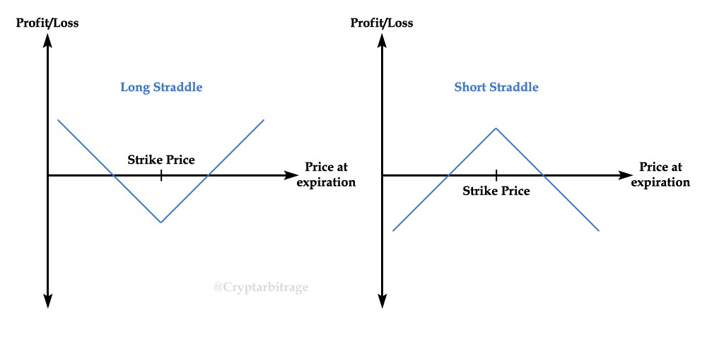
Trading Volatility
Straddles/Strangles are a way for us to express our view on volatility without a view in the underlying, it involves buying a call and a put the same distance from ATM. This is delta neutral at inception and is holding a lot of vega.
Notes:
Options r always packaged to 100.
Make not of American vs euros also interesting other things ppl do with this like Asian options which payout the average price over the time period
Questions:
does it make sense to exercise an option early? When does it make sense to do so.
Lets say expiry day has come, so the past question is now irrelevant, when does it make sense to use your option. When does it not make sense?

Slide 14
Get in Touch
Feel free to reach out to us over Facebook or email if you have any questions
www.quantfsnyu.com
quantfsnyu@gmail.com
President – Daniel Shahab Diaz (daniel.diaz@stern.nyu.edu)
Vice-President – Jessica Wu (jessica.wu@stern.nyu.edu)
Co – Head of All Portfolios – Vishwakrit Choradia (vc1484@stern.nyu.edu)
Co – Head of All Portfolios – Austin Tang (austin.tang@stern.nyu.edu)

