Slide 1
Options 201 – Intro to Black Scholes

Slide 2
Brain Teaser
We have 10 bags with 100 identical coins in each bag. In all bags but one, each coin weighs 10 grams. However, there is one counterfeit bag in which all the coins weigh either 9 grams or all the coins weigh 11 grams. Using a digital scale (which tells you the exact weight) can you find the counterfeit bag.

Slide 3
Solution: Brain Teaser
Solution: Take one coin from the first bag, two from the second bag, three from the third, etc. This leaves us with 55 coins (sum of 1-10). Assuming there was no counterfeit bag the weight of these 55 coins it would be 550 grams. However, we know there is a counterfeit bag so the weight will be 550 $± n$. Therefore, with this $n$ we can identify the counterfeit bag and if its coins are 9 or 11 grams (|n| will be the number of the bag).

Slide 4
Review – What is an option?
Options are contracts between two traders who agree to certain conditions under which they are allowed/required to buy/sell stock over a prearranged timeframe. These contracts are exchange traded
Calls are agreements where the buyer has the right but not the obligation to buy a security at a specific strike price, as such the seller is required to sell the security to the buyer at that price if the buyer exercises their rights under the option agreement
Puts are agreements where the buyer has the right but not the obligation to sell a security at a specific strike price, as such the seller is required to buy the security from the buyer at that price if the buyer exercises their rights under the option agreement
Notes:
Options r always packaged to 100.
Make not of American vs euros also interesting other things ppl do with this like Asian options which payout the average price over the time period
Questions:
does it make sense to exercise an option early? When does it make sense to do so.
Lets say expiry day has come, so the past question is now irrelevant, when does it make sense to use your option. When does it not make sense?

Slide 5
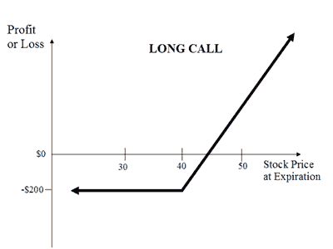
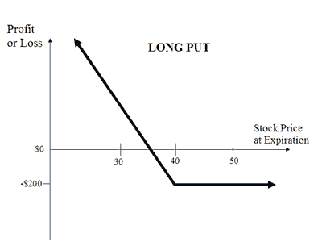
Review – Payoff Diagrams
Notes:
Notice that there is limited loss, why is this?
This is from the buyers perspective, what about from the seller’s perspective.
In this picture, how much did we pay per option (not per 100), what is the strike price? What would my pnl be if the stock was trading at 41? Where is my breakeven point?
What is the trick for finding breakevens (add per contract price to strike price = breakeven).

Slide 6
Review – Payoff Diagrams
Notes:
Unlimited loss/risk. Why would someone buy these? because you are on credit, you don’t need to put money down upfront for this position. Also for hedging, selling covered calls = income.

Slide 7
Review - Moneyness
Moneyness relates to how far above/below the strike price the underlying (and thus the option) is.
Out of the money (OTM) means that the underlying spot price (share price of the stock itself) is away from the share price towards the worthless direction (if the option expired today, it would be $0).
In the money (ITM) means that the underlying spot price (share price of the stock itself) is away from the share price towards the valuable direction (if the option expired today, it would still have intrinsic value).
At the money (ATM) means that the spot price is exactly at the options strike price (can think of this as between ITM and OTM).

Slide 8
Intrinsic vs Extrinsic Value
The Value of an option changes over time depending on a host of factors, we can divide this value into two components:
Intrinsic Value is simply what the option would be worth if we were to exercise it at this exact moment (i.e. the actual pnl you would make).
Extrinsic Value is the remainder of an options value besides the intrinsic value, this includes mainly time value of an option.
Extrinsic Value can also be thought of as the difference in the intrinsic value of an option (the value you know you can extract by exercising it), vs the price the option is trading at.
Notes:
For example, if I have a stock trading at $50 and a call with a strike price of $40, the intrinsic value of that option is $10. i.e. if I exercised it right now I would make $10, but does this mean that it is trading for 10 dollars. If it was

Slide 9
Options Pricing
What affects the price of options?
Does spot price make a call more or less valuable? A put?
Does time make a call more or less valuable? A put?
Does volatility make a call more or less valuable? A put?
Do changes in rates make a call more or less valuable? A put?
Notes:
Actually ask the question about what goes into it.
Ask all of these
Answers:
Higher Spot makes calls higher and puts lower
Higher time makes everything higher
Higher vol makes everything higher
Higher rates = good for calls, bad for puts

Slide 10
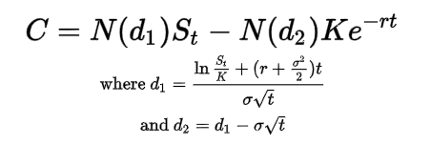
Black Scholes
Black Scholes is a differential equation used to price European options:
Inputs:
$S_{t}=Spot Price$
$K=Strike Price$
R = risk free interest rate
T = Time to expiry
C = Call Price
σ = Volatility of the underlying

Slide 11
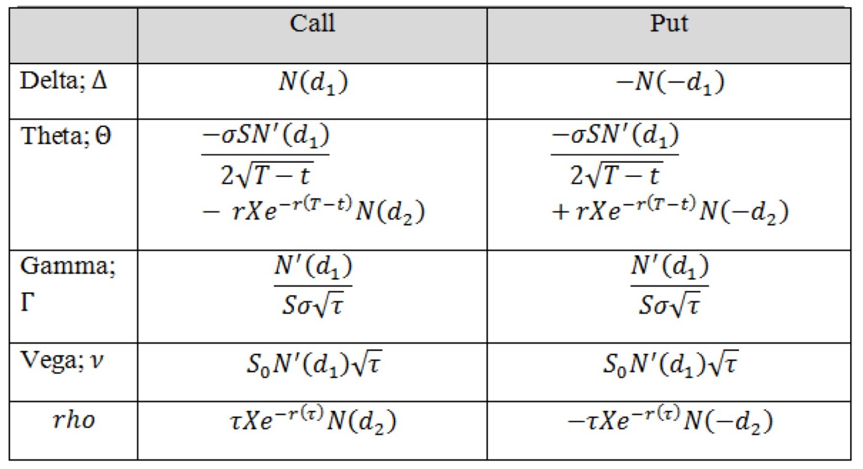
Black Scholes - Greeks
The greeks are a set of partial derivatives which describe the effect of different :

Slide 12
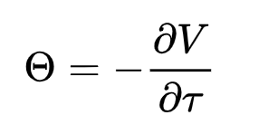
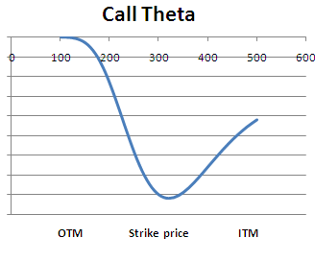
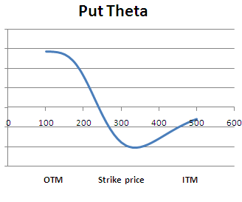
Greeks – Theta
Theta is the Change in the Price of an Option Relative to a 1 day passage of time.

Slide 13
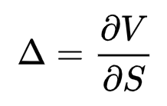
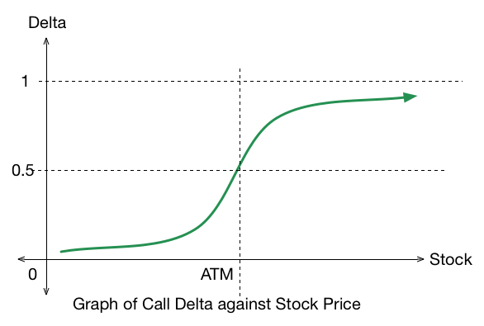
Greeks - Delta
Delta is the Change in the Price of an Option Relative to a $1 Movement in Spot.
Notes:
An ATM call has 0.5 delta, intuitively this is because it has a 50% chance of ending up ITM or OTM (in practice the reasoning is more complex)

Slide 14
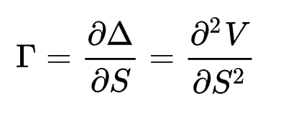
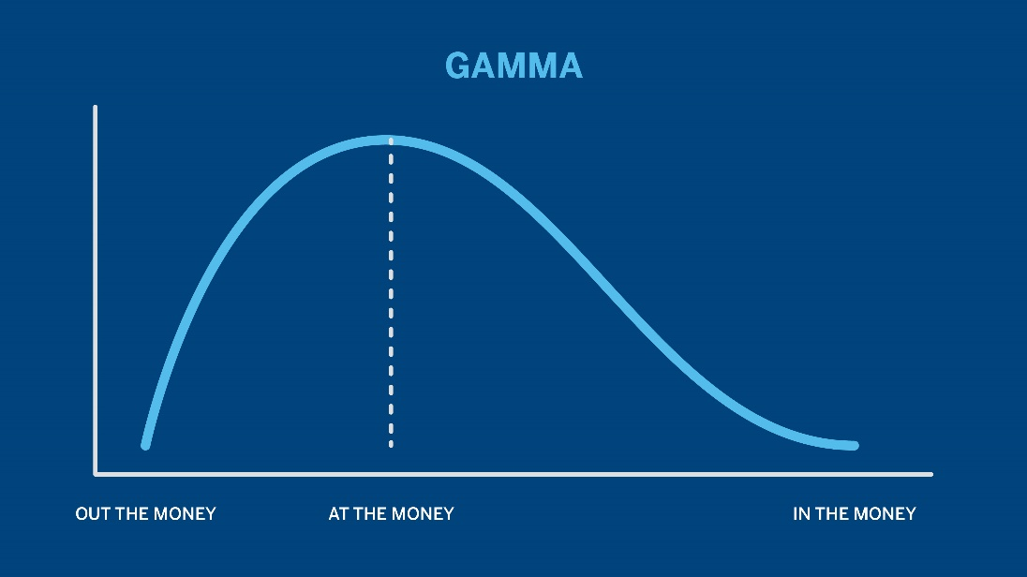
Greeks – Gamma
Gamma is the Change in the Price of an Option Relative to a change in delta.
Notes:
Just derivative of delta graph

Slide 15
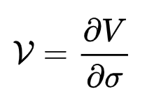
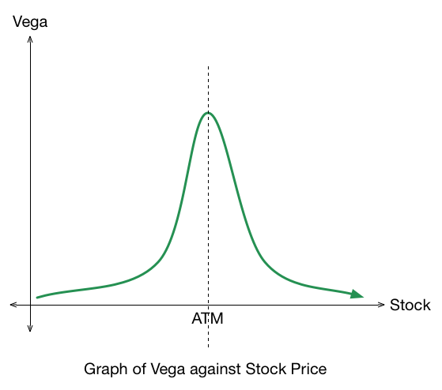
Greeks – Vega
Vega is the Change in the Price of an Option Relative to a 1% change in volatility.

Slide 16
What is volatility?
Statistically volatility is simply the standard deviation of an assets returns. Returns are just a way of tracking an asset’s performance over a given period.
We intuitively expect these returns to be normally distributed (events get less and less likely as they become more and more extreme).
In reality, our distributions are fat tailed (platykurtic/negative kurtosis) indicating more volatility/extreme events than a simple normal distribution.
Notes:
Options r always packaged to 100.
Make not of American vs euros also interesting other things ppl do with this like Asian options which payout the average price over the time period
Questions:
does it make sense to exercise an option early? When does it make sense to do so.
Lets say expiry day has come, so the past question is now irrelevant, when does it make sense to use your option. When does it not make sense?

Slide 17
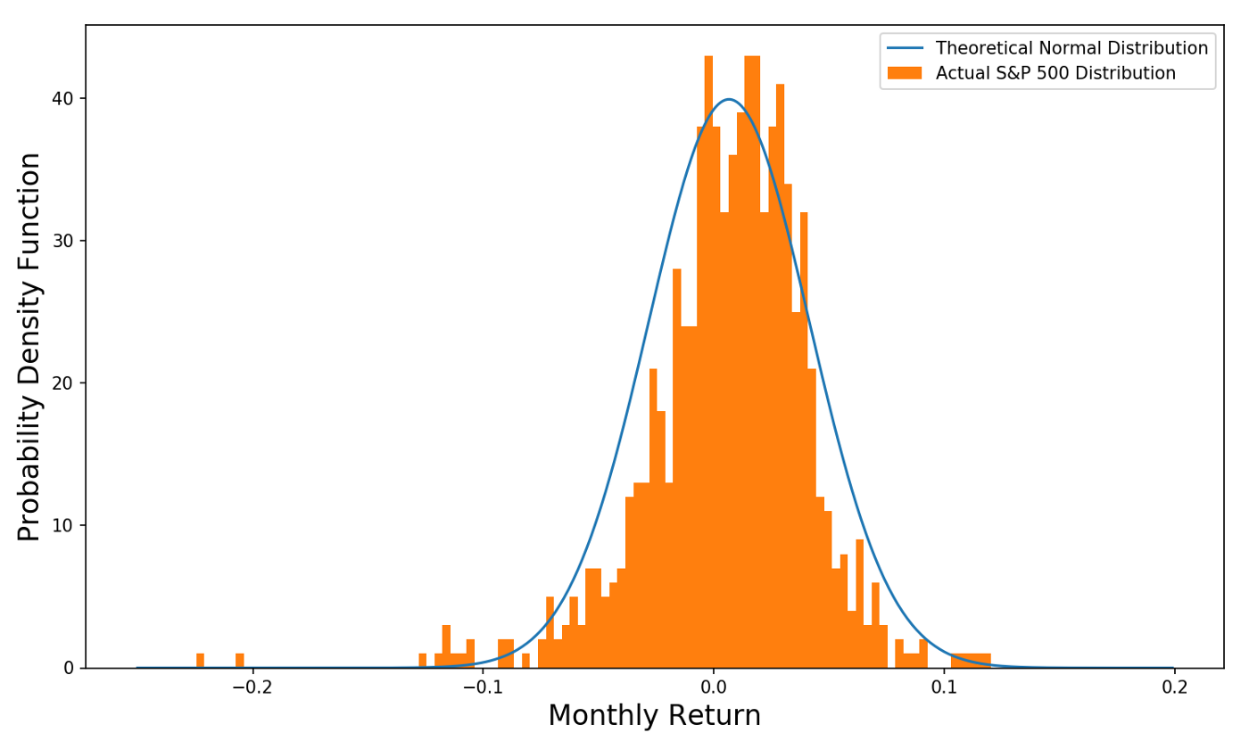
Normal Distribution of Returns
Notes:
Options r always packaged to 100.
Make not of American vs euros also interesting other things ppl do with this like Asian options which payout the average price over the time period
Questions:
does it make sense to exercise an option early? When does it make sense to do so.
Lets say expiry day has come, so the past question is now irrelevant, when does it make sense to use your option. When does it not make sense?

Slide 18
Deep Dive – Realized Volatility
Realized Volatility is a value calculated on top of spot prices which gives us a metric for past volatility. It is not forward looking which means it is solely based on past data.
Calculating realized volatility can be done in many ways but it is always based on a set statistical test/formula to determine a value from intraday prices, daily returns, overnight jumps, etc.
We can calculate realized volatility without options prices, it is only based on the spot value as our formulae are not dependent on forward looking options strikes.
Notes:
Options r always packaged to 100.
Make not of American vs euros also interesting other things ppl do with this like Asian options which payout the average price over the time period
Questions:
does it make sense to exercise an option early? When does it make sense to do so.
Lets say expiry day has come, so the past question is now irrelevant, when does it make sense to use your option. When does it not make sense?

Slide 19
Deep Dive – Implied Volatility
Implied Volatility is a value dependent on current options black Scholes prices for those options. As we know there are 5 inputs to BSM (spot, strike, expiry, rates, and vol), if we know 4 of these and the market price, we can derive an inverse function to imply the 5th
In practice this derivation is only really done for volatility hence why we call it ”implied volatility” as we are implying it from BSM.
This volatility is forward looking as it is attached to a strike and expiry date. It is quoted in percent terms where the percent corresponds to a 1 std dev move in price. For example, if spot is $100 and IV is 10% a 1 std dev move in prices implied by the market is from 90 - 110, which, of course, has a 68% probability.
Notes:
Options r always packaged to 100.
Make not of American vs euros also interesting other things ppl do with this like Asian options which payout the average price over the time period
Questions:
does it make sense to exercise an option early? When does it make sense to do so.
Lets say expiry day has come, so the past question is now irrelevant, when does it make sense to use your option. When does it not make sense?

Slide 20
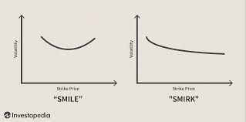
Black Scholes Failure
Returns are not normally distributed which means that our black scholes assumptions have been violated.
This manifests in something called skew as we want to hedge out our increased risk of negative tail events. I.e., BSM underprices puts.
Notes:
Options r always packaged to 100.
Make not of American vs euros also interesting other things ppl do with this like Asian options which payout the average price over the time period
Questions:
does it make sense to exercise an option early? When does it make sense to do so.
Lets say expiry day has come, so the past question is now irrelevant, when does it make sense to use your option. When does it not make sense?

Slide 21
Skew in current events
Oil and other commodities have recently experienced supply shock fears, this has caused greater negative skew (skew towards the OTM options prices) as supply shocks cause prices to increase, and people want protection against those events.
The S&P still shows skew towards lower strikes (as we would expect).
Notes:
Options r always packaged to 100.
Make not of American vs euros also interesting other things ppl do with this like Asian options which payout the average price over the time period
Questions:
does it make sense to exercise an option early? When does it make sense to do so.
Lets say expiry day has come, so the past question is now irrelevant, when does it make sense to use your option. When does it not make sense?

Slide 22
Skew in current events
Notes:
Options r always packaged to 100.
Make not of American vs euros also interesting other things ppl do with this like Asian options which payout the average price over the time period
Questions:
does it make sense to exercise an option early? When does it make sense to do so.
Lets say expiry day has come, so the past question is now irrelevant, when does it make sense to use your option. When does it not make sense?

Slide 23
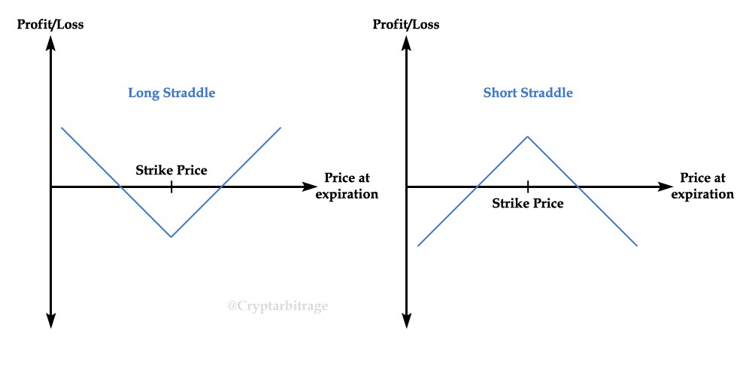
Trading Volatility
Straddles/Strangles are a way for us to express our view on volatility without a view in the underlying, it involves buying a call and a put the same distance from ATM. This is delta neutral at inception and is holding a lot of vega.
Notes:
Options r always packaged to 100.
Make not of American vs euros also interesting other things ppl do with this like Asian options which payout the average price over the time period
Questions:
does it make sense to exercise an option early? When does it make sense to do so.
Lets say expiry day has come, so the past question is now irrelevant, when does it make sense to use your option. When does it not make sense?

