Slide 1
Options 201 – Intro to Black Scholes

Slide 2
Brain Teaser
You have two ropes, each of which takes 1 hour to burn. But either rope has different densities at different points, so there’s no guarantee of consistency in the time it takes different sections within the rope to burn. How do you use these two ropes to measure 45 min

Slide 3
Solution: Brain Teaser
Solution: Burn both ends of one rope and one end of the other, when the first is done light the remaining end.
Explanation: We know that if you light one rope from one end it takes 60 mins to burn, so if we light both ends of one rope it would take 30 mins. Based on this logic we can start by lighting one rope on both ends and one end of our second rope.
After the first rope has burned through, we know it has been 30 mins and the 2nd rope has half its time (30 mins) left. At this exact time, we should light the other end of the second rope, this cuts the remaining 30 mins in half and burns through in 15 mins for a total of 45 mins including the first rope.

Slide 4
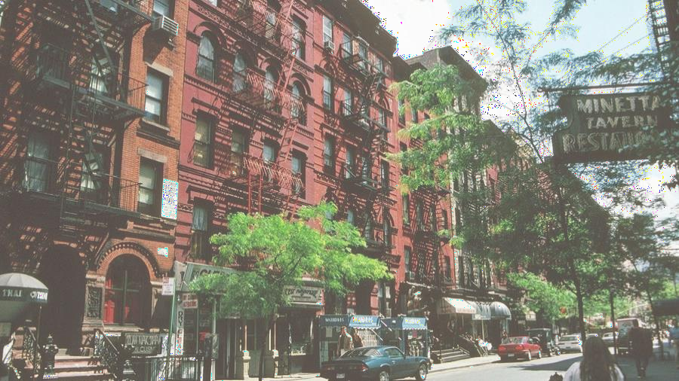
Por t folio Team Application
Timeline:
Opens on Friday, 2/11 at 12:00 AM
Closes on Friday, 2/18 at 9:00 AM
Eligibility: open to all NYU students, no experience required
Application Process:
Fill in Google form (admin details & portfolio preference)
Submit your application responses as a PDF/Word
All instructions will be on the front page of our website, and emailed to everyone on our mailing list (https://tinyurl.com/3zardr3r)

Slide 5
Por t folio Team Application Tips
If you are an underclassmen, please answer all questions for your grade, regardless of portfolio interest
Helpful if you cite sources (links are fine)
2 pages max for the three responses
Can easily be done in one page
Try to submit as a PDF or Word, if you choose to submit as a google docs, please give quantfsnyu@gmail.com access
Primarily looking for effort, not accuracy

Slide 6
Portfolio Team Open House
Time:
Wednesday, 2/16 at 7:00 PM
Location: TBD
Investment Pitches:
Each portfolio team will present a pitch to give you more insights on what our portfolios focus on & their investment strategies
You are encouraged to participate during the pitches and ask any questions you may have
You will also get a chance to talk to members of the portfolio team and learn more about what they do

Slide 7
Review – What is an option?
Options are contracts between two traders who agree to certain conditions under which they are allowed/required to buy/sell stock over a prearranged timeframe. These contracts are exchange traded
Calls are agreements where the buyer has the right but not the obligation to buy a security at a specific strike price, as such the seller is required to sell the security to the buyer at that price if the buyer exercises their rights under the option agreement
Puts are agreements where the buyer has the right but not the obligation to sell a security at a specific strike price, as such the seller is required to buy the security from the buyer at that price if the buyer exercises their rights under the option agreement
Notes:
Options r always packaged to 100.
Make not of American vs euros also interesting other things ppl do with this like Asian options which payout the average price over the time period
Questions:
does it make sense to exercise an option early? When does it make sense to do so.
Lets say expiry day has come, so the past question is now irrelevant, when does it make sense to use your option. When does it not make sense?

Slide 8
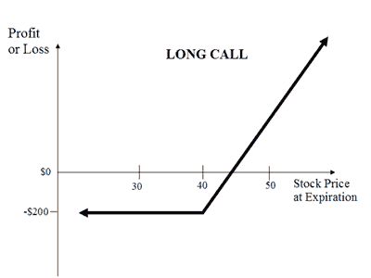
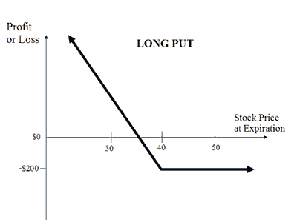
Review – Payoff Diagrams
Notes:
Notice that there is limited loss, why is this?
This is from the buyers perspective, what about from the seller’s perspective.
In this picture, how much did we pay per option (not per 100), what is the strike price? What would my pnl be if the stock was trading at 41? Where is my breakeven point?
What is the trick for finding breakevens (add per contract price to strike price = breakeven).

Slide 9
Review – Payoff Diagrams
Notes:
Unlimited loss/risk. Why would someone buy these? because you are on credit, you don’t need to put money down upfront for this position. Also for hedging, selling covered calls = income.

Slide 10
Review - Moneyness
Moneyness relates to how far above/below the strike price the underlying (and thus the option) is.
Out of the money (OTM) means that the underlying spot price (share price of the stock itself) is away from the share price towards the worthless direction (if the option expired today, it would be $0).
In the money (ITM) means that the underlying spot price (share price of the stock itself) is away from the share price towards the valuable direction (if the option expired today, it would still have intrinsic value).
At the money (ATM) means that the spot price is exactly at the options strike price (can think of this as between ITM and OTM).

Slide 11
Intrinsic vs Extrinsic Value
The Value of an option changes over time depending on a host of factors, we can divide this value into two components:
Intrinsic Value is simply what the option would be worth if we were to exercise it at this exact moment (i.e. the actual pnl you would make).
Extrinsic Value is the remainder of an options value besides the intrinsic value, this includes mainly time value of an option.
Extrinsic Value can also be thought of as the difference in the intrinsic value of an option (the value you know you can extract by exercising it), vs the price the option is trading at.
Notes:
For example, if I have a stock trading at $50 and a call with a strike price of $40, the intrinsic value of that option is $10. i.e. if I exercised it right now I would make $10, but does this mean that it is trading for 10 dollars. If it was

Slide 12
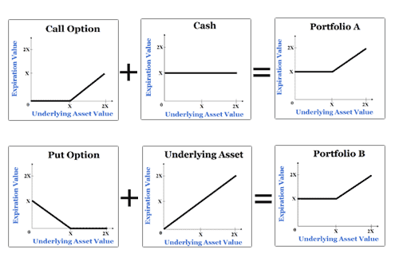
Put Call Parity
Calls: C = P + S – PV(K) Puts: P + S = C + PV(K)
Notes:
No Arbitrage Rule
Can also be written as: C + X/((1+r)^t) = S + P (Call + Strike/(1+rfr)^time = Spot + Put)
Or as C+Xe^(-rt) = S+P
Basically PV(K) = present value of the strike discounted at risk free which is basically just Xe^(-rt) = X/(1+r)^t

Slide 13
Options Pricing
What affects the price of options?
Does spot price make a call more or less valuable? A put?
Does time make a call more or less valuable? A put?
Does volatility make a call more or less valuable? A put?
Do changes in rates make a call more or less valuable? A put?
Notes:
Actually ask the question about what goes into it.
Ask all of these
Answers:
Higher Spot makes calls higher and puts lower
Higher time makes everything higher
Higher vol makes everything higher

Slide 14
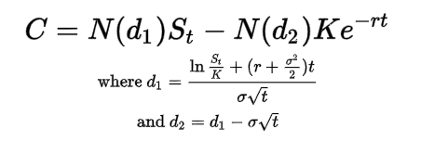
Black Scholes
Black Scholes is a differential equation used to price European options:
Inputs:
$S_{t}=Spot Price$
$K=Strike Price$
R = risk free interest rate
T = Time to expiry
C = Call Price
σ = Volatility of the underlying

Slide 15
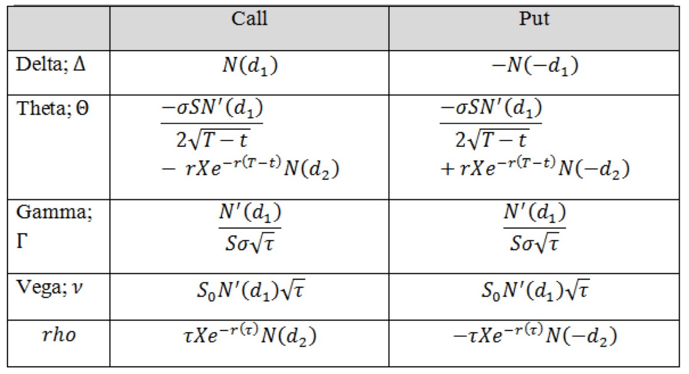
Black Scholes - Greeks
The greeks are a set of partial derivatives which describe the effect of different :

Slide 16
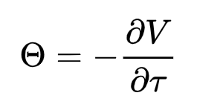
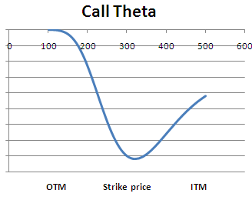
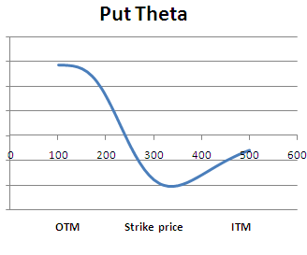
Greeks – Theta
Theta is the Change in the Price of an Option Relative to a 1 day passage of time.

Slide 17
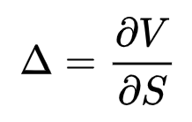
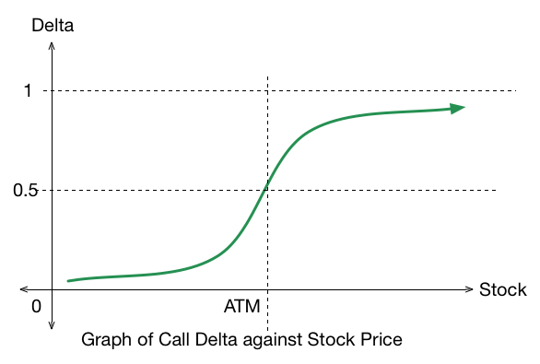
Greeks - Delta
Delta is the Change in the Price of an Option Relative to a $1 Movement in Spot.
Notes:
An ATM call has 0.5 delta, intuitively this is because it has a 50% chance of ending up ITM or OTM (in practice the reasoning is more complex)

Slide 18
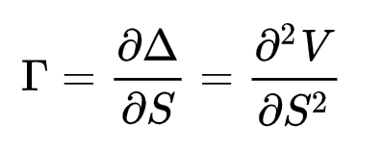
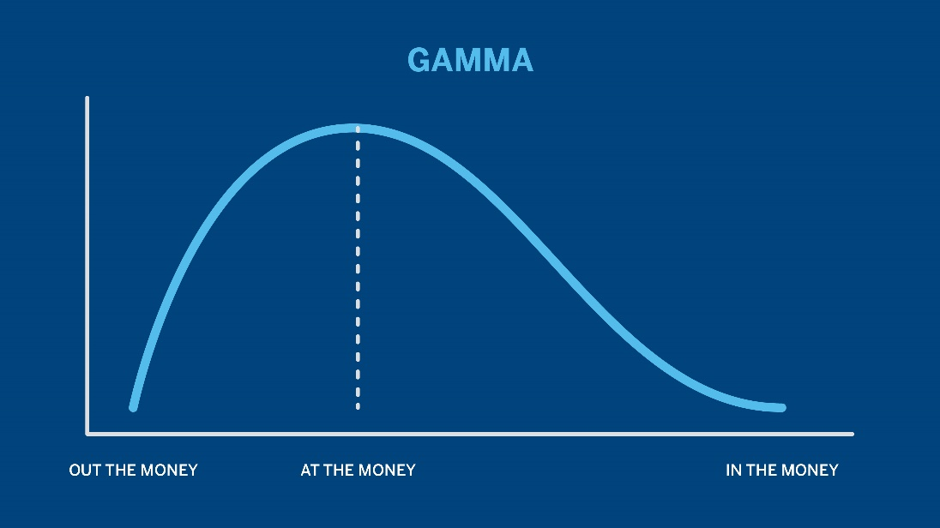
Greeks – Gamma
Gamma is the Change in the Price of an Option Relative to a change in delta.
Notes:
Just derivative of delta graph

Slide 19
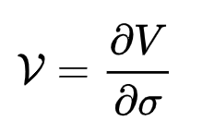
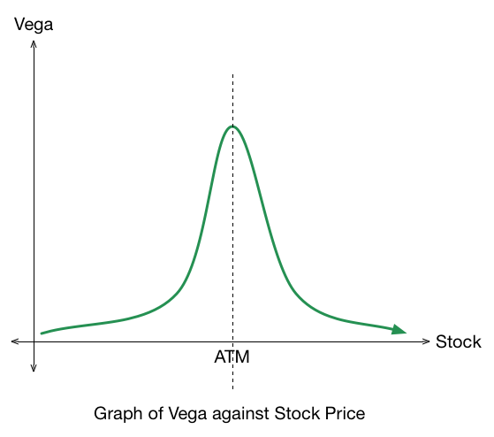
Greeks – Vega
Vega is the Change in the Price of an Option Relative to a 1% change in volatility.

Slide 20
Get in Touch
Feel free to reach out to us over Facebook or email if you have any questions
www.quantfsnyu.com
quantfsnyu@gmail.com
President – Daniel Shahab Diaz (daniel.diaz@stern.nyu.edu)
Vice-President – Jessica Wu (jessica.wu@stern.nyu.edu)
Co – Head of All Portfolios – Vishwakrit Choradia (vc1484@stern.nyu.edu)
Co – Head of All Portfolios – Austin Tang (austin.tang@stern.nyu.edu)

