Slide 1
Options 201

Slide 2
Brainteaser!
I'm driving out to a resort, which is pretty far away. Luckily, the first three quarters of the distance is all highway driving, but I have to drive the rest on slower local roads. I drive at 60 mph on the highway, but only 20 mph on local roads. What's my average speed for this trip?

Slide 3
Answer:
You might think you can just take a weighted average of the two speeds, and conclude the answer is just $\frac{3}{4}×60+ \frac{1}{4}×20=50$ mph, but that’s not correct! This is because average speed is calculated by averaging speed over time, not over distance.
Solution:
Let x be the total distance to the resort. The time you spend on the highway is $\frac{\frac{3}{4}x}{60}= \frac{x}{80}$ hours, and the time you spend on the local roads is $\frac{\frac{1}{4}x}{20}= \frac{x}{80}$ hours. Then your average speed is $\frac{x}{\frac{x}{80}+\frac{x}{80}}=40$ mph.

Slide 4
Key Definitions
Call Option
An agreement that gives the buyer the right, but not the obligation, to buy an underlying asset at a specified price within a specific time period
Put Option
An agreement that gives the buyer the right, but not the obligation, to sell an underlying asset at a specified price within a specific time period

Slide 5
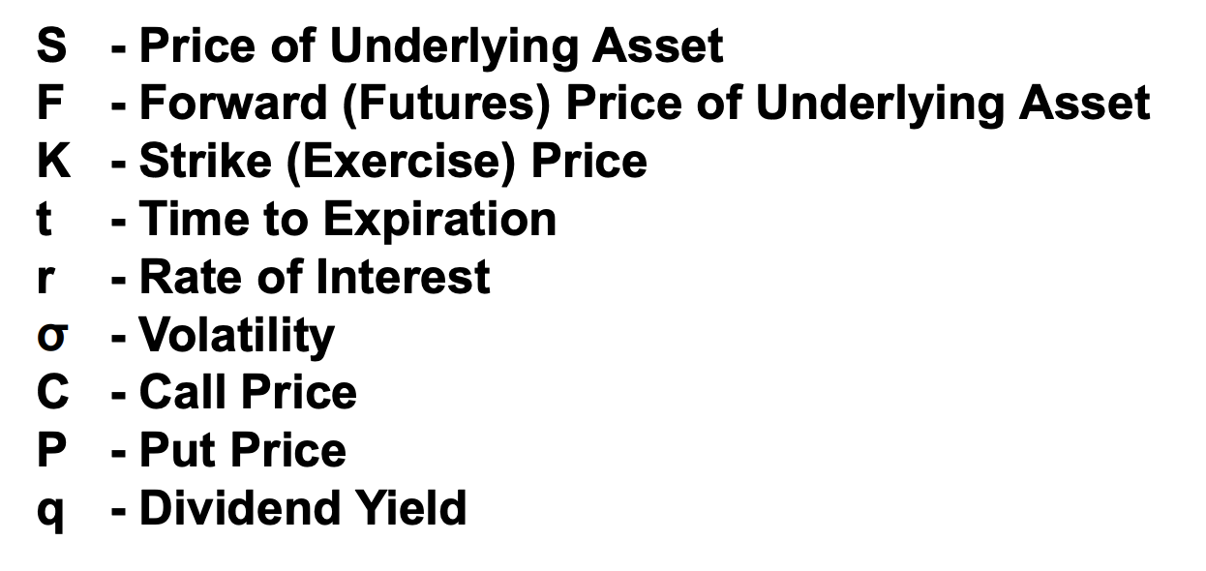
Other Key Terms To Know
What is the difference between the price of the underlying asset and the strike price?

Slide 6
2 Types of Options
American Options – buyter can exercise option early
European Options – buyer cannot exercise option early and has to wait until expiration

Slide 7
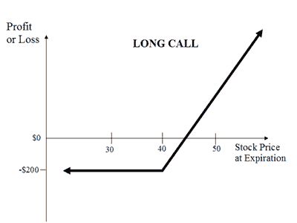
Payoff Diagram For Buying A Call

Slide 8
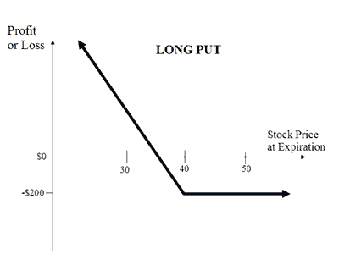
Payoff Diagram For Buying A Put

Slide 9
Early Exercise of American puts
American Options – buyer can exercise option early
Why would someone ever exercise their option early?

Slide 10
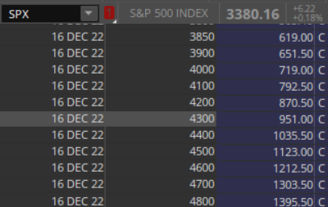
Option Pricing- ITM EUROPEAN PUT

Slide 11
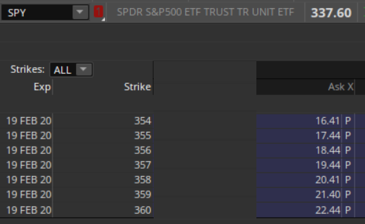
Option Pricing- itm american put

Slide 12
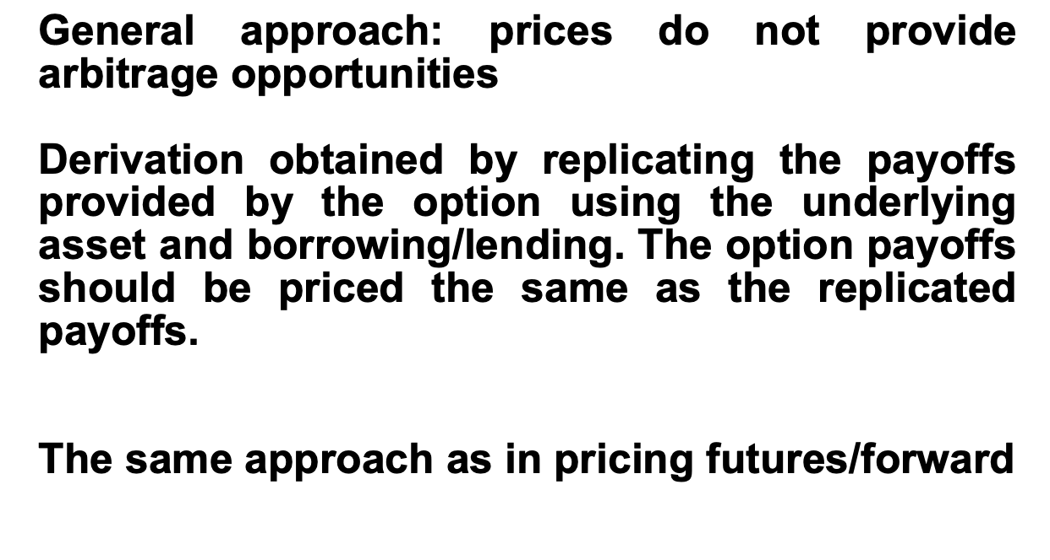
Put-Call Parity

Slide 13
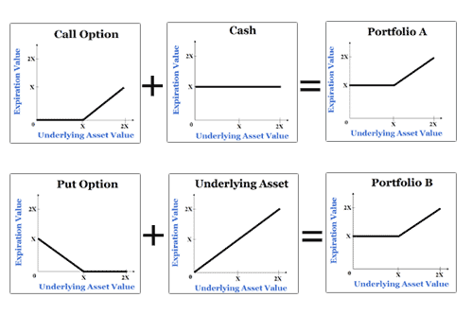
Put-Call Parity
Defines the relationship between the price of a European put and European call of the same class (same strike/underlying asset/expiration date)

Slide 14
Put-Call Parity
P + S = C + PV(K)
C = P + S – PV(K)

Slide 15
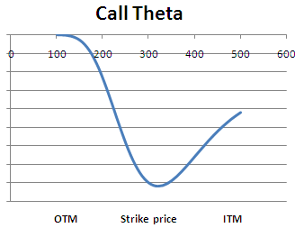
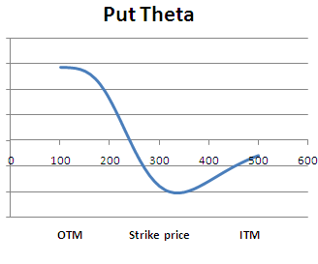
Theta
Change in value of option as you move closer to expiry (time decay)

Slide 16
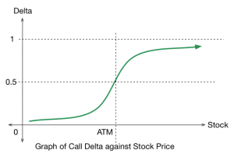
Delta
Change in price of option for every dollar movement in underlying

Slide 17
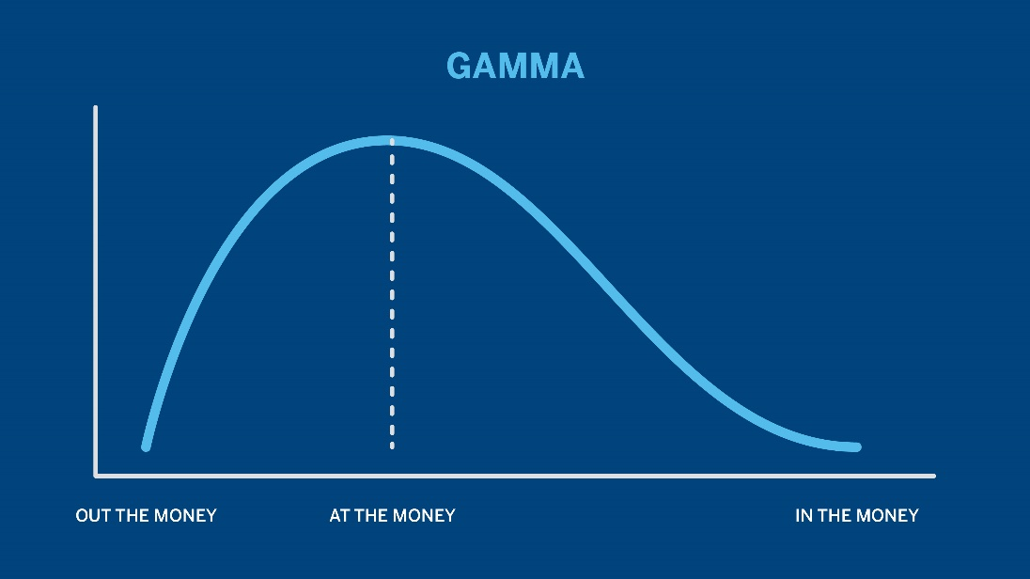
GAMMA
Second derivative of delta – measures rate of change in delta

Slide 18
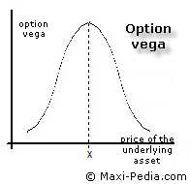
vega
Price sensitivity to 1% change in volatility of underlying

Slide 19
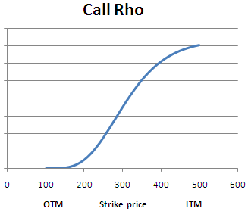
Rho
How sensitive options pricing is to interest rates

Slide 20
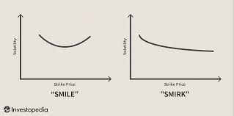
Volatility skew
Measures implied vol (demand) of options

