Slide 1
Intro to Macro and Fixed Income

Slide 2
Brain Teaser
Suppose you’re playing a game where the goal is to construct the best poker hand. You can either choose from a pile of 10 cards with which to construct this hand, or a pile of 8 cards and a pile of 9 cards, but cards from the 8 card and 9 card piles cannot be mixed. Would you rather have the pile of 10 cards or the piles of 8 and 9 cards?

Slide 3
Answer
You should choose the pile with 10 cards.
The key is to notice that more options means a higher probability of a better hand.
A 10 card pile yields: 10c5 possibilities = 252
A 9 card pile yields: 9c5 possibilities = 126
An 8 card pile yields: 8c5 possibilities = 56
Since 252 > 126 + 56 = 182, choosing the pile with 10 cards creates more possibilities of hands which increases the likelihood of having a better poker hand

Slide 4
Macro Investing
Analyzing broad market trends, political events, and global economies
Developing a view on how something should trade based on a well researched opinion
Identifying potential mispricings in different asset classes and trading on it

Slide 5
Review of Different Asset Classes
Forex (FX)
Rates
Fixed Income (Bonds)
Derivatives
Commodities
Equity Indices

Slide 6
Overview of Cur rency Markets
What drives currency movements?
Supply and Demand
Think of currencies appreciating and depreciating against each other (relative valuation)
Importance of currencies : Use currencies to trade a lot of other ideas
For example: how would you invest in a South African bond (denominated in ZAR)?
Risk-Off Currencies: Currencies that perform well in environments where investors/traders are more focused on protecting capital
Risk-On Currencies: Currencies that tend to outperform when risk appetite is high
What are some examples of risk-off currencies? risk-on currencies?

Slide 7
Cur rency Trade Over view
How are currencies quoted?
USD/JPY (USD is the base currency, JPY is the quote/counter currency)
Buying one currency, selling the other (long/short pair)
Make money when currency appreciates or depreciates

Slide 8
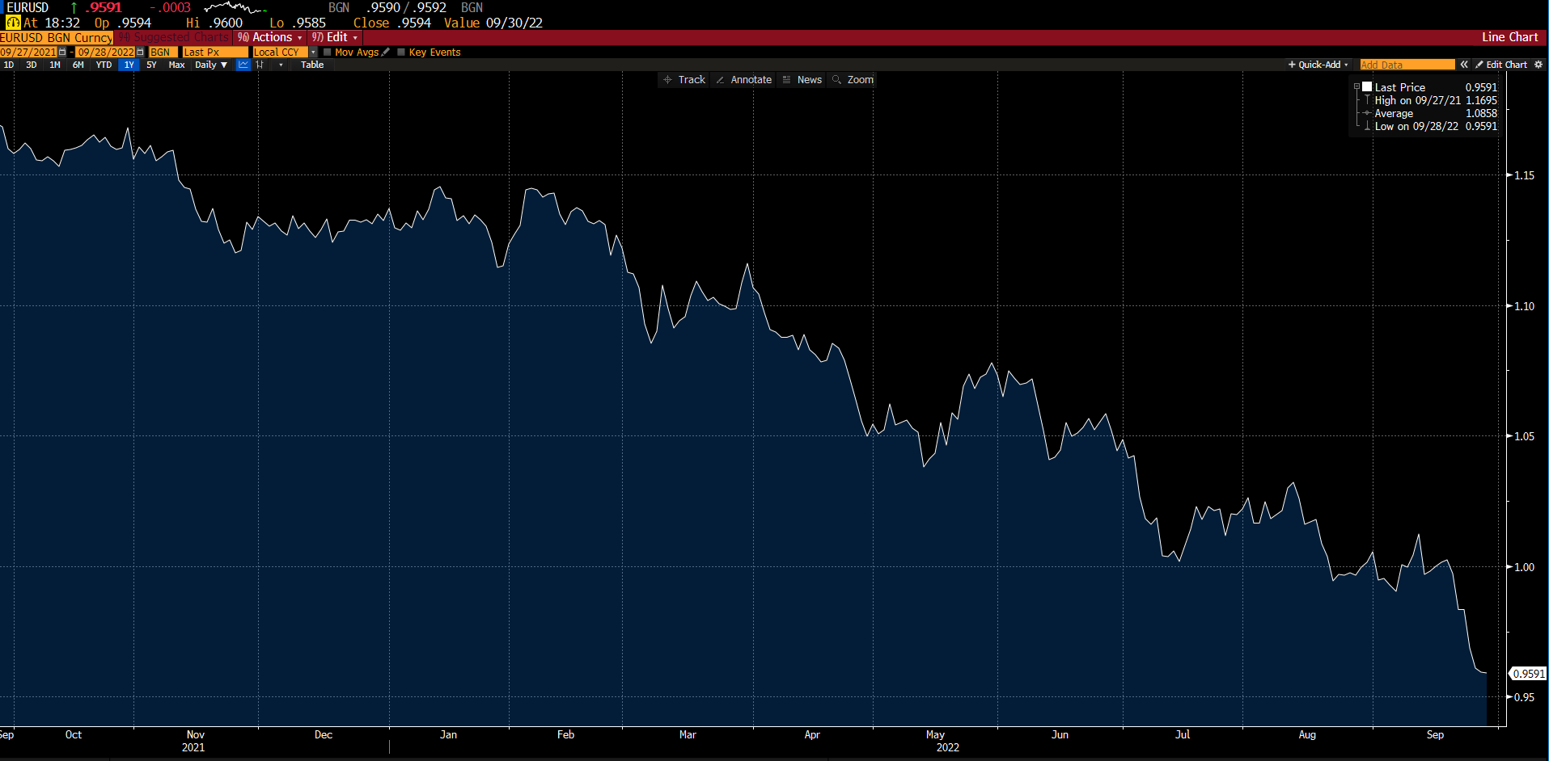
Thought Exercise : EUR/USD
What do you think drives people to buy the US Dollar right now ?
Why would people short the EUR ?
Do you think this is a good trade?

Slide 9
Overview of Commodities
Moves on supply and demand and expectations of supply and demand disruptions
Typically trade commodities through futures
Commodity futures contracts are a standardized agreement to buy/sell a predetermined amount of commodities at a specific price on a specific date on the future
Commodity futures are composed of speculators and hedgers – hedgers post less margin than speculators

Slide 10
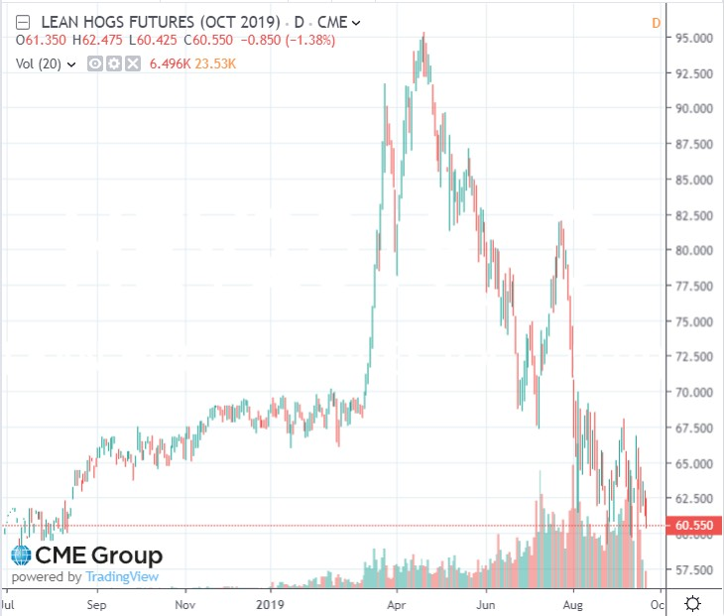
Commodities Continued
China orders less hogs than expected
Announcement of swine fever epidemic in China
Expectations of increased Chinese buying

Slide 11
Overview of Fixed Income Markets
Relationship between bond price and yield
Indicator of capital flows in a country
Moves on economic data, geopolitical events, central bank policy changes
Good reflection of “risk” priced into a country

Slide 12
Why would people buy US Treasuries?
Return ?
Risk profile ?
How do people interpret the Treasury yield?

Slide 13
What is a bond?
Face Value/Par: Value of a bond at maturity
Principal: Exclusive of coupon and interest
Coupon: semi-annual/annual payments from a bond
Yield to Maturity(YTM): Total annualized return anticipated on a bond held to maturity
Premium
Discount

Slide 14
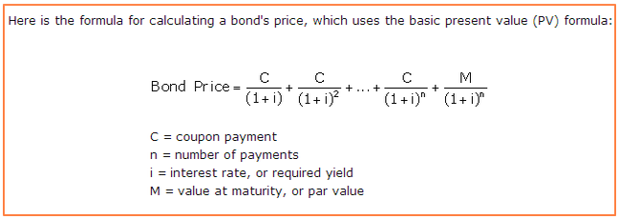
Bond Pricing

Slide 15
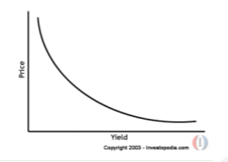
Bond Prices and Yields
Inverse relationship between bond price and bond yield

Slide 16
How to Value a Zero Coupon Bond vs Coupon Bond
1 year ZCB pays out principal of 100. Assuming a discount rate of 5%, what should that bond be worth today?
2 year coupon bond pays interest annually of 4% of 100 principal. Assuming discount rate of 5% what should bond be worth today?
Learning
Investing
Community

Slide 17
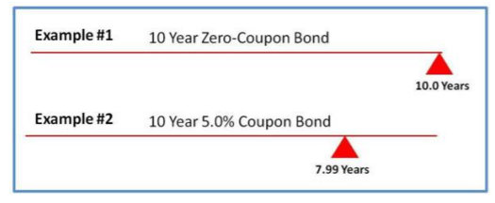
Duration Intuition
Can be considered approximation of average payback period of bond

Slide 18
Duration
Is duration higher for a 5 year ZCB or a 10 year ZCB?
Is duration higher for a 1 year bond that pays a 5% or 10% interest rate?

Slide 19
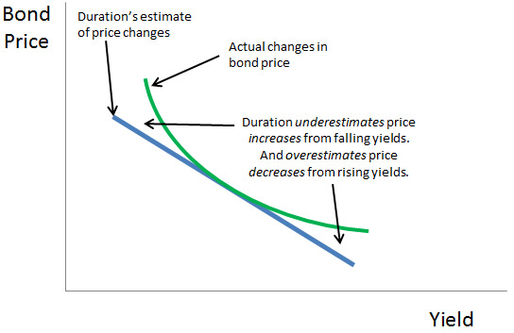
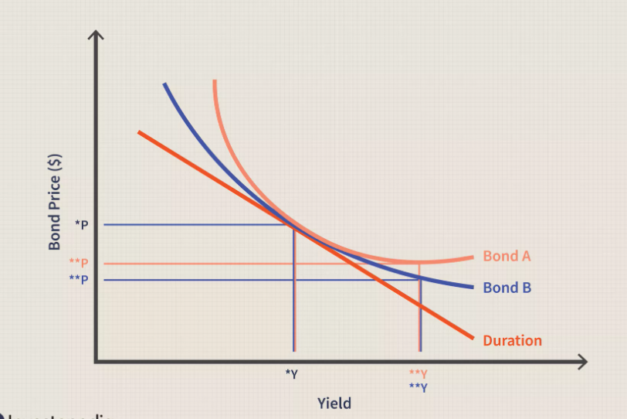
Convexity
Convexity measures change in duration as interest rates change

Slide 20
What Effects Interest Rates?
Fischer Equation: Nominal rates = real + inflation expectations
Central Bank
Credit/Default Risk
Term premium (risk premium)
Demand for asset

Slide 21
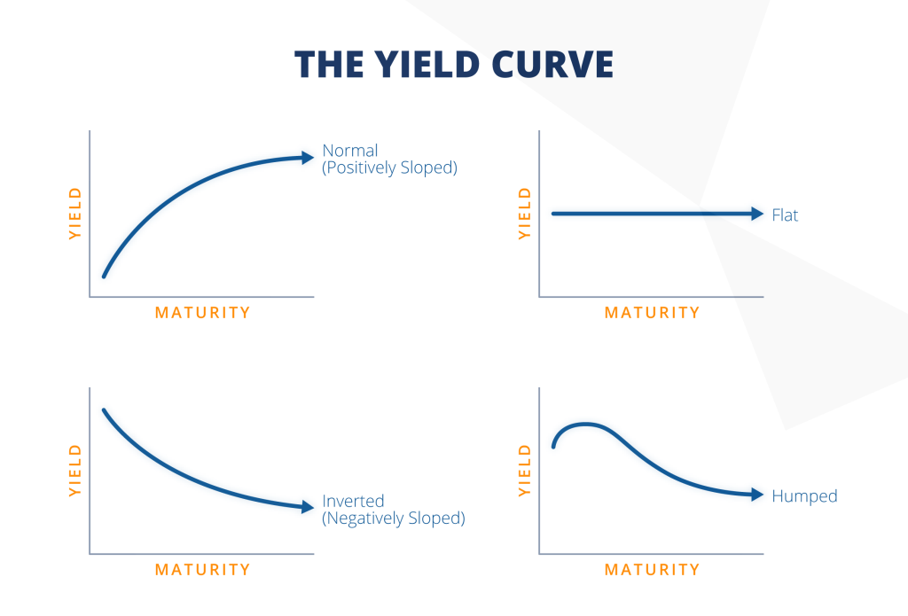
Yield Curve
Plots yields of bonds across different maturities
When can it be upward sloping? Downward sloping? Flat?

Slide 22
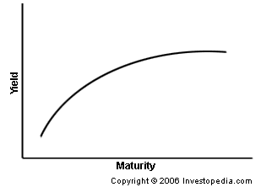
Trading Bonds: Steepener
Long near end of the yield curve – yields go down
Short far end of the yield curve - yields go up
Cost of the trade
What would a flattener be?

Slide 23
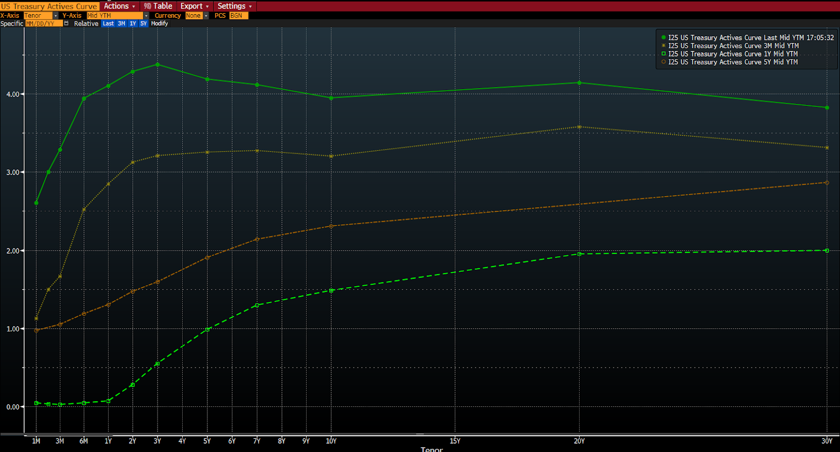
Treasury Yield Curve

Slide 24
TIPS
Treasury Inflated Protected Securities
How it works:
Interest Payments increase with increases in inflation
Example :
Principle : 100
Interest: 5%
CPI inflation measure: 2%
Interest: (100*1.02) *0.05
Nominal vs. Real Returns – Which is this?
When would you want to own TIPS?

Slide 25
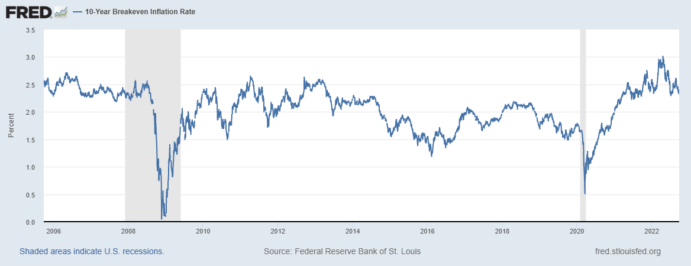
Breakeven Inflation : Market Expectations
Difference in yield of TIPS and US Treasury

Slide 26
Fun & Famous Macro Trades!

Slide 27
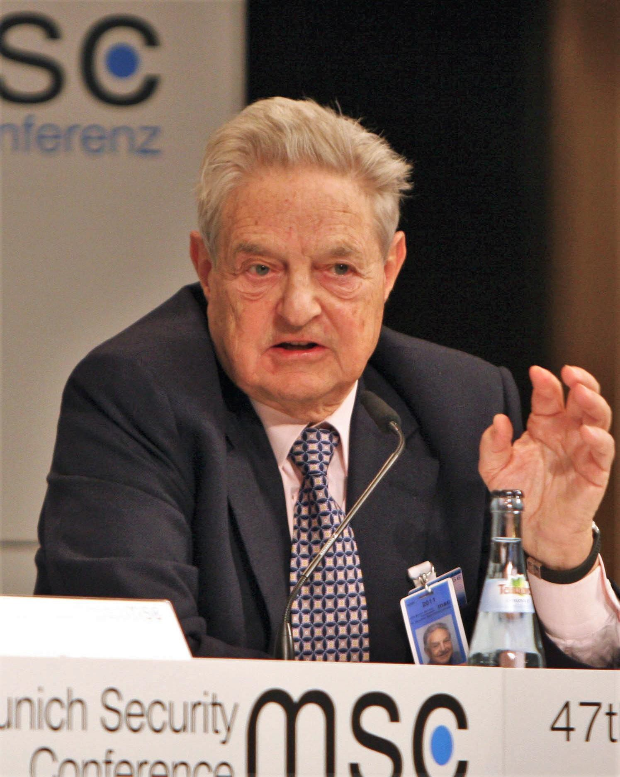
How George Soros Broke the Bank of England ( 1992 )
British pound was pegged to German mark as apart of Europe’s
Exchange Rate Mechanism System
Germany was stronger economically than Britain➔ German mark should have been fundamentally stronger
To keep up with German economy, the BoE set high interest rates and the UK economy had very high inflation
Soros, along with other speculators realized the Bank of England could not keep their currency tied to the mark and started shorting the currency (Soros borrowed a lot of money to establish a large
position)
In response, BoE raised interest rates to strengthen currency)
Eventually British government realized they couldn’t keep up with
short sellers and was forced to devalue the pound
Moral of the story : Soros made a LOT of money $$$$$

Slide 28
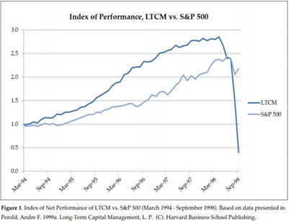
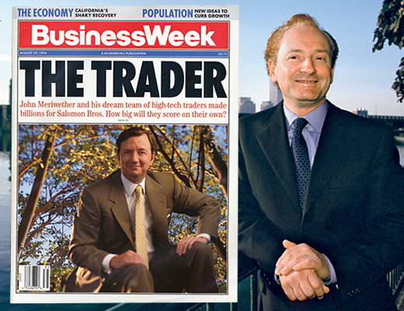
LTCM Convergence Trades

Slide 29
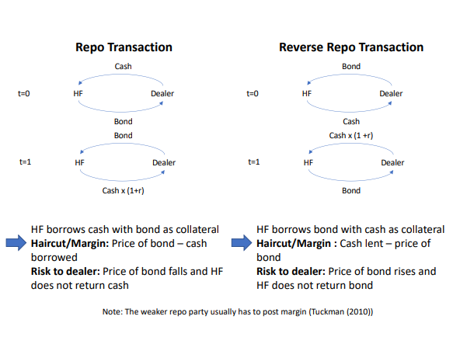
Repo and Reverse Repo Transactions

Slide 30
Treasury Convergence Trade

Slide 31
Treasury Convergence Trade

Slide 32
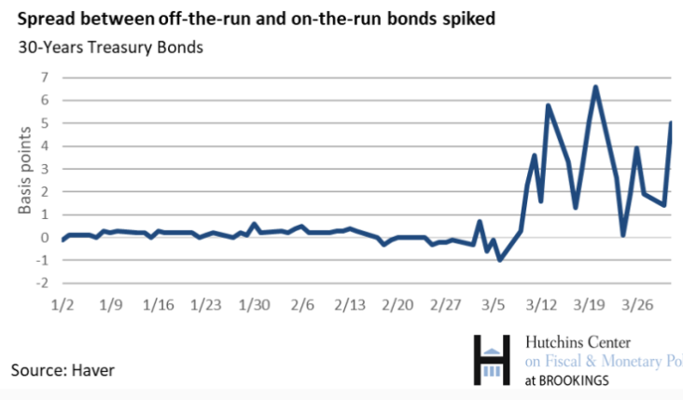
Spreads widened during Coronavirus

Slide 33
Get in Touch
Feel free to reach out to us over Facebook or email if you have any questions
www.quantfsnyu.com
quantfsnyu@gmail.com
President – Daniel Shahab Diaz (daniel.diaz@stern.nyu.edu)
Vice-President – Jessica Wu (jessica.wu@stern.nyu.edu)
Head of All Portfolios – Michael Lu (michael.j.lu@stern.nyu.edu)

