Slide 1
Intro to Macro and Bonds

Slide 2
Brain Teaser
There is a lightbulb inside a closet. The door is closed and you cannot see if the light is on or off through the door. However, you know the light is off to start.
Outside the closet, there are 3 light switches.
One of the door light switches controls the lightbulb in the closet. You can flip the switches however you want, but once you open the door, you can no longer touch the switches.
How do you figure out without a doubt which of the three light switches controls the light?
Learning
Investing
Community

Slide 3
Solution: Brain Teaser
Flip switch 1 for a few minutes.
Then turn it off. Flip switch 2.
Open the closet door.
If the light is on, its switch 2. If the bulb is a little warm, its switch 1. And if it’s cold, its switch 3.
Learning
Investing
Community

Slide 4
Macro Investing
Analyzing broad market trends, political events, and global economies
Developing a view on how something should trade based on a well researched opinion
Identifying potential mispricing's’ in different asset classes and trading on it

Slide 5
Review of Different Asset Classes
Forex
Rates
Fixed Income (Bonds)
Derivatives
Commodities
Equity Indexes
As a portfolio, we look at all classes, but most of our trades involve fixed income (bonds) and forex

Slide 6
Over view of Fixed Income Markets
Relationship between bond price and yield
Indicator of capital flows in a country
Moves on economic data, geopolitical events, central bank policy changes
Good reflection of “risk” priced into a country

Slide 7
Why would people buy US Treasuries?
Return ?
Risk profile ?
How do people interpret the Treasury yield?

Slide 8
Over view of Cur rency Markets
What drives currency movements?
Supply and Demand
Think of currencies appreciating and depreciating against each other (relative valuation)
Importance of currencies : Use currencies to trade a lot of other ideas
For example: how would you invest in a bond ?

Slide 9
Cur rency Trade Over view
How are currencies quoted?
USD/EUR (base currency- currency against which exchange rates are generally quoted
Buying one currency, selling the other (long/short pair)
Make money when currency appreciates or depreciates

Slide 10
Thought Exercise : USD/ EUR
What do you think drives people to buy the US Dollar right now ?
Why would people short the EUR ?
Do you think this is a good trade?

Slide 11
Over view of Commodities
Moves on supply and demand and expectations of supply and demand disruptions
Which do you think matters more- supply or demand?
Trade commodities through futures typically
What are other assets exposed to commodity prices ?

Slide 12
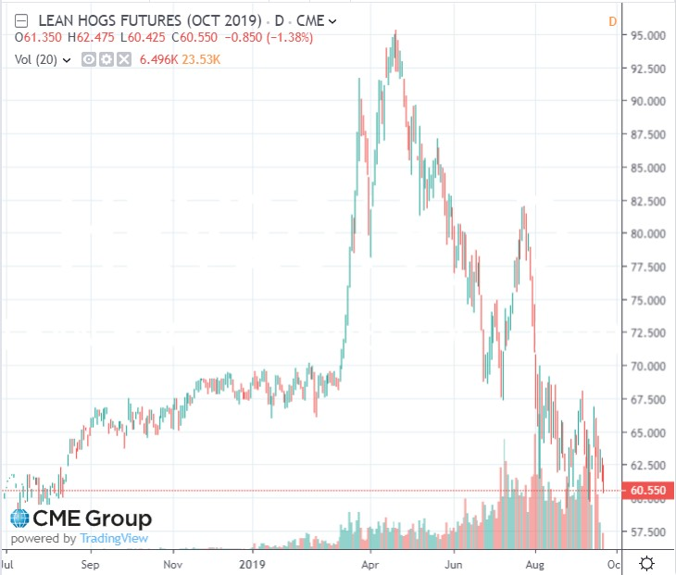
Commodities Continued
China orders less hogs than expected
Announcement of swine fever epidemic in China
Expectations of increased Chinese buying

Slide 13
Fun & Famous Macro Trades!

Slide 14
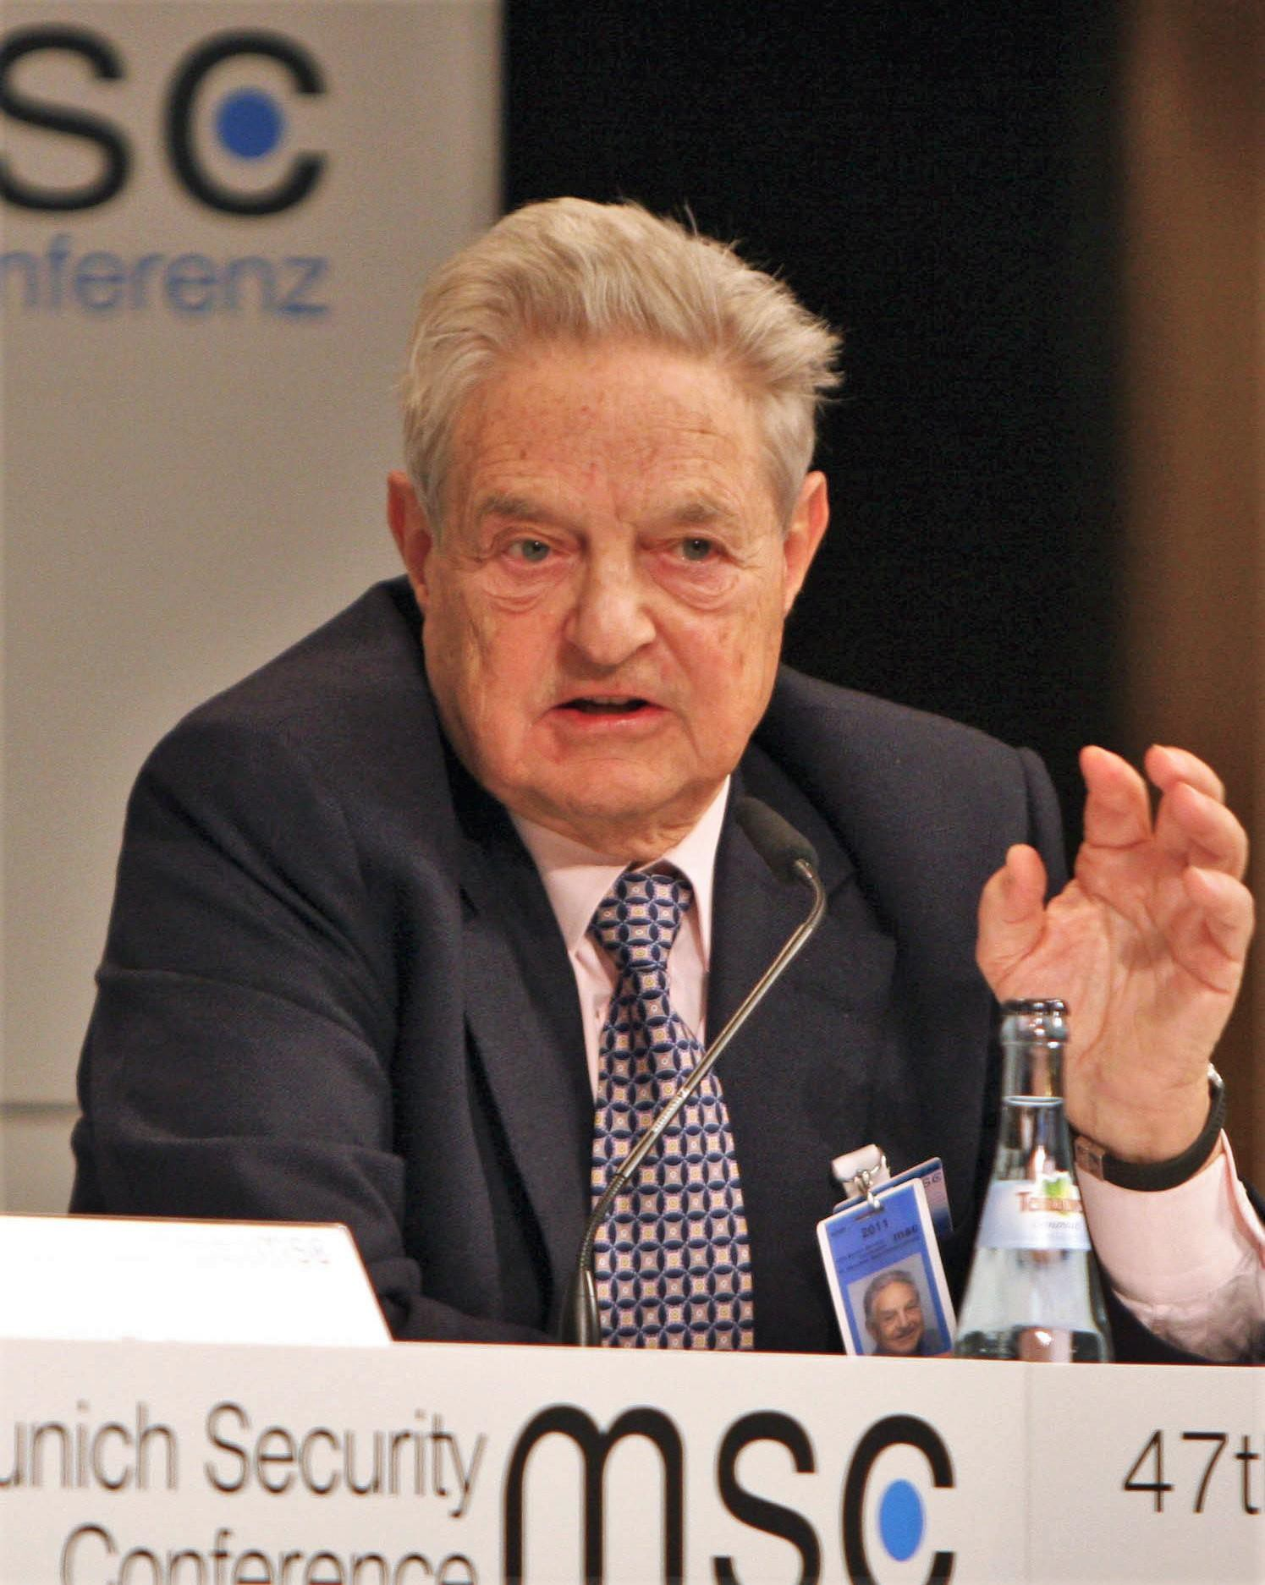
How George Soros Broke the Bank of England ( 1992 )
British pound was pegged to German mark as apart of Europe’s
Exchange Rate Mechanism System
Germany was stronger economically than Britain➔ German mark should have been fundamentally stronger
To keep up with German economy, the BoE set high interest rates and the UK economy had very high inflation
Soros, along with other speculators realized the Bank of England could not keep their currency tied to the mark and started shorting the currency (Soros borrowed a lot of money to establish a large
position)
In response, BoE raised interest rates to strengthen currency)
Eventually British government realized they couldn’t keep up with
short sellers and was forced to devalue the pound
Moral of the story : Soros made a LOT of money $$$$$

Slide 15
How George Soros Broke the Bank of Thailand( 1997 )
Asian Financial crisis- begins with the fall of the Thai baht and financial crisis in Thailand
Before the Asian Financial Crisis of 1997, Thai baht was pegged to USD.
USD kept getting stronger and stronger, and the Thailand government was encouraging banks and large companies to borrow US dollars without hedging their exposure
The central bank of Thailand couldn’t maintain the peg eventually because they were running out of reserves to defend the peg and didn’t have enough dollars to pay their debt
Central bank tried to raise rates and restrict speculation, but it still wasn’t enough
Soros realized that something of this magnitude could happen and shorted 1bn of the Thai baht
VS.

Slide 16
What is a bond?
“Fixed Income”
Price of a bond
Interest
Principal
Zero Coupon vs. Coupon

Slide 17
Bond Terminology
Face Value
Principal
Coupon
Yield
Premium
Discount
Par

Slide 18
Time Value of Money
“A dollar today is worth more than a dollar tomorrow”
Why?

Slide 19
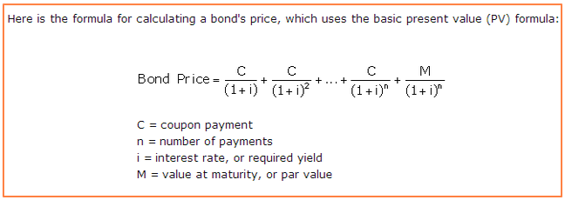
Bond Pricing

Slide 20
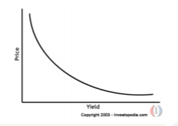
Bond Prices and Yields
Inverse relationship between bond price and bond yield

Slide 21
How to Value a Zero Coupon Bond vs Coupon Bond
1 year ZCB pays out principal of 100. Assuming a discount rate of 5%, what should that bond be worth today?
2 year coupon bond pays interest annually of 4% of 100 principal. Assuming discount rate of 5% what should bond be worth today?
Around $98
Learning
Investing
Community

Slide 22
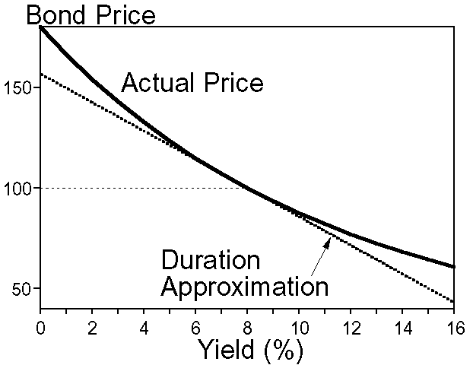
Duration
1st derivative of a yield curve
Intuition: Change in price of a bond for a 1% change in the interest rate

Slide 23
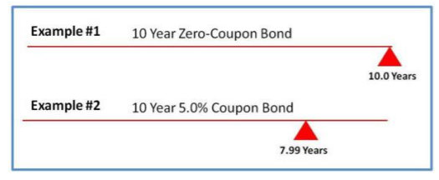
Duration Intuition
Can be considered approximation of average payback period of bond

Slide 24
Duration
Is duration higher for a 5 year ZCB or a 10 year ZCB?
Is duration higher for a 1 year bond that pays 5% interest or 10% interest?

Slide 25
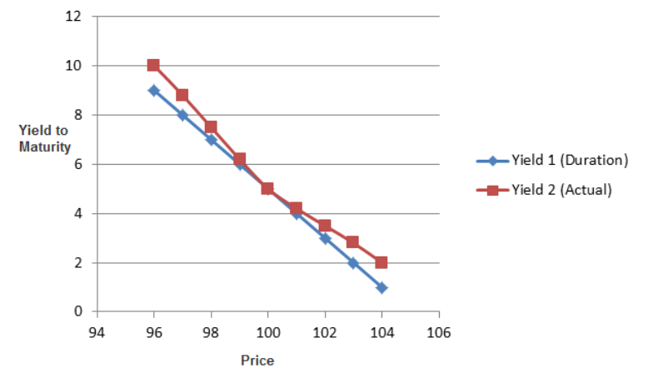
Benefits of Duration / Issues with Duration
For hedging
Limits exposure to changing rates
But, not perfect (other methods for estimating this sensitivity)

Slide 26
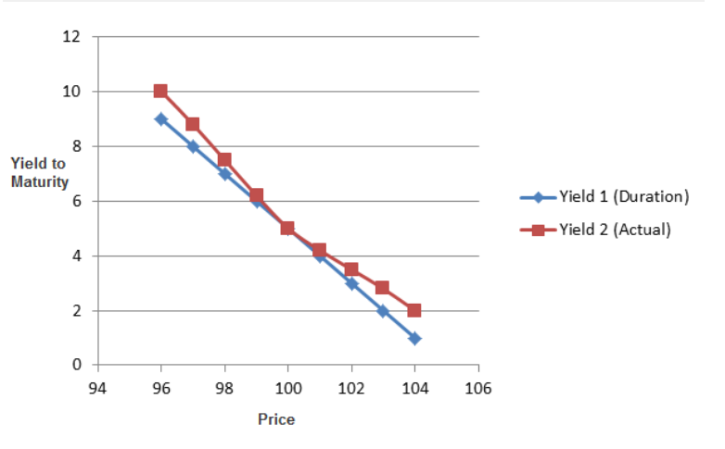
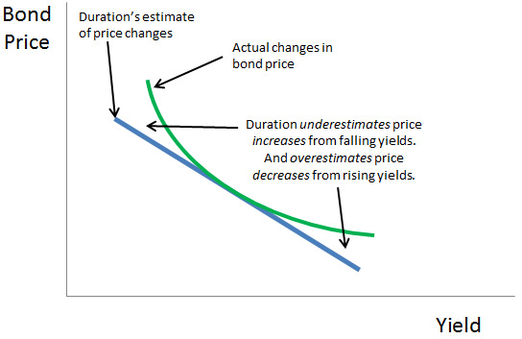
Convexity
Convexity measures change in duration as interest rates change
Differential between linear duration measure and actual price change

Slide 27
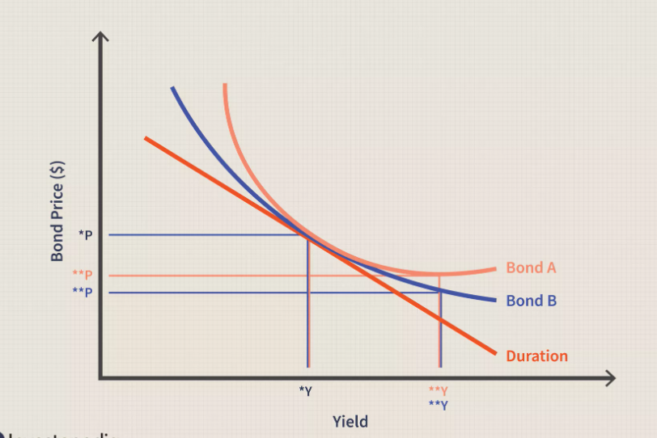
Convexity

Slide 28
What Effects Interest Rates?
Fischer Equation: Nominal rates = real + inflation expectations
Central Bank
Credit/Default Risk
Term premium (risk premium)
Demand for asset

Slide 29
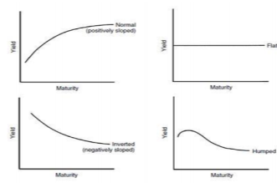
Yield Curve
Plots yields of bonds across different maturities
When can it be upward sloping? Downward sloping? Flat?

Slide 30
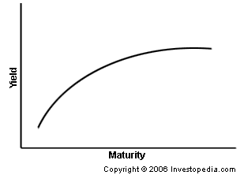
Trading Bonds: Steepener
Long near end of the yield curve – yields go down
Short far end of the yield curve - yields go up
Cost of the trade
What would a flattener be?

Slide 31
Steepener Trade
When would we use this?
Duration hedging during bond trades
Difficulties of trade – curves rarely steepen

Slide 32
TIPS
Treasury Inflated Protected Securities
How it works:
Interest Payments increase with increases in inflation
Example :
Principle : 100
Interest: 5%
CPI inflation measure: 2%
Interest: (100*1.02) *0.05
Nominal vs. Real Returns – Which is this?
When would you want to own TIPS?

Slide 33
Breakeven Inflation : Market Expectations
Difference in yield of TIPS and US Treasury
What investors expect inflation to be
What do you think has happened to the spread in yields over time?

Slide 34
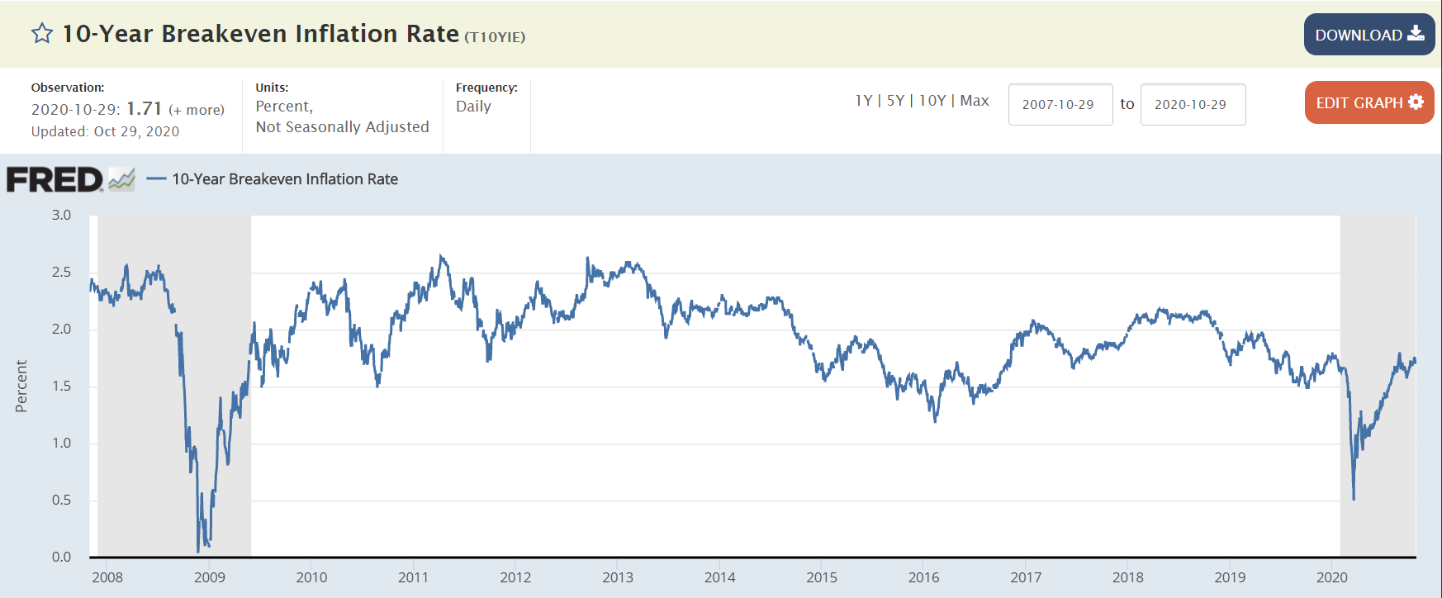
Breakeven Inflation : Market Expectations

Slide 35
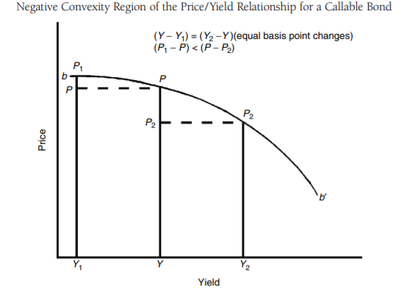
Fabozzi Charts

Slide 36
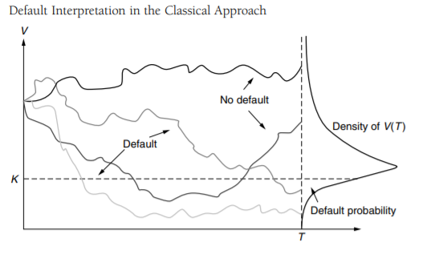
Fabozzi Charts

Slide 37
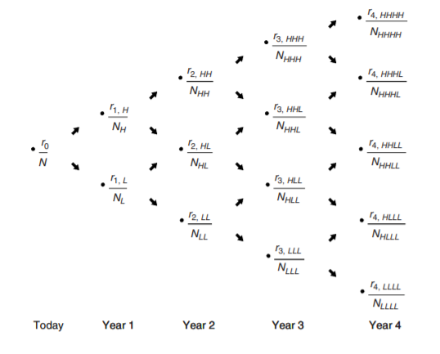
Fabozzi Charts

Slide 38
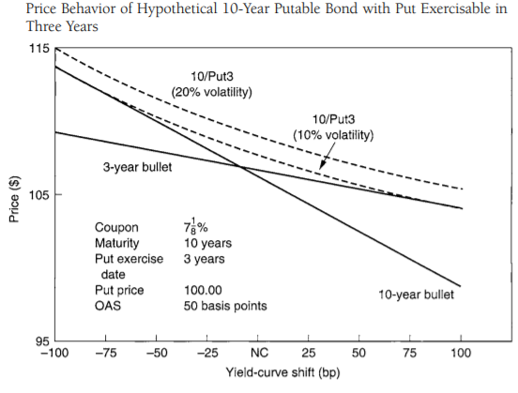
Fabozzi Charts

Slide 39
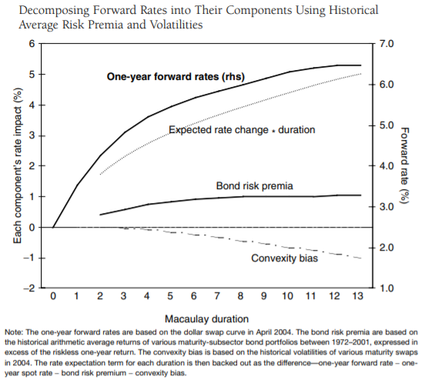
Fabozzi Charts

Slide 40
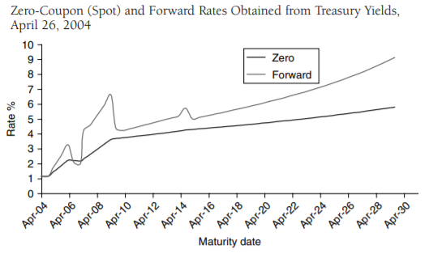
Fabozzi Charts

Slide 41
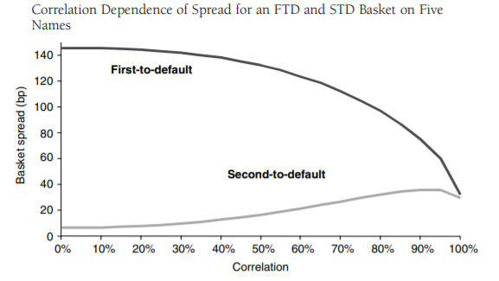
Fabozzi Charts

Slide 42
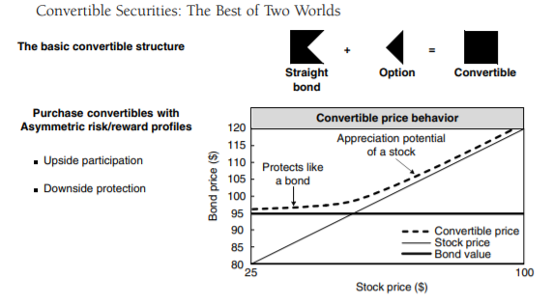
Fabozzi Charts

Slide 43
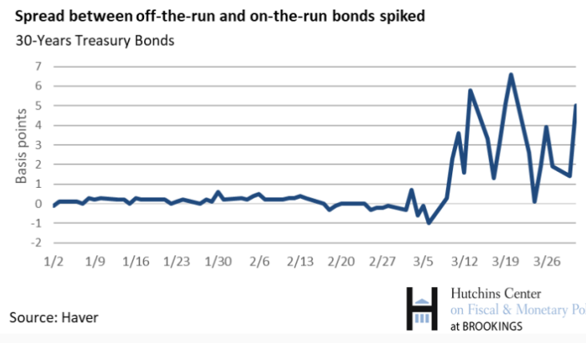
Few Final Things

Slide 44
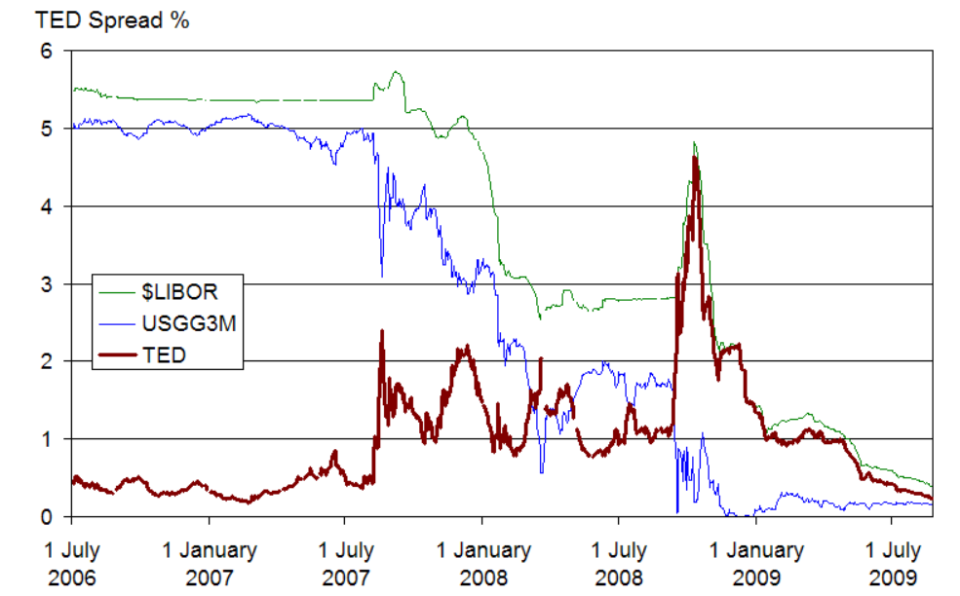
Few Final Things

