Slide 1
Intro to Financial Industry & Asset Classes

Slide 2
Brain Teaser
The mean, median, and range of a set of eight integers are all equal to 8. What’s the largest number that can be part of the set?

Slide 3
Solution: Brain Teaser
Solution: 14
Explanation: 16 can’t be the highest number, because the range is 8 and that would force all the numbers to be at least 8. If all the numbers are at least 8, with one 16, then the mean cannot be 8, so 16 (and above) doesn’t work.
15 cannot be the highest number. Since the mean is 8, this means the eight numbers sum to 8 * 8 = 64. If 15 is the highest number, then all the numbers in the set are at least 7, since the range is 8. If the sum of the set is 64, then the sum of the other seven numbers is 64-15=49. This means that all the other numbers in the set would be 7 if 15 was the highest number.
But {7,7,7,7,7,7,7,15} fails, because its median is 7, not 8.
14 does work; the set {6,6,6,8,8,8,8,14} satisfies the criteria.

Slide 4
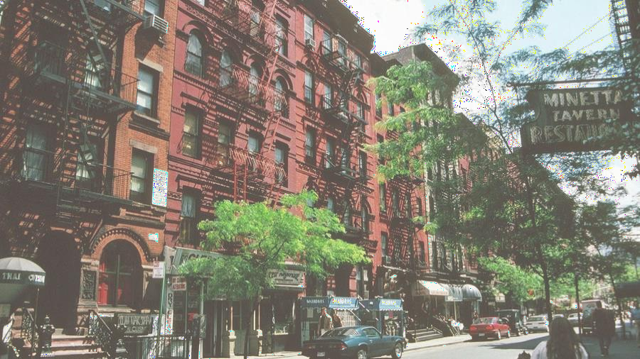
Mailing List
quantfsnyu.com

Slide 5
Por t folio Team Application
Timeline:
Opens on 9/25 at 9:00 AM
Closes on 10/1 at 9:00 AM
Eligibility: open to all NYU students
Application Process:
Fill in Google form (admin details & portfolio preference)
Submit your application responses as a PDF/Word
All instructions will be on the front page of our website, and emailed to everyone on our mailing list

Slide 6
Open House
Time:
Wednesday, 9/29 at 7:00 PM
Location: TBD
Investment Pitches:
Each portfolio team will present a pitch to give you more insights on what our portfolios focus on & their investment strategies
You are encouraged to participate during the pitches and ask any questions you may have
You will also get a chance to talk to members of the portfolio team and learn more about what they do

Slide 7
Expectations
Ask
Par t i c ipate
Lear n

Slide 8
What is a Financial Market?
Market is a mechanism where goods are transferred from people who have them, to people who need them, for a price
Capital markets are where capital (money) is transferred from people who have it (investors) to people who need it (issuers)
Capital markets consist of the primary market (new securities are issued and sold) and secondary market (already-issued securities are traded between investors)

Slide 9
What is a Financial Market?
What are two types of capital you can raise?

Slide 10
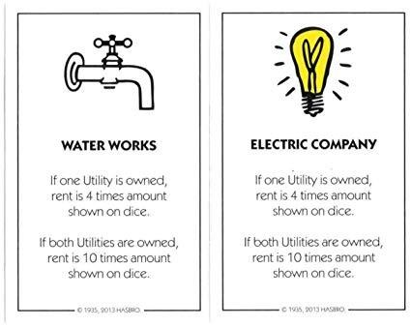
How Does Money Flow?
Investors Issuers
Capital
Return
Have spare capital
Require capital

Slide 11
How Does a Bank Make Money?
How many people here have a credit or debit card with Chase?
How does Chase make money?

Slide 12
Breaking Down an Investment Bank
Customer Facilitation
Investment Banking: Facilitate the buying and selling of businesses
Sales & Trading: Making markets for clients
Asset & Risk Mana gement
Private Wealth Management: Invest on behalf of wealthy individuals
Asset Management: Invest on
behalf of institutional money / pensions
Commercial Banking: Lending and borrowing money
Mar ket
Intelligence
Market Research: Gather industry information and trade ideas (eg. Equity, Credit, and Macro Research)

Slide 13
Divisions Within Investment Banking
Merger s & Acquisitions
Equity Capital Mar ket
Debt Capital Mar ket
Restr ucturing
A d v i s e o n b u y i n g a n d
A d v i s e o n I P O s a n d s e c o n d a r y o f f e r i n g s
A d v i s e o n d e b t
r a i s i n g & r e f i n a n c i n g
A d v i s e o n s i t u a t i o n s
s e l l i n g o f b u s i n e s s e s
o f f i n a n c i a l d i s t r e s s

Slide 14
Other Players in the Financial Market
Buy-Side Investors
Central Banks
Regulators

Slide 15
Buy- Side Investors
Funds that purchase stocks, securities, and other financial products based
on the needs and strategy of their company’s or client’s portfolio needs.
Make direct investments in public and private markets, rather than just assist the investing market with recommendations (sell-side)
Vary in size – can range from $50 million to $5 trillion
Examples:
Hedge Funds
Private Equity
Venture Capital

Slide 16
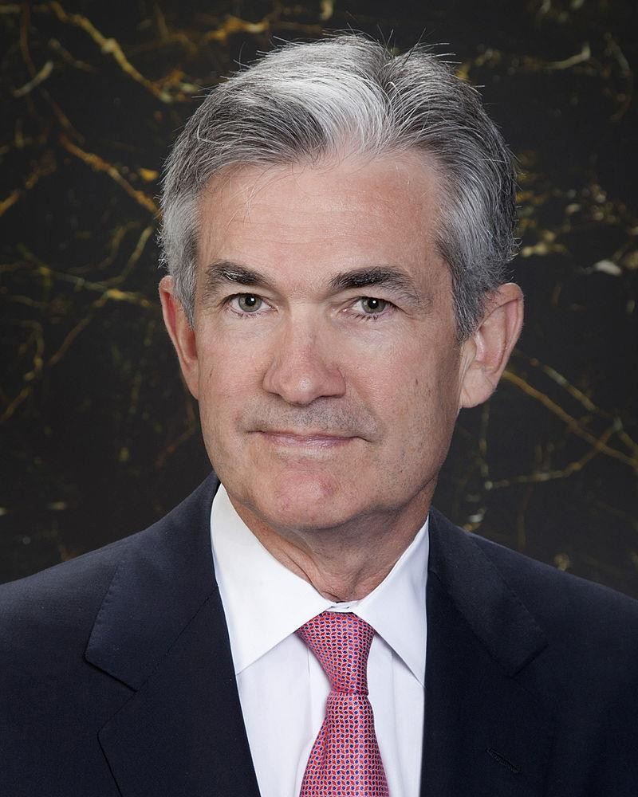
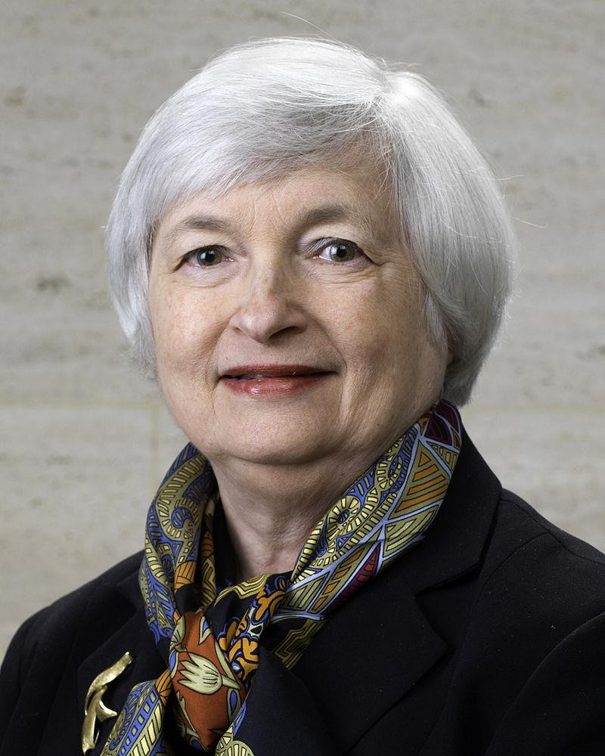
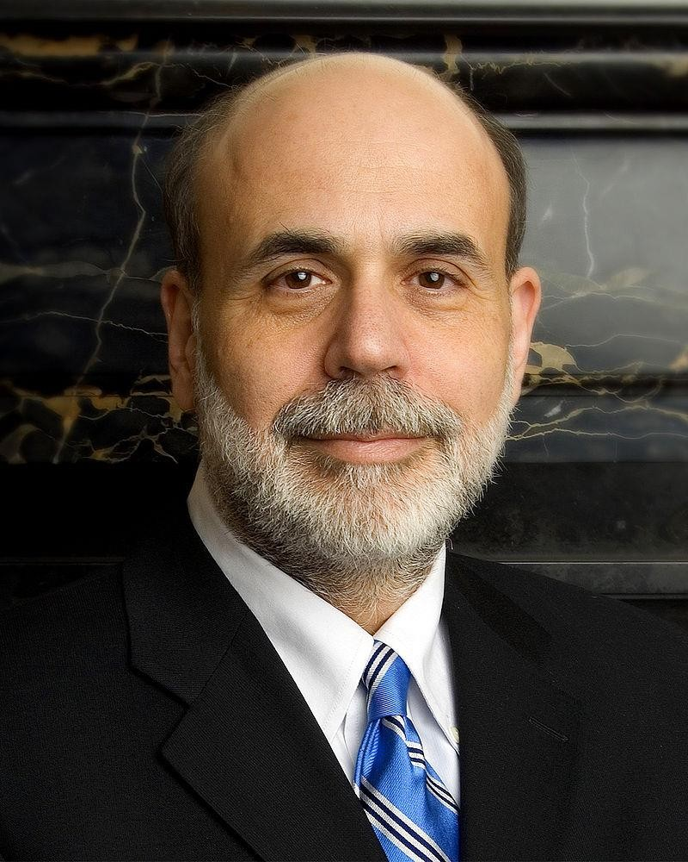
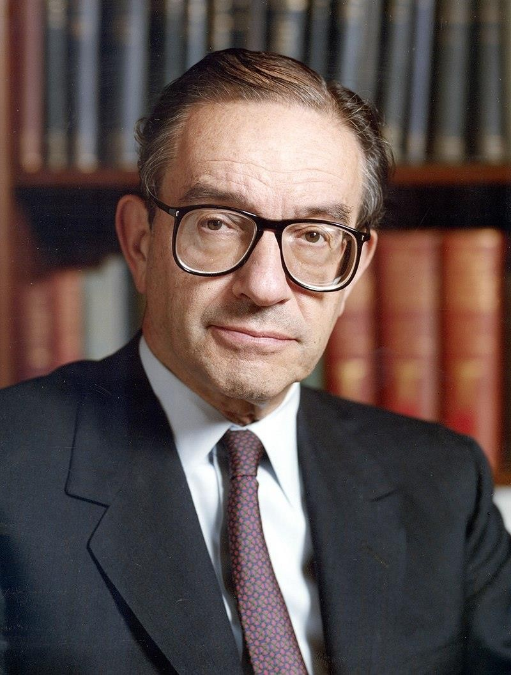
Central Banks

Slide 17
Central Banks
An independent national authority that conducts monetary
policy, regulates banks, and provides financial services including economic research
Central Banks have the important role of setting the interest rate so as
to manage economic growth, inflation, and the country’s exchange rate
What is the dual mandate of the Fed?
What are some examples of Central Banks outside of the US?

Slide 18
Regulators
The objectives of financial regulators are to maintain market confidence, ensure financial stability, and provide consumer protection
There are many different types of regulators – eg. Securities and Exchange Commission (SEC), Financial Industry Regulatory Authority (FINRA), Commodity Futures Trading Commission (CFTC), etc.

Slide 19
Asset Classes
Grouping of investments that exhibit similar characteristics, behave similarly to one another, and are subject to the same laws and regulations
Equity
Fixed Income
Commodities
Currencies
Derivatives

Slide 20
Equity
A share of stock is basically a piece of ownership in a corporation – entitles stockholder to that proportion of the corporation’s assets and earnings
Bought and sold predominantly on global stock exchanges (NYSE, NASDAQ, FTSE, TSE)
What does it mean to long or short a stock?
How do you short a stock?
ETFs (exchange-traded funds) – a collection of securities, such as stocks, that tracks an underlying index
Eg. S&P 500

Slide 21
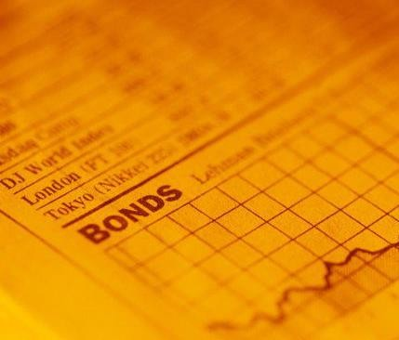
Fixed- Income
Investment security that pays investors fixed interest payments until its maturity date
Relates to credit (debt) of a company or a country
Eg. Give me $100 now, and I will pay out back the
$100 + extra compensation back (generally coupons from interest rate)
What’s an example of a fixed-income security that is common to households?
If you are deciding between investing in fixed- income asset versus equity, which one is usually safer? Which one do you think you should expect a higher return from?

Slide 22
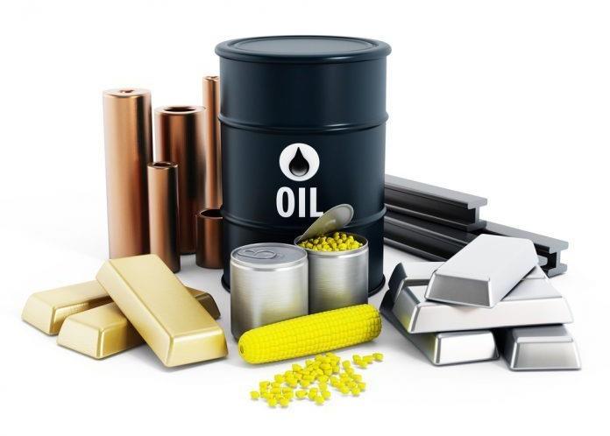
Commodities
Basic good used in commerce – most often used as inputs in the production of other goods
Agricultural:
Grains: corn, soybean, wheat
Softs: cocoa, coffee, sugar, frozen concentrated orange juice
Livestock: cattle, hogs
Metals:
Industrial: copper, aluminum, iron, nickel, zinc
Precious: gold, silver
Energy:
Oil: WTI, Brent
Distillates (Refined Products): heating oil, gasoline

Slide 23
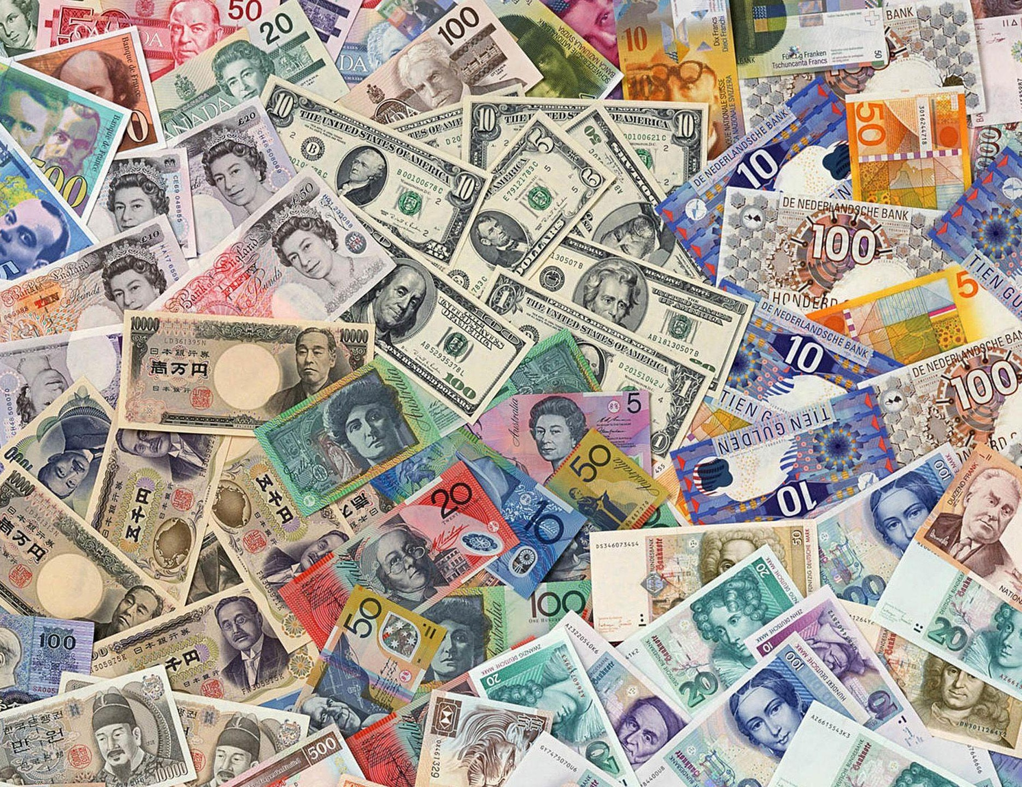
Cur rencies
Any country’s currency
Why do you need to pair two currencies when you make a trade?
Driven by many different factors, but broadly speaking, currencies are influenced by economic well-being, interest rates, and investor flows of money
Which market do you think is bigger? Global equity market or the foreign exchange market?

Slide 24
Derivatives
An asset that derives its value from the performance of an underlying entity
Ownership of derivative =/= ownership of an asset
Examples of derivatives
Futures
Options
Swaps
Credit Default Swaps
Does anyone know what caused the 2008 financial crisis?

Slide 25
Get in Touch
Feel free to reach out to us over Facebook or email if you have any questions
www.quantfsnyu.com
quantfsnyu@gmail.com
President – Ram Ramanathan (rer407@stern.nyu.edu)
Vice-President – Alex Poon (alex.poon@stern.nyu.edu)
Co – Head of All Portfolios – Connor Sheehy (connor.sheehy@stern.nyu.edu)
Co – Head of All Portfolios – Kevin Duan (skd359@stern.nyu.edu)

