Slide 1
Intro to Valuation

Slide 2
Brain Teaser
You have an 11-minute hourglass and a 7-minute hourglass. You need to measure exactly 15 minutes. How do you do it?
There’s more than one method, what is the most efficient one?

Slide 3
Solution: Brain Teaser
Answer:
First Method: Flip 11 and 7 at the same times, when 7 runs out, you start your time. After 4 minutes, the 11 runs out and you flip it, combined that is 15 minutes, but it took 22 total minutes to measure.
A faster method is to flip both, but then when the 7 runs out, flip it again. After 4 minutes, 11 total minutes have passed, if you flip the 7 again (4 minutes have passed since first flipped), you can now time 15 minutes in 15 minutes

Slide 4
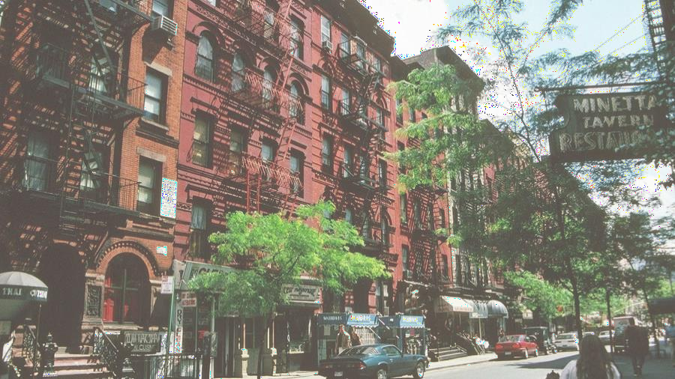
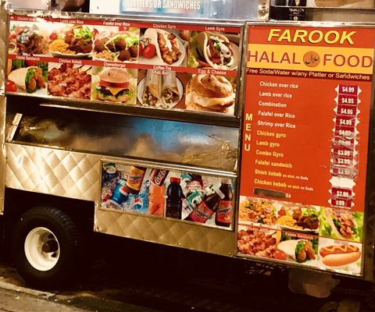
Thought Exercise
How much would you pay for Farook’s Halal cart? Walk us through how you would think about this.

Slide 5
What Is Valuation?
Determining how much a business is currently worth
Relies on assumptions of the business
Analyzes historical financials and projects future prospects
No exact number that everyone will agree on
Art, not a science

Slide 6
What are the primary types of valuation?

Slide 7
Types of Valuation
2 Major Types of Valuation
Relative Valuation
Values a company by comparing it to other similar companies in the same industry
Intrinsic Valuation
Values a company based on how much cash the business can generate

Slide 8
Relative Valuation

Slide 9
What Are You Comparing?
When doing relative valuation, we look for companies that are
In the same industry
Have similar business model / sell similar products
In the same geography
Around the same size

Slide 10
Thought Exercise
Back to the Farook’s:
What would you compare it to when trying to value it?

Slide 11
Thought Exercise
Back to the Farook’s:
What would you compare it to when trying to value it?

Slide 12
How Do You Compare?
Price that these other businesses are valued at
Eg. Halal Cart A store is valued at $100,000
Does this mean that Farook’s should also be valued at
$100,000?
If not, what are we missing?

Slide 13
Ear nings!
Companies from the same industry can have different levels of profitability that we need to consider
If Halal Cart A makes $10,000 of earnings, and Farook’s makes $50,000, but they are both valued at $100,000 – is this fair?
Just based on this, which one would you rather invest in?
Why do you think we can see such a drastic difference between two companies in the same industry?

Slide 14
What is a Valuation Multiple?
A ratio of A/B
A is usually defined as price or value of the business
B is a financial metric of the company (Revenue, Earnings,
etc…)
Price / Net Earnings (P/E Ratio) is the most well-known multiple, but another valuation multiple is much more common

Slide 15
EV/ EBITDA
One of the most used multiples in relative valuation
Numerator: Enterprise Value
Value of the core operating assets of the business
EV = Equity Value + Debt – Cash
Considers both the debt and equity investors of a business
Denominator: EBITDA
Earnings Before Interest, Tax, Depreciation, and Amortization

Slide 16
Example
Halal Cart A
EV = $100
EBITDA = $20
EV/EBITDA = ?
Farook’s
EBITDA = $50
What should the EV be assuming that the two companies trade at the same multiple?

Slide 17
Comparable Companies Analysis
What you just did is a comparable companies valuation!
In practice, you would find the multiple for a group of comparable companies (other Halal carts) and find the median/mean
Can also use other multiples besides EV/EBITDA
Company is worth what the market will pay for it

Slide 18
Precedent Transactions Analysis
Similar to comparable companies analysis except that you use historical transactions
Eg. Use a list of halal carts that have been acquired in the past and see at what multiple they were acquired at

Slide 19
Intrinsic Valuation

Slide 20
Intrinsic Valuation
Based on a company’s ability to bring in cash
Valuation doesn’t reference the market value
Most popular form of intrinsic valuation:
Discounted Cash Flow Analysis (DCF)

Slide 21
Time Value of Money
Let’s say you are working a job that pays you $100 a week.
Would you rather be paid now? Or in a year? Why?

Slide 22
Time Value of Money
Let’s say you are working a job that pays you $100 a week.
Would you rather be paid now? Or in a year? Why?
Now!
Opportunity Cost! Money received today can be invested and you can earn interest on it.
Less Risk

Slide 23
Parts of a DCF
Projection Period
Why can’t we project forever?
Project out FCF during projection period based on business analysis
Terminal Value
Gordon Growth Method
Multiples Method

Slide 24
Discounted Cash Flow Analysis ( DCF)
Value of a firm equals the present value of future cash flows
Values a company based on how much cash it generates in the future
Cash generated next year will be worth more than cash generated 5 years from now

Slide 25
Formula for FCF
Revenue
(-) COGS
Gross Profit
(-) Operating Expenses
EBIT
(-) Cash Taxes
(+) Depreciation
(-) Changes in Net Working Capital
(-) Capital Expenditures
Unlevered Free Cash Flow

Slide 26
Financial Projections
How would you go about projecting revenue for Farook’s? What factors what would you consider?
How would you project costs?
At it’s core you are projecting out Revenues * Margins
Then adjusting for FCF conversion from EBIT or EBITDA
CapEx
NWC
Tax

Slide 27
Top-Down vs Bottom-Up
Top-Down Projection
Bottom-Up Projection

Slide 28
Top-Down vs Bottom-Up
Top-Down Projection
TAM * Market Share
Bottom-Up Projection
Units sold * Price per unit

Slide 29
Farook’s Revenue Projection
Top-Down
TAM -
Market Share –
Bottom-Up
Units Sold -
Price Per Unit -

Slide 30
Farook’s Revenue Projection
Top-Down
TAM
Total $ spent on Halal food in union square area
Adjust for future price increases as well
Market Share – Current market share adjusted for your expected changes
Bottom-Up
Units Sold – Project out future units sold
Price Per Unit – Project out future price increases and mix shifts

Slide 31
Operating Leverage
Fixed vs. Variable Costs
If I have $100 in revenue, and $50 in costs, profit of $50
Revenue increases 10%
If all my costs are fixed what happens to profit?
How about if they are variable?

Slide 32
FCF Conversion
If EBIT is $100, and FCF is $60
What is FCF conversion?
Think back to the formula
The primary factor here is CapEx
Maintenance CapEx
CapEx to maintain the cart for Farook
Growth CapEx
CapEx if Farook plans on building a new cart somewhere else

Slide 33
Ter minal Value
Value of a business beyond the forecast period when future cash flows can’t be estimated
Assumes that a company will grow into perpetuity
Can represent a significant part of the value in a DCF

Slide 34
Discount Rates
Typically you’re weighted average cost of capital
Reflects TVM, risk, and required rate of return
Measured by weighted average cost of equity and cost of debt

Slide 35
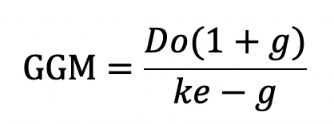
Ways to Project Terminal Value
Multiple method: Apply a multiple to final year’s projection of EBITDA
Gordon Growth Model:

Slide 36
How are the two methods connected?
Farook produces $20k per year in EBITDA and $10k per year in FCF
Multiples Method: Comparable Halal Carts to Farook in 5 years are being valued at 10x EBITDA
This implies valuation of 200k for Farook in 5 years
Gordon Growth Method: To get to 200k in valuation with 10k in FCF, at an 8% discount rate, what is the implied growth rate?

Slide 37
Get in Touch
Feel free to reach out to us over Facebook or email if you have any questions
www.quantfsnyu.com
quantfsnyu@gmail.com
President – Ram Ramanathan (rer407@stern.nyu.edu)
Vice-President – Alex Poon (alex.poon@stern.nyu.edu)
Co – Head of All Portfolios – Connor Sheehy (connor.sheehy@stern.nyu.edu)
Co – Head of All Portfolios – Kevin Duan (skd359@stern.nyu.edu)

