Slide 1
Intro to Valuation

Slide 2
Brain Teaser
You have 2 pieces of rope of different, unspecific lengths, and some matches. Each piece of rope takes exactly and hour to burn, but the burn rate is not constant (could take 59 minutes to burn the first ¼, and 1 minute for the rest).
Using only the matches and the rope, is it possible to measure 45 minutes?

Slide 3
Solution: Brain Teaser
Answer:
Light both ends of Rope A
Light one end of Rope B
After 30 minutes have passed (after Rope A is completely gone), light the other end of Rope B
When Rope B is gone, 45 minutes
will have passed

Slide 4
Thought Exercise
How much would you pay for the Just Salad store? Walk us through how you would determine the value of the shop

Slide 5
What Is Valuation?
Determining how much a business is currently worth
Relies on assumptions of the business
Analyzes historical financials and projects future prospects
No exact number that everyone will agree on

Slide 6
Types of Valuation
2 Major Types of Valuation
Relative Valuation
Values a company by comparing it to other similar companies in the same industry
Intrinsic Valuation
Values a company based on how much cash the business can generate

Slide 7
Relative Valuation

Slide 8
What Are You Comparing?
When doing relative valuation, we look for companies that are
In the same industry
Have similar business model / sell similar products
In the same geography
Around the same size

Slide 9
Thought Exercise
Back to the Just Salad store:
What would you compare it to when trying to value it?

Slide 10
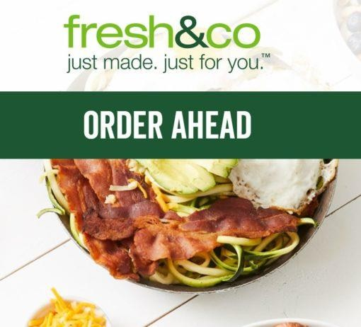
Thought Exercise
Back to the Just Salad store:
What would you compare it to when trying to value it?

Slide 11
How Do You Compare?
Price that these other businesses are valued at
Eg. SweetGreen store is valued at $100,000
Does this mean that the Just Salad should also be valued at
$100,000?
If not, what are we missing?

Slide 12
Ear nings!
Companies from the same industry can have different levels of profitability that we need to consider
If SweetGreen makes $10,000 of Net Earnings, and Just Salad makes $50,000, but they are both valued at $100,000 – is this fair?
Just based on this, which one would you rather invest in?

Slide 13
What is a Valuation Multiple?
A ratio of A/B
A is usually defined as price or value of the business
B is a financial metric of the company (Revenue, Earnings,
etc…)
Price / Net Earnings (P/E Ratio) is the most well-known multiple, but another valuation multiple is much more common

Slide 14
EV/ EBITDA
Most commonly used multiple in relative valuation
Numerator: Enterprise Value
Value of the core operating assets of the business
EV = Equity Value + Debt – Cash
Considers both the debt and equity investors of a business
Denominator: EBITDA
Earnings Before Interest, Tax, Depreciation, and Amortization

Slide 15
Example
SweetGreen
EV = $100
EBITDA = $20
EV/EBITDA = ?
Just Salad
EBITDA = $50
What should the EV be assuming that the two companies trade at the same multiple?

Slide 16
Comparable Companies Analysis
What you just did is a comparable companies valuation!
In practice, you would find the multiple for a group of comparable companies (eg. SweetGreen, Chopt, Fresh&Co) and find the median/mean
Can also use other multiples besides EV/EBITDA
Company is worth what the market will pay for it

Slide 17
Precedent Transactions Analysis
Similar to comparable companies analysis except that you use historical transactions
Eg. Use a list of salad stores that have been acquired in the past and see at what multiple they were acquired at

Slide 18
Intrinsic Valuation

Slide 19
Intrinsic Valuation
Based on a company’s ability to bring in cash
Valuation doesn’t reference the market value
Most popular form of intrinsic valuation:
Discounted Cash Flow Analysis (DCF)

Slide 20
Time Value of Money
Let’s say you are working a job that pays you $100 a week.
Would you rather be paid now? Or in a year? Why?

Slide 21
Time Value of Money
Let’s say you are working a job that pays you $100 a week.
Would you rather be paid now? Or in a year? Why?
Now!
Opportunity Cost! Money received today can be invested and you can earn interest on it.
Less Risk

Slide 22
Time Value of Money
Money today is worth more than money tomorrow!

Slide 23
Steps to a DCF
Understand financials
Project out cash flows
Figure out discount rate and discount cash flows
Find the terminal value and discount it
Add discounted terminal value and discounted cash flows

Slide 24
Discounted Cash Flow Analysis ( DCF)
Value of a firm equals the present value of future cash flows
Values a company based on how much cash it generates in the future
Cash generated next year will be worth more than cash generated 5 years from now

Slide 25
Formula for FCF
Revenue
(-) COGS
Gross Profit
(-) Operating Expenses
EBIT
(-) Cash Taxes
(+) Depreciation
(-) Changes in Net Working Capital
(-) Capital Expenditures
Unlevered Free Cash Flow

Slide 26
Ter minal Value
Value of a business beyond the forecast period when future cash flows can’t be estimated
Assumes that a company will grow into perpetuity
Can represent a significant part of the value in a DCF

Slide 27
Financial Projections
How would you go about projecting revenue for Just Salad? What factors what would you consider?
How would you project costs?
What about capital expenditures?
How does this tie to your thesis?

Slide 28
Discount Rates
Typically you’re weighted average cost of capital
Reflects TVM, risk, and required rate of return
Measured by weighted average cost of equity and cost of debt

Slide 29
Cost of Equity and CAPM

Slide 30
Cost of Debt
Can be weighted average interest rate of debt outstanding, interest expense/debt, or some market based rate on a companies’ debt

Slide 31
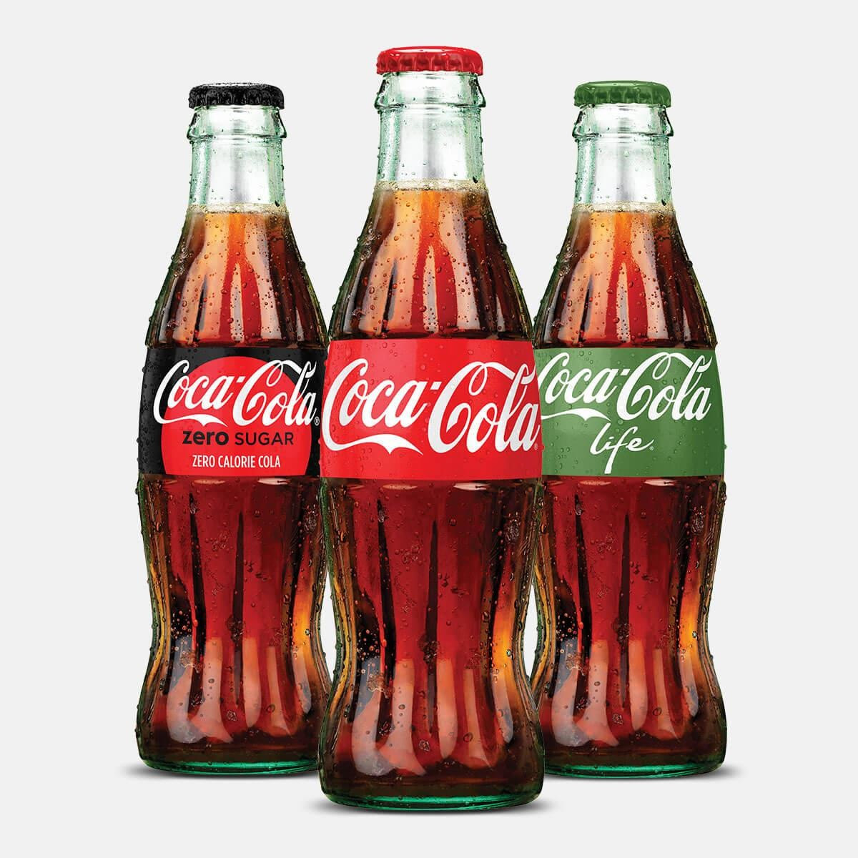
Ter minal Value
If I asked you, how much cash is Coca Cola going to generate 15 years from now, how well do you think you could estimate?

Slide 32
Ter minal Value
Not very well! Do you think Coca Cola is going to go out of business within the next 15 years?

Slide 33
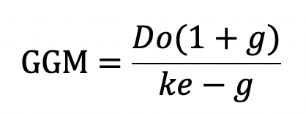
Ways to Project Terminal Value
Multiple method: Apply a multiple to final year’s projection of EBITDA
Gordon Growth Model:

Slide 34
Get in Touch
Feel free to reach out to us over Facebook or email if you have any questions
www.quantfsnyu.com
quantfsnyu@gmail.com
President – Avni Patel (avni.patel@stern.nyu.edu)
Co – Head of All Portfolios – Cory Peshkin (cory.peshkin@stern.nyu.edu)
Co – Head of All Portfolios – Peter Park (peter.park@stern.nyu.edu)

