Slide 1
Intro to Quant Investing

Slide 2
Quant Investing
What is Quant Investing?
Employ a lot of techniques from mathematics, statistics, and computer science to search for, ‘backtest’, and optimize financial investments; theses are still grounded on fundamental ideas.
A few strategies that we use: mean reversion, momentum, factor modeling, systematic volatility trading

Slide 3
Quant Investing
Mean Reversion
Idea that asset prices will ‘even out’ over time
If something is overpriced for an extended amount of time, it is a good opportunity to sell. Or if it is underpriced for an extended amount of time, it is a good opportunity to buy
Can be captured with pairs trades
Take two related securities, which have had a historical spread-level or ratio
When spread / ratios deviate too far from historical-levels, short the overpriced security and buy the underpriced security

Slide 4
Quant Investing
Momentum
Idea that ‘winners’, stocks that have done well, will continue to do well. And vice-versa, ‘losers’, those that have done poorly, will continue to do poorly
Seems very simple but many quant funds and asset managers (most notably AQR) support the existence of momentum and even use strategies that boils down to longing ‘winners’ and shorting ‘losers’.

Slide 5
Quant Investing
Factor Models: What is a ‘Factor’
‘Factors’ are characteristics that relate a group of securities, which are important in explaining their returns and risks
Some of the most popular factors:
Value – cheap stocks are better than overpriced ones
Low Size – smaller companies better than larger ones
Low Volatility – companies with less volatile share prices better
Momentum
These are just examples of factors for equities, but there are factors for currencies, commodities, credit, etc.

Slide 6
Quant Investing
Factor Modeling
Actual factor models use specific factor values to pick investments
e.g. a higher 'momentum factor score' for stock X implies it is a better investment
There are a few ways to come up with the factor scores themselves
One metric for each factor, e.g. EV/EBITDA -> Profitability
Multiple metrics + dimensionality reduction
As well as a few ways to select assets based on the factor scores
Weighing factors & ranking among them
Long top basket, short bottom basket
Forecasting returns based on factors

Slide 7
Quant Investing
Factor Modeling – ranking method example
Rank the stocks s based on the sum of their scores in each factor
Then long the 20 highest-ranked stocks, short the 20 lowest-ranked

Slide 8
Quant Investing
Volatility Trading
Selling volatility can be done at a market level through products like VIX futures or calls/puts on indices, as well as for individual equities. Both strategies are lucrative in the long run but may suffer sharp drawdowns in the short term.
Back-testing helps manage risk levels and optimize for ideal situations to enter the trade.
Options pricing, through a proprietary volatility model, combined with a low latency trading system is another common quant strategy

Slide 9
Quant Investing
Steps of the Process
Brainstorm ideas by looking at past research and analyzing data
Build models / strategies for these ideas
Backtest the strategies and assess performance
Apply novel techniques to optimize / improve strategies, then repeat 3
If strategy performs well, start trading it ‘forward’

Slide 10
Quant Investing
What is Backtesting?
Assume you have a strategy to trade some security that is grounded on some fundamental ideas. Before you can use the strategy on your own PA, you want to know how well the strategy performed in the past → backtesting
Take historical data, test strategy over it, then assess performance
Things to keep in mind: In-Sample and Out-of-Sample, OVERFITTING

Slide 11
Quant Investing
How to assess performance?
Average returns
Volatility of returns (measured in standard deviation)
Sharpe Ratio:
Mean portfolio return
Risk-free return
Standard deviation of portfolio returns
Histogram of returns to look at its shape
Skewness
Kurtosis
Max Drawdowns
Equity Curve

Slide 12
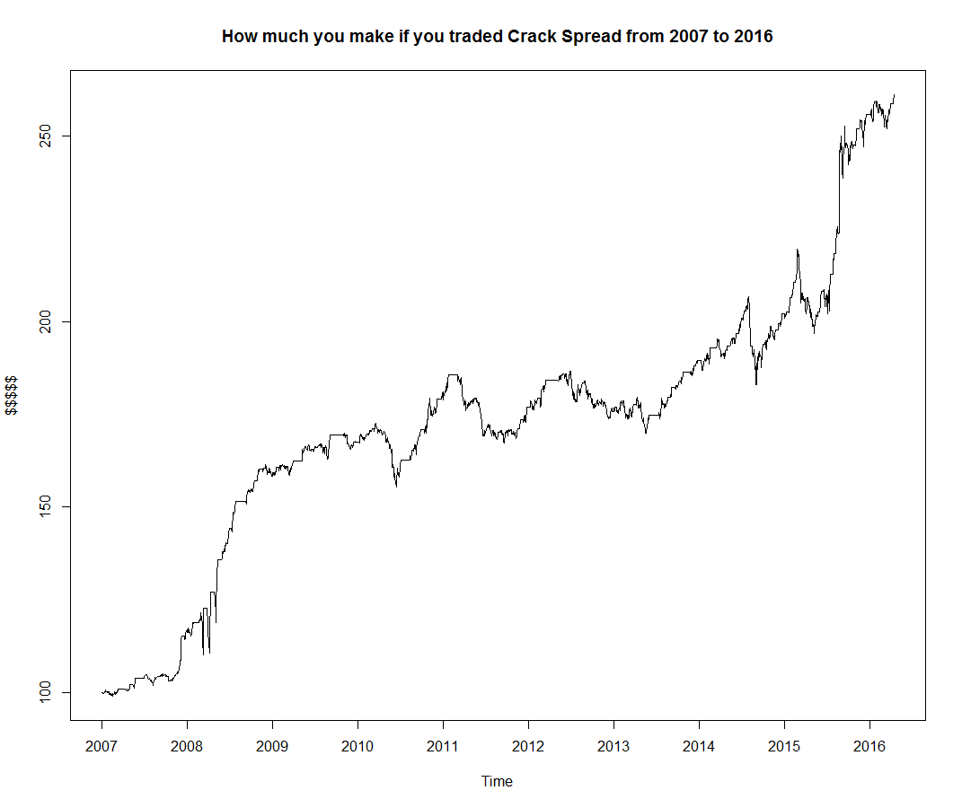
Quant Investing
Example
Summary Statistics
Sharpe | 1.146
Annualized Returns (w/o Transaction Costs) | 11.29%
Max Drawdown | -11.46%
Skewness | 4.5411

Slide 13
Quant Investing
What are industry players / real-world Quant hedge funds doing?
High frequency trading
Latency arbitrage
Front running
Volatility Modeling
Data Science
Funds have access to and analyze TONS of data (numerical, text-based, imager and more) to help guide investment decisions
Unsurprisingly, a bulk of the data analysis is done by employing machine learning techniques
Examples: emails; social network data; credit card transactions; satellite images

Slide 14
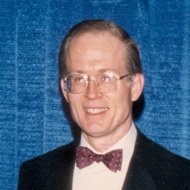
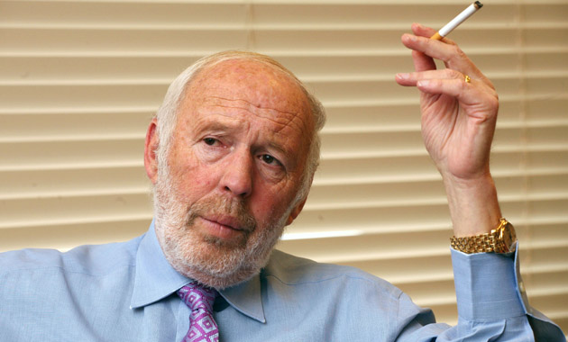
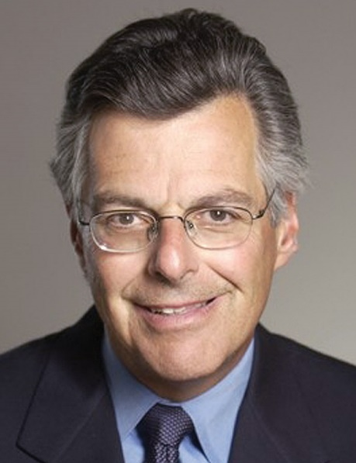
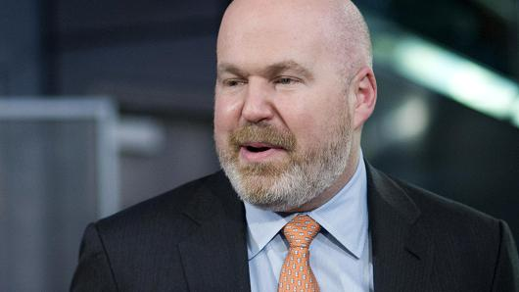
Quant Investing
Famous Quants

Slide 15
Quant Investing
Projects in Quant Portfolio
Previous
Mean Reversion on Commodity Pairs
VIX Regression
Equity Factor Models
Systematic volatility-skew selling
Current
Use of Machine Learning and Statistical Inference techniques (Neural Networks, Support Vector Machines, Bayesian Inference) for return prediction
Volatility trades
Equity pairs trading

