Slide 1
Intro to Macro Investing
General Meeting: 10/16/2018

Slide 2
The Agenda
What is Macro Investing?
How to think Macro
Why a Macro-oriented perspective can be valuable no matter the kind of investing

Slide 3
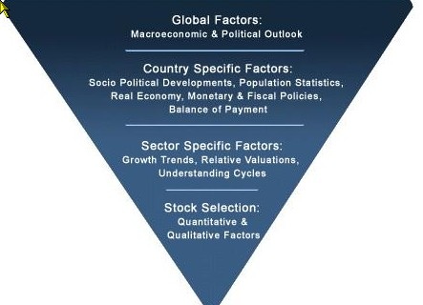
What is Macro Investing?
Betting on global trends across asset classes
Top-down approach
Political and economic analysis
Watching for breakdowns in correlation or economic principles

Slide 4
Macro Investing v. Fundamental Equity
Harder to capture long-term idiosyncratic value in comparison with equity value investing
Macro investing requires building an understanding of how global markets are economic and politically interrelated
Why? Because everything in the world is interrelated, impossible to operate on an isolated thesis
How to do this? Where to begin?

Slide 5
Thought Exercise: Gold as a safe haven
Gold is considered the ‘safe flight’ asset
Fear in the market -> people pull money out of ‘riskier’ assets like equities and invest into gold
Belief is that gold is a long-term storage of value
Investing into gold means investing into a ’risk-off’ mentality
The Japanese yen is a similar ‘safe haven’
Now….What can induce fear in the markets? And what can do the opposite, and increase appetite for risk?

Slide 6
Things to Understand
What drives the economy?
Indicators of economic cycles
Effects of central bank policy and rates
Supply and demand principles
Global industry, major buyers and sellers
Country’s major trading partners, exports
Dominant economic players such as US and China

Slide 7
Thinking Macro: Some Questions
What is the current state of the global economy?
What is a particular country’s economy being driven by?
What about new or cyclical trends in global industries?
Emerging markets?

Slide 8
Thought Exercise: What’s going on in the world right now?

Slide 9
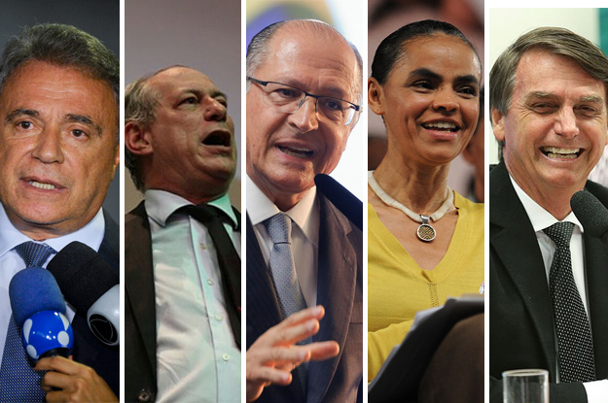
Country Framework
Political elections
Major trading partners
Major exports and imports (commodities/industry)
Central bank action
…Any country with an upcoming major political election?

Slide 10
Some Economic Indicators
PMI (Purchasing Manager’s Index)
GDP Growth
Central bank interest rates
Political uncertainty
Major industries’ cyclicality
‘Dr. Copper’
Foreign investment
Interest rates set by the central bank
Crude prices

Slide 11
Country-specific Trade Idea Expressions
Currencies (JPY/USD, GBP/EUR)
Government Bonds (Government-backed debt)
CDS (Credit Derivative Swaps), think of them as ‘insurance’
ETFs
Equities

Slide 12
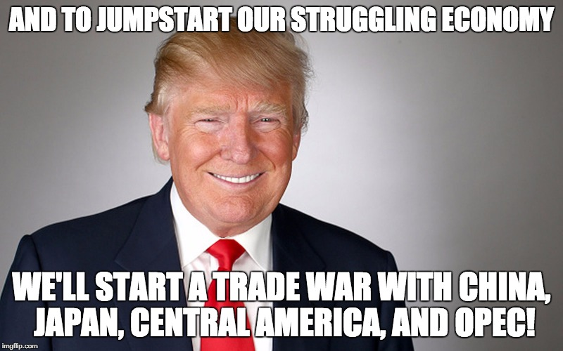
Thought Exercise:
How does the American economy affect other economies? What are the effects of the trade war between the United States and China? How could you trade this?

Slide 13
Thought Exercise: How does rising US interest rates affect the global economy?
Interest rates affect supply and demand of money
Affects the pricing of currency
What if a country or company has a lot US-denominated debt and the US raises interest rates?
What if a country is a net exporter to the United States?

Slide 14
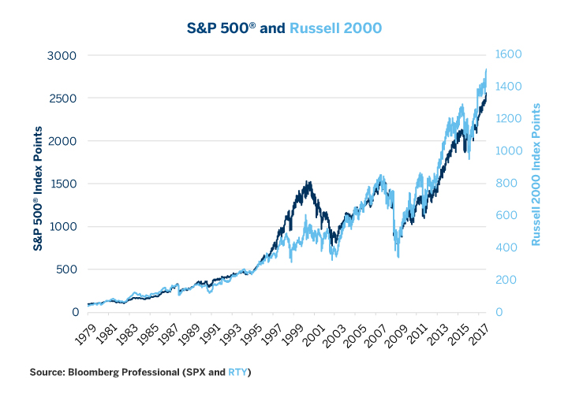
Macro as a Screener for Value Ideas
Russell 2000 growth outpaced S&P 500 beyond historical average
Low interest rate environment led many companies to lever up
Trade war led initial bullish sentiment on small caps
Screen for small-cap, high-leverage companies excluding financials, tech. etc.

