Slide 1
Intro to Derivatives: Futures & Forwards

Slide 2
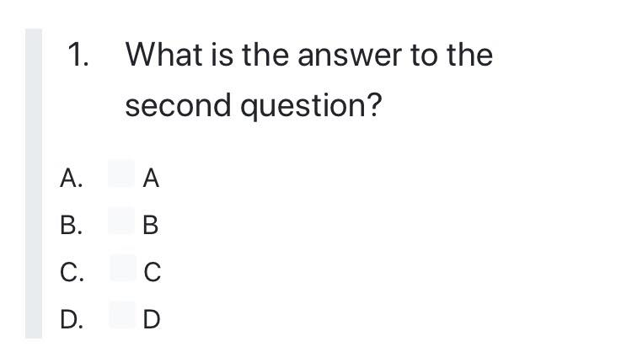
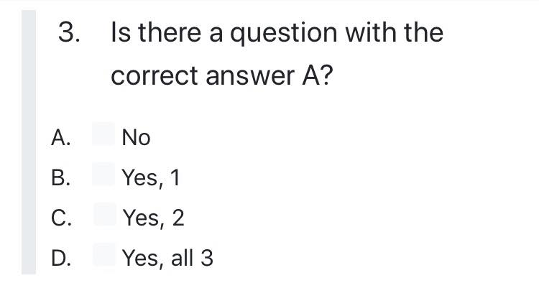
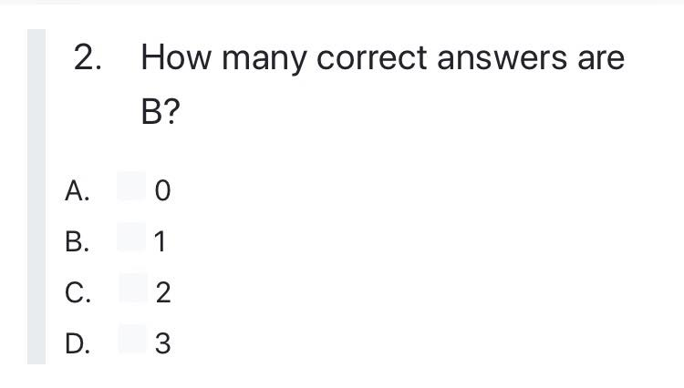
Brainteaser!
What are the answers to these MC questions?

Slide 3
Answer:
Examine Question 3. Suppose no questions have an answer of A. Then the answer to question 3 would be A, a contradiction since we supposed none of the answers were A. Thus, there must be at least one A, and Question 3 is not A so either Question 1 or Question 2 is A. Since Question 1 always has the same answer as Question 2, if one of the two is A then both must be A. So both Question 1 and Question 2 are A, which means there are 2 answers that are A. Thus, the answer to Question 3 is C, so the final set of answers is AAC. Going back to check our work, we can verify that AAC makes all three questions true.

Slide 4
What Is a Derivative?
Derivative
A derivative is a financial instrument, whose value is from the value of another underlying asset
When the price of the underlying changes, the value of the derivative also changes
Types of Derivatives
Forwards/Futures
Options
Swaps
Warrants/Convertibles

Slide 5
What was the first financial derivative?
British – Opium Derivatives, 1850
Dutch – Tulip Derivatives, 1636
Japan – Dojima Rice Exchange, 1697
India – Cotton Derivatives, 1875
Chicago – Chicago Board of Trade Grain Futures, 1864

Slide 6
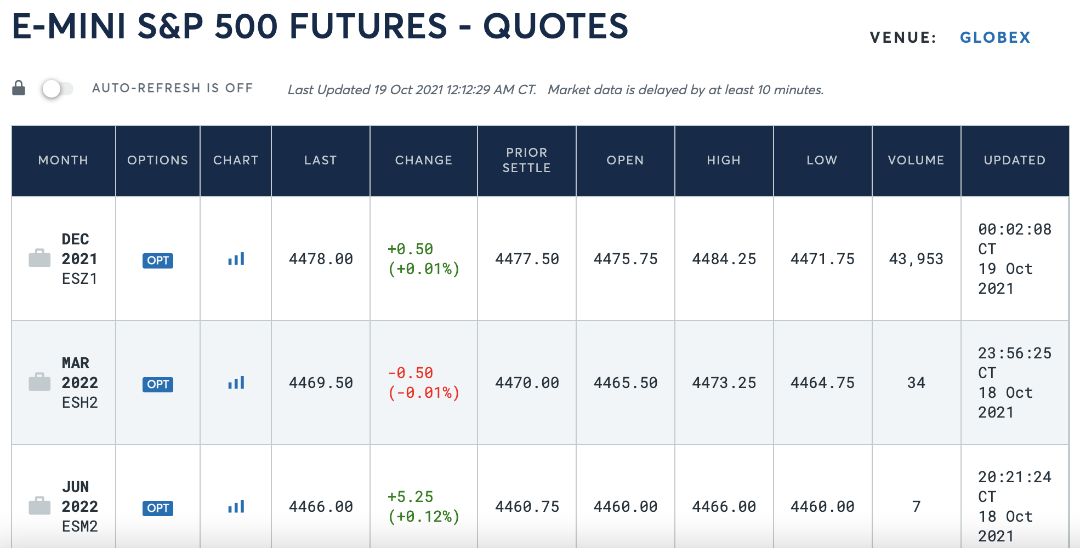
Futures and Forwards
The obligation to buy/sell an underlying at a specific price at a specific maturity date.
Settlement: physical (underlying) or cash
Purposes: hedging, speculation
Main asset classes: Equity indices, VIX, commodities, FX, rates

Slide 7
Futures and Forwards
Purposes
“Lock in” a price today for something you need to eventually purchase/sell
Protect against fluctuating prices
Farmers: need to sell their produce after this season’s harvest
Airlines: need to buy fuel to operate their flights
Simple/efficient way of speculating on prices
Capital requirements
Liquidity
Accessibility to certain markets
Can you trade VIX?
Can you trade Bitcoin in your retirement account?
How did ProShares manage to get a Bitcoin ETF approved by the SEC?
Pricing
Intuition: the futures price should be the expected price of the underlying on the delivery date.
$$Futures Price≈E\left[Spot @ T\right]≈Forward Price$$

Slide 8
Futures and Forwards
Mechanics
No money is exchanged when the position is opened
No premium, no buying/shorting the underlying
Generally, 5% margin must be maintained throughout the time you hold a position
Mark to Market: at the end of each day, cash is added/subtracted from each account to offset the change in the futures price
Purpose: reduce the chance of/incentive to default on the obligation
Ensures that you end up paying/receiving the original futures price that you entered at
Exposure to underlying can be amplified by leverage
Stock: use $100 to establish a $100 position, it goes up $5, I make 5%
Future: use $10 to establish a $100 position, it goes up $5, I make 50%

Slide 9
Futures and Forwards
Trading
Most investors do not hold until maturity
Most don’t actually want to exchange 1,000 barrels of oil
Instead: simply take the offsetting position in the market to cancel out your contract
Spot prices
Underlying = Spot
Spot Price = the current price (today) for delivery of the underlying
Convergence
As any futures contract reaches the delivery date, the Futures price approaches the Spot price
Otherwise, arbitrage would exist (buying the less expensive of the two, selling the more expensive of the two, and then waiting until maturity)

Slide 10
Futures vs. Options?
Entry
Futures: post initial margin
Options: pay / receive the option premium
Trading
Futures: simply exit the position by taking the offsetting position, lock in the MTM profits/losses you accumulated
Options: sell the contract in the market, or exercise early (American options)
Payoff
Futures: at delivery, the payoff is linear with respect to underlying
Options: at expiry, the payoff is asymmetric!
At worst, your option is worth $0 (expiring ATM or OTM)
At best, your option is worth a lot/infinity (expiring extremely ITM)
Settlement
Options: the right to buy/sell
If an option expires worthless, the buyer simply ends up losing the premium they paid to enter the position
The seller does nothing and gets to keep the premium
Futures: the obligation to buy/sell

Slide 11
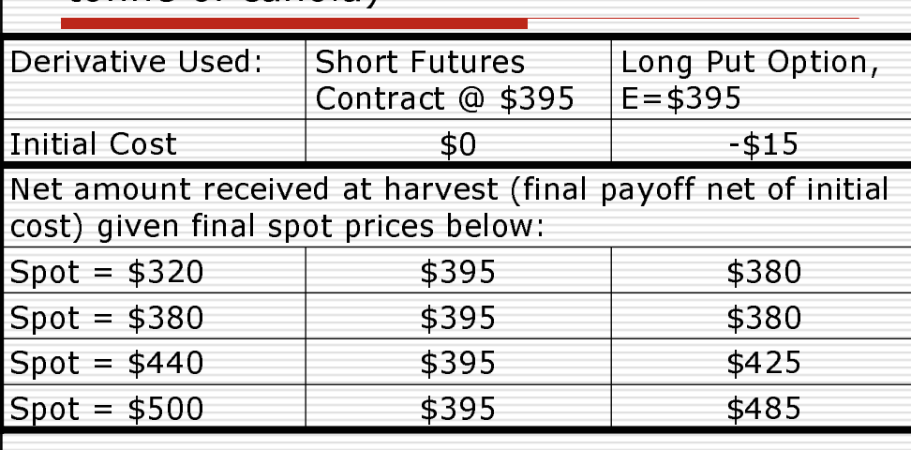
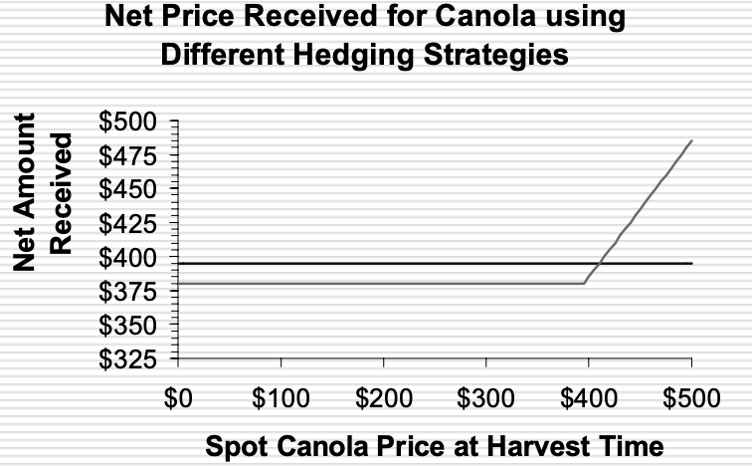
Futures vs. Options Example

Slide 12
Futures and Forwards Compared
Futures | Forwards
Exchange Traded | Over the Counter
Standardized | Bespoke
Actively traded | Non-transferrable
No counterparty risk | Credit default risk of counterparty
Marked to Market | Open and Close
Margined | Unmargined

Slide 13
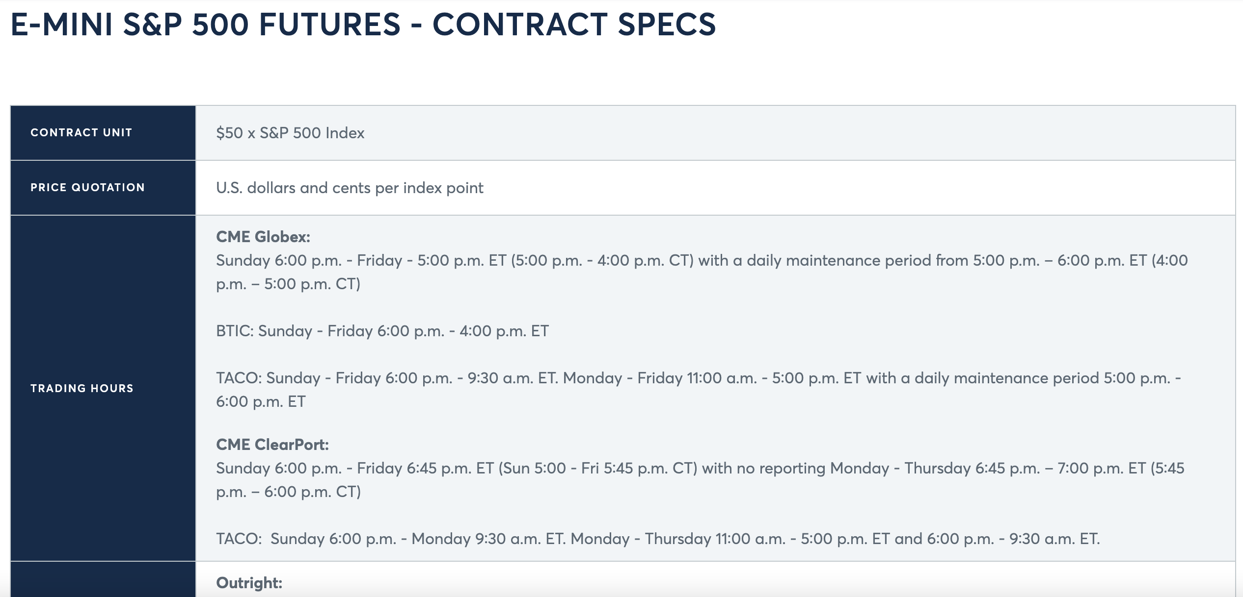
Exchange + Standardization

Slide 14
Counterparty Risk
Credit Default Risk
The risk that one of the parties within a transaction may default or renege on a prior obligation
Is this generally a problem?
Buyer
Forward
Seller
Buyer
Future
Clearinghouse
Seller

Slide 15
Pricing Futures
$$Futures Price≈discounted (E_{t}\left[{Spot}_{T}\right])≈Forward Price$$
1. Arbitrage Pricing (“Cost of Carry”)
$Futures Price \left(t,T\right)=Spot\left(t\right)∗e^{(r+s−c)(T−t)}$
2. Expectations Pricing
$$Futures Price(t, T)=E_{t}\left\{Spot\left(T\right)\right\}∗e^{−(r)(T−t)}$$
r = risk-free interest rate
s = storage costs
c = convenience yield
t = time of entry into futures position
T = delivery date of futures contract

