Slide 1
Quantitative Finance Society

Slide 2
Brain Teaser
There are 100 tigers and 1 sheep. Tigers like eating sheep, but they don’t like being eaten themselves. However, if a tiger eats a sheep, then it turns into a sheep. When there are 100 tigers and 1 sheep, what happens? (Assume every tiger acts rationally)
Learning
Investing
Community

Slide 3
Answer
If we work backwards. When there is 1 sheep and 1 tiger, the tiger will eat the sheep because no one is there to eat it
When there are 2, neither tiger will eat the sheep, because whoever eats, knows they will be eaten by the remaining tiger
When there are 3, one tiger will eat the sheep as it will then the same scenario as when there were 2 tigers and 1 sheep where no one ate
Moving up, it is clear that on even numbers, no tiger will eat the sheep and on odds they will, so at 100, the sheep will not be eaten.
Learning
Investing
Community

Slide 4
Overview
QFS is a multi-strategy investment club that provides a platform for members to share knowledge and learn about the financial markets and investing
Our Focus
Learning
Investing
Community

Slide 5
Why Join QFS?
Learn
Practice
Explore
Learn different investing strategies across multiple assets (stocks, currencies, commodities, etc.)
Specifically dedicated to developing a strong grasp of financial knowledge
Gain hands-on experience and feedback in pitching and executing investment ideas
Get direct exposure to a wide variety of investing opportunities and career paths in the finance industry
Strong recruiting ties to a wide range of sell-side and buy-side financial jobs
Extensive alumni network across the financial industry, ranging from Investment Banking to hedge funds
Learning
Investing
Community

Slide 6
Alumni Network
IB/S&T
Buy-Side

Slide 7
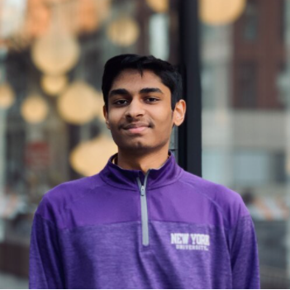
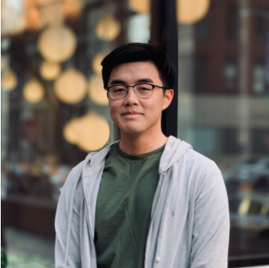
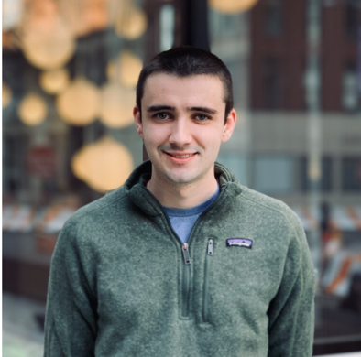
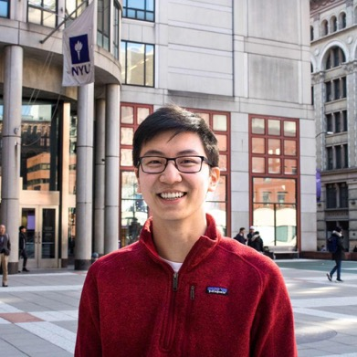
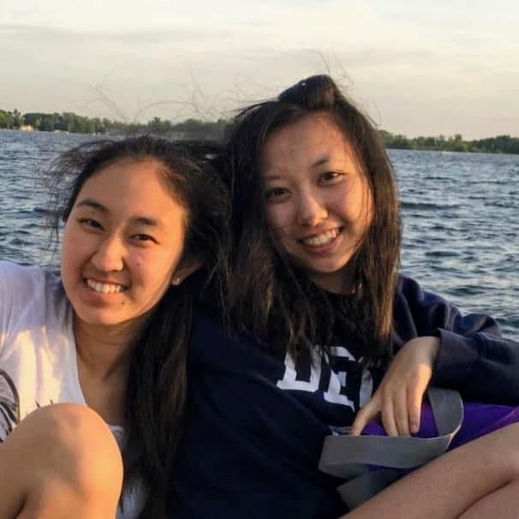
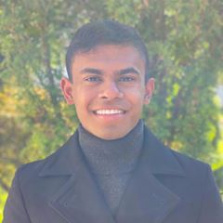
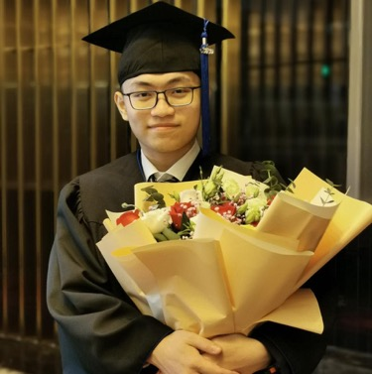
Our Executive Board
Ram Ramanathan
President
Alex Poon
Vice-President
Connor Sheehy
Co - Head of Portfolios
Kevin Duan
Co - Head of Portfolios
Jessica Wu
Treasurer
Ashwin Mathukumar
Co - Marketing Chair
Yukai Liu
Co - Marketing Chair
Peter Shi
Tech Chair

Slide 8
Events & Activities
Charity Poker Tournament
Alumni Mingle
Picnic in the Park
Portfolio Team Retreat
Portfolio Bonding
Long Short
Learning
Investing
Community

Slide 9
How to Get Involved?
General Meetings
Portfolio Team

Slide 10
1. General Meetings
Weekly workshops taught by portfolio team members of QFS on a variety of topics – open to all NYU students
Tuesday, 12:30 – 1:45 PM
Long Short
Learning
Investing
Community

Slide 11
Past General Meeting Topics
The Financial Industry
Intro to Asset Classes
Intro to Investing and Trading
Valuation Methodologies
Intro to Value Investing
Rates & FX
Intro to Credit Investing
Intro to Quant Investing
Intro to Options/Other Derivatives
P-Team Pitches

Slide 12
2. Portfolio Team
Join 1 of 3 teams (Long-Short, Macro, and Quant) and learn to develop investment ideas and manage our paper money portfolio
Weekly meetings
Portfolio Meeting – meet with your individual portfolio to discuss various investment ideas
All Portfolio Meeting – listen to pitches from the other portfolios and provide feedback
No prior investing experience or
financial knowledge required
Long Short
Learning
Investing
Community

Slide 13
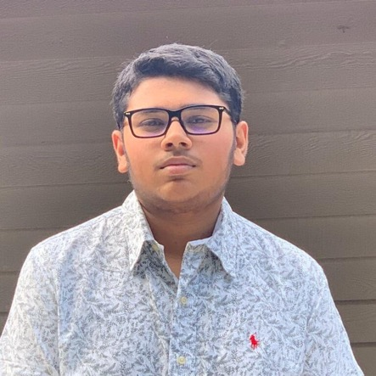
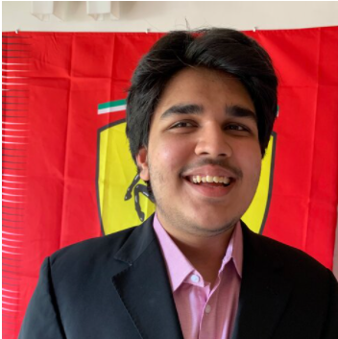
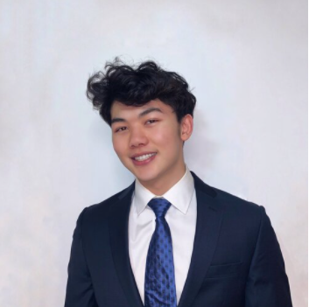
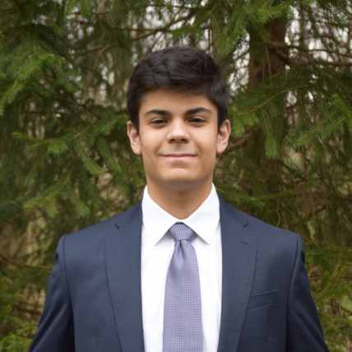
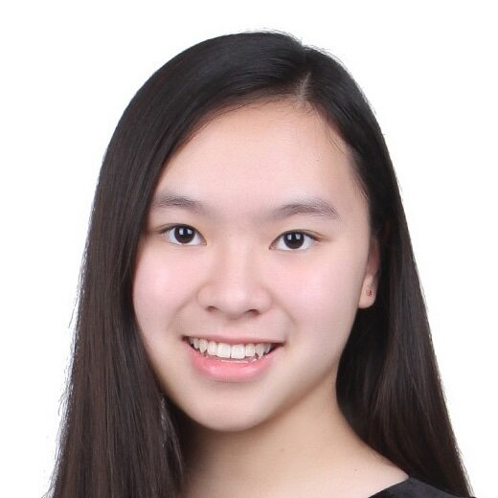
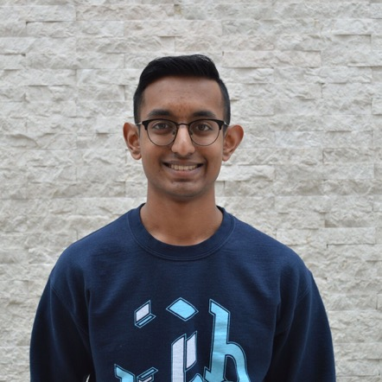
Our Portfolio Managers
Vedant Iyer
Long-Short
Vish Choradia
Macro
Austin Tang
Quant
Daniel Diaz
Long-Short
Jovi Koh
Macro
Arjun Venigalla
Quant

Slide 14
Long-Short Portfolio
Overview
Sample Pitches
Applies fundamental and intensive bottom-up analysis to find undervalued stocks
Understands different business models and tries to find opportunities where price doesn’t equal value
Long Redbubble (ASX: RBL)
Short Vital Farms (NASDAQ: VITL)
Long Twitter (NYSE: TWTR)

Slide 15
Macro Portfolio
Overview
Sample Pitches
Follows global economic and political trends to develop cross-asset trades
Applies economics principles and analyzes current events to find mispricings in the market
Long EU Carbon Futures
Short EUR/MXN
Long Ecuador 2030s

Slide 16
Quant Portfolio
Overview
Sample Pitches
Builds quantitative models and strategies using given data to generate outsized returns
Backtest strategies based on historical data to understand historical performance
SPAC Unit Arbitrage
Short r/WallStreetBets
LSTM Modeling of Hurts Exponent Returns

Slide 17
Q&A
Who is eligible to apply for Portfolio Team?
I am interested in learning more about finance, but I don’t have any prior experience in it - can I still be involved?
What is the difference between QFS, FS, and IAG?
Do you need to have a quantitative background to be part of QFS?
I am interested in exploring a career in investment banking / sales & trading / hedge funds, how can QFS help me?
I am not sure what all the above jobs even mean, how can QFS help me?

Slide 18
Application Process
1st round applications: Open 9/25 and close 10/1 at 9:00 AM
1st round interviews: 10/3
2nd round interviews: Through the week of 10/9
Open House: Wednesday, 9/29 at 7:00 PM
Our applications test ability to think, general interest, and amount of effort
Join our mailing list to stay updated on events and due dates

Slide 19
Get in Touch
Feel free to reach out to us over Facebook or email if you have any questions
www.quantfsnyu.com
quantfsnyu@gmail.com
President – Ram Ramanathan (rer407@stern.nyu.edu)
Vice-President – Alex Poon (alex.poon@stern.nyu.edu)
Co – Head of All Portfolios – Connor Sheehy (connor.sheehy@stern.nyu.edu)
Co – Head of All Portfolios – Kevin Duan (skd359@stern.nyu.edu)

