Slide 1
Intro to Value Investing

Slide 2
Brain Teaser
Suppose you’re playing a game against me. One of us will start the game by saying a number between 1 and 10. The other person must say a number 1-10 higher than the previous number, and we take turns continuing to increment. The winner of the game is the person who says 50 first. If I give you the option to choose to go first or second, can you guarantee yourself a strategy to win?
EX: 1, 5, 15, 21, …
EX: 9, 10, 13, 18, 27, …

Slide 3
Answer
You should go first and say 6.
We can solve this by working backwards:
If we want to say 50 first,
We want to say 39 first. (Why?)
We want to say 28 first.
We want to say 17 first.
We want to say 6 first.
This is a solved game: if you want to say n and can increment by x, always start the game by saying
n mod(x + 1)

Slide 4
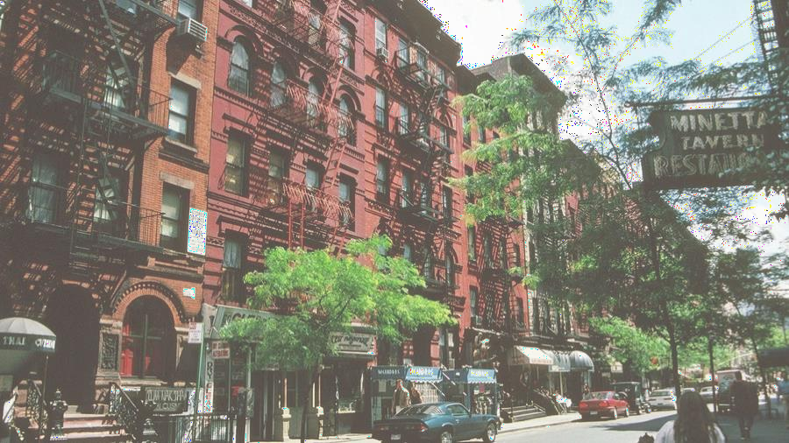
Por t folio Team Application
Timeline:
Opens on Friday, 09/16 at 9:00 AM
Closes on Friday, 09/23 at 11:59 PM
Eligibility: open to all NYU students, no experience required
Application Process:
Fill in Google form (admin details & portfolio preference)
Submit your application responses as a PDF/Word
All instructions will be on the front page of our website, and emailed to everyone on our mailing list (https://tinyurl.com/3zardr3r)

Slide 5
Por t folio Team Application Tips
If you are an underclassmen, please answer all questions for your grade, regardless of portfolio interest
Helpful if you cite sources (links are fine)
2 pages max for the three responses
Can easily be done in one page
Try to submit as a PDF or Word, if you choose to submit as a google docs, please give quantfsnyu@gmail.com access
Primarily looking for effort, not accuracy

Slide 6
QFS Charity
Poker Tournament
QFS will be hosting its 6th annual charity poker tournament and first one since 2020. Join us to play poker, meet other students, and win prizes.

Slide 7
Value Investing
Buying something for less than its intrinsic value
“Buying a dollar for 50 cents”
Identifying business that are
Fundamentally good
Mispriced by the market
Investing with a long-term time horizon, does not rely on speculation

Slide 8
Not Value Investing
Determining whether a company is a good investment just by looking at the stock chart
Relying on short-term market movements or speculation

Slide 9
What Makes a Good Business?
Economic Moat: a business’ ability to maintain competitive advantages over its competitors in order to protect its long-term profits and market share from competing firms
What are some examples of economic moats?
Quality of Management
Historical behavior of the management team
Nature of the Industry
How competitive is the industry? How many players are in the industry? Is the industry growing or declining?

Slide 10
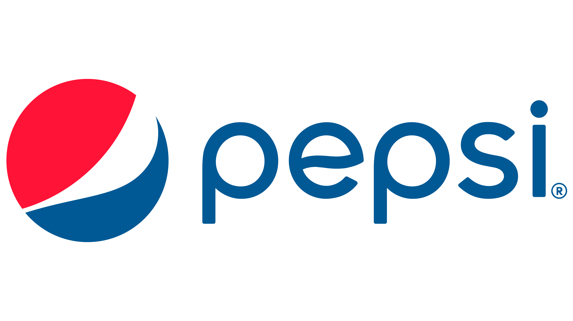
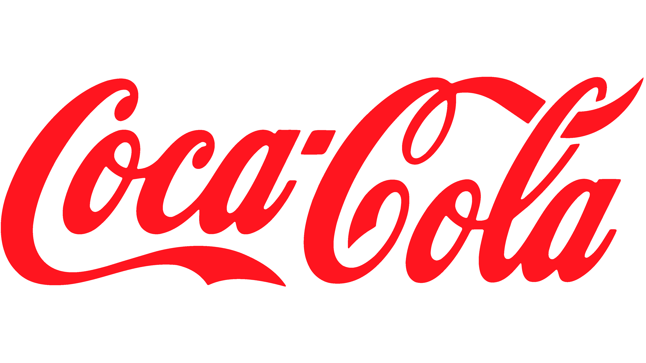
Economic Moat
Is there a fundamental difference between these products

Slide 11
Economic Moat
Economic moat can extend beyond the quality of the product itself
Brand Name (Customer Loyalty)
Bargaining Power – Product Margin
Economies of Scale
Diversification

Slide 12
Management
Capital Allocators
Where and how a corporation decides to spend money that the company has earned – seeks to generate as much wealth as possible for its shareholders
What can a company use its capital on?
How would you want the CEO of Uber to allocate their capital?
Understanding of the Business
Does the management know what he is taking about?
Motivation and Character
Management history at other companies
Incentives

Slide 13
Nature of the Industry
Which of these two companies faces greater competition? Which of the companies has greater pricing power?

Slide 14
Some Golden Rules
Being Conservative
Margin of Safety
Circle of Competency
Swing Once, Swing Well

Slide 15
Being Conservative
Tune out optimism bias
Sunk Cost fallacy
Conduct thorough due diligence
Most important rule: Do Not Lose Money!
Trying to play a game that we win the majority of the time (only need to be correct 51% of the time)
Want bets where you make a strong return under conservative assumptions

Slide 16
Margin of Safety
Buy at a discount – account for possibility that things just don’t go the way you expect them to
Analyze downside case
Discount to intrinsic value
What is an acceptable margin of safety?
Seth Klarman book – Margin of Safety
Basis of value investing philosophy

Slide 17
Circle of Competency
Know what you know, know what you don’t know
“The most important thing in terms of your circle of competence is not how large the area of it is, but how well you’ve defined the perimeter”
Biotech

Slide 18
Swing Once, Swing Well
Batting Average vs Slugging Average
“What’s nice about investing is you don’t have to swing at pitches. You can watch pitches come in one inch above or one inch below your navel and you don’t have to swing. No umpire is going to call you out. You can wait for the pitch you want”
Concentrated, high-conviction bets

Slide 19
Being Contrarian & Market Pricing
Be careful about big names that are heavily covered
Know what you don’t know
Structural opportunities
Small-cap equities → Fund restrictions
Short-term market exaggerations → Be wary of bull market, search for mispricing in bear markets
Differences in time-horizon – (COVID winners today)
Understand how the market is pricing the security
Equity Research, News, Press Releases

Slide 20
Common Pitch Types - Longs
Strong business with barriers to entry
Awesome businesses that you want to hold forever
Market mispricing due to short-term fears
Smart management teams
Strategically compound value over the long-term
Hidden opportunities
Margin expansion, cost-cutting
Dirty, ugly, but cheap
Bad business at an amazing price
Special Situations
Event-driven situations that the market is mispricing for various reasons
Spin-off, Distress/Bankruptcy, Busted IPOs, Credit, Merger-Arb

Slide 21
Common Pitch Types - Shorts
Structural Share Donor
Brick and Mortar retail
First-mover in high-growth industry without a moat
Frauds/Accounting Gimmicks
Enron
Companies with crazy high-expectations, popular fads
Plant-based meat
Overearning Cyclical
Industry in an upcycle (demand outstripping supply in the short-term), yet the market assumes this upcycle will last forever
Overleveraged Companies
Difficulty servicing debt
Unrealistic expectations

Slide 22
Case Studies

Slide 23
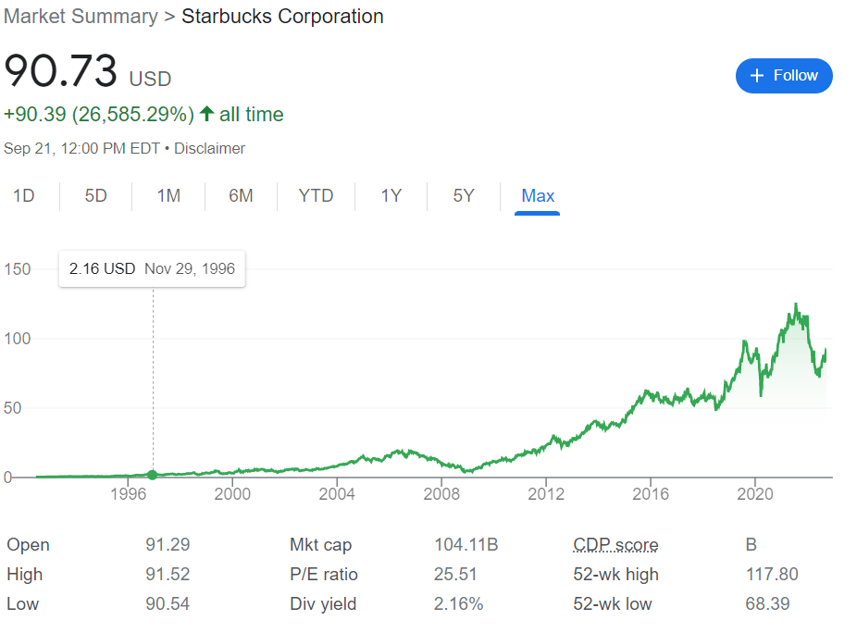
Barriers to Entry: Starbucks (NASDAQ: SBUX)
Business Overview: Multinational chain of coffee stores
Situation Overview: In 1996, Starbucks had about 1000 stores and was trading at a 64x P/E multiple (market multiple tends to be around 20x). They were generating around $700k in revenue per store
Thesis: Although the market gave Starbucks credit for its strength as a branded coffee store company with a significantly above market multiple, it repeatedly failed to underwrite the number of stores Starbucks could create over the next decade. If you were confident in Starbucks’ long-term potential to be dominant, you could underwrite the amount of stores Starbucks could continue create based on population (500m target customers across wealthy European cities and the US) and penetration rates for similar chain concepts that were more mature (Need a store near 10% of the population and need to service 10% of customers per day, and each store can service roughly 180 people per day (15 hours of operation, 5 min per customer) you could derive about 28k stores as the long-term potential in steady-state for Starbucks stores). Although it was expensive near-term, over the long-term, their ability to continue to compound stores long-term resulted in an 18% IRR over 25 years

Slide 24
Special Sits: Tuesday Morning (NASDAQ: TUESM)
Business Overview: Discount store chain, similar to Ollie’s Bargain Outlet
Situation Overview: In September 2020, the company had just filed for bankruptcy to break unfavorable leases and was struggling due to COVID store closures and general decline in brick-and-mortar retail spend. Company was trading on the OTC with a market cap of only $47m and share price of $0.35.
Thesis: Initially the company was struggling quite a bit and the bankruptcy judge believed there was no potential for a recovery to the equity. However, as the COVID situation continued to improve it was clear that the Company could return to EBITDA positive within the next year and there would likely be a recovery for the equity. Additionally, the bankruptcy overhang, OTC listing, and lack of market cap made it difficult for many institutional investors to get involved in size. This created a situation where a company had entered bankruptcy to improve its lease terms (reduce lease rent on 35% of leases which would lead to margin expansion) and had the benefit of recovery from COVID. From a math perspective, the company could potentially produce $0.5-$1 in EBITDA and could trade from 5-8x (compared to OLLI at 22x). Today, the company has emerged from bankruptcy and is trading at a share price of $1.79, which represents 8x upside from September of 2020.

Slide 25
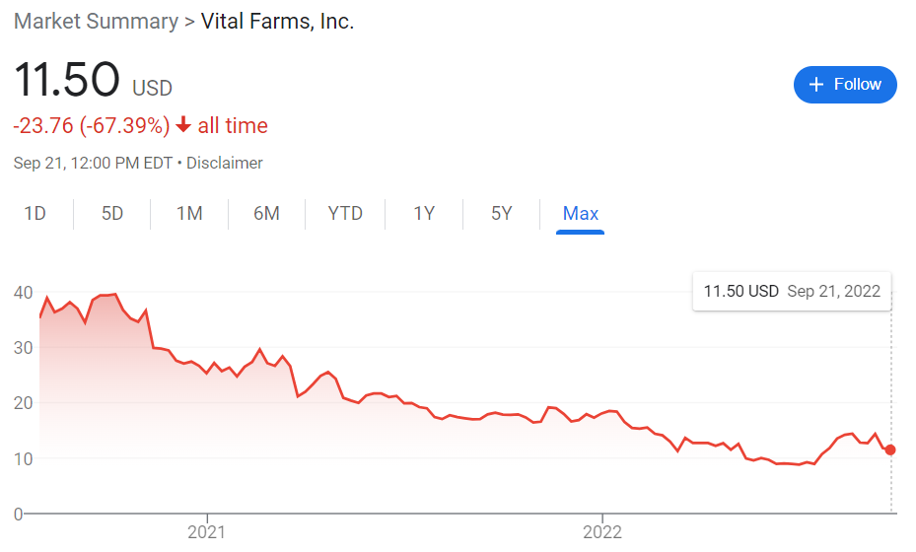
Crazy Expectations: Vital Farms (NASDAQ: VITL)
Business Overview: Branded pasture-raised egg company. Eggs are produced in a more animal friendly manner and are sold for $6 per dozen vs $1-2 per dozen for normal eggs
Situation Overview: Company IPO’d in July of 2020 and was doing extremely well on the back of COVID-induced stockpiling and ESG tailwinds leading to very bullish sell-side coverage
Thesis: Ultimately, on the back of their success in the last year due to stockpiling, the market assumed this company could maintain 70% market share over the next decade and the market could grow at a 20% CAGR for the foreseeable future. The market was valuing it as a growthy tech business, valuing it on sales despite 30% gross margins. Long-term, it was clear that the pasture-raised egg market could not CAGR at 20% for the next decade. Pre-COVID the market was seeing declining YoY velocities (sales per distribution points). Distribution points were going to be harder and harder to increase as Vital had already penetrated all of the nature store locations (Whole Foods, Sprouts). Meanwhile the remaining whitespace was at Target, Walmart where the customer base is significantly less affluent. Further, private-label competition was rapidly increasing in Whole Foods, Kroger etc. Valuing the company, it was clear that they would likely see a return to pre-COVID velocities. Giving the company credit for consensus estimates of ~15% CAGR in distribution points, but a -9% CAGR in velocities (largely driven by a return to pre-COVID, market share loss to private label and lower quality locations) as well as a more realistic multiple in-line with Cal-Maine Foods at 15x EBITDA led to significant downside

Slide 26
Get in Touch
Feel free to reach out to us over Facebook or email if you have any questions
www.quantfsnyu.com
quantfsnyu@gmail.com
President – Daniel Shahab Diaz (daniel.diaz@stern.nyu.edu)
Vice-President – Jessica Wu (jessica.wu@stern.nyu.edu)
Head of All Portfolios – Michael Lu (michael.j.lu@stern.nyu.edu)

